Slide 1
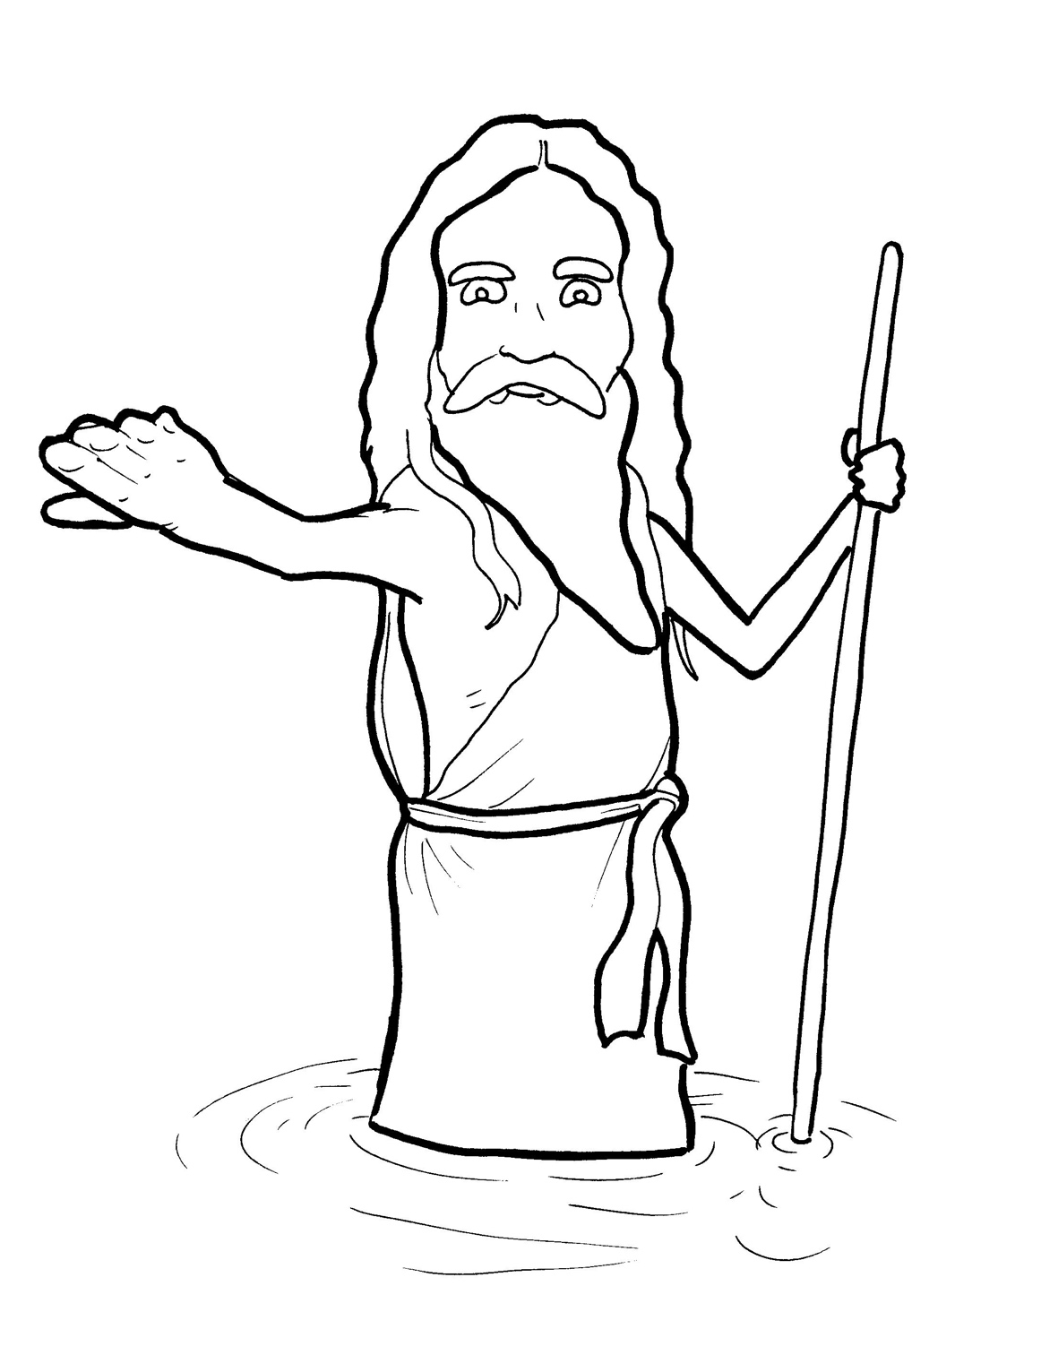
8. John the Baptist Points to Jesus
Part 4
Story in Easy Read English
Questions
Story in Phrases

Slide 2
John ate crunchy bugs for lunch.

Slide 3
He wore an itchy shirt made out of camel’s skin. Why?

Slide 4
John had a job to do - an important job.

Slide 5
This job did not pay him money.

Slide 6
So, John lived on what he could find in the wild.

Slide 7
John pointed the way to Jesus.

Slide 8
He shouted from the desert, “Repent!

Slide 9
Say you are sorry for your sins.

Slide 10
God’s kingdom is almost here.”

Slide 11
Hundreds came.

Slide 12
They repented.

Slide 13
“We’re sorry for our sins.”

Slide 14
John baptized them in the river.

Slide 15
John was a burning light.

Slide 16
He shined the way to Jesus.

Slide 17
“John, are you the Messiah?”
the crowd asked.

Slide 18
“Are you the Holy One we are waiting for?”

Slide 19
“No, it is not me.

Slide 20
A man more powerful is coming from heaven,” John said.

Slide 21
“I am not fit to even untie his sandals.”

Slide 22
“Who are you?” the teachers and priests asked.

Slide 23
John said, “I am a voice calling in the wilderness:

Slide 24
‘Get ready for your Lord.’ ”

Slide 25
The Jewish people got ready.

Slide 26
It was time to meet
the Messiah.

Slide 27
Question 1
What important job did John the Baptist have?

Slide 28
Question 2
John was like a sign pointing to
Jesus.
What did he tell the people they needed to do?

Slide 29
Question 3
Who pointed you
toward Jesus?

Slide 30
Question 4
Now, you can be a sign, too.
Who would you like to point
toward Jesus?

Slide 31
Prayer
Dear Messiah Jesus,
You are the one I was waiting for. Thank you that someone pointed me toward you! Can you use me to point a friend to Jesus?
Amen

Slide 32
John the Baptist
Points to Jesus
Phrased for Fluency

Slide 33
John ate
crunchy bugs
for lunch.

Slide 34
He wore
an itchy shirt
made out
of camel’s skin .
Why?

Slide 35
John
had a job
to do -
an important job.

Slide 36
This job
did not pay
him money.

Slide 37
So,
John lived
on what he could find
in the wild.

Slide 38
John pointed
the way
to Jesus.

Slide 39
He shouted
from the desert,
“Repent!

Slide 40
Say you are sorry
for your sins.

Slide 41
God’s kingdom
is almost here.”

Slide 42
Hundreds came.

Slide 43
They repented.

Slide 44
“We are sorry
for our sins.”

Slide 45
John baptized them
in the river.

Slide 46
John was
a burning light.

Slide 47
He shined the way
to Jesus.

Slide 48
“John,
are you
the Messiah?”
the crowd asked.

Slide 49
“Are you
the Holy One
we are waiting for?”

Slide 50
“No,
it is not me.

Slide 51
A man
more powerful
is coming
from heaven,”
John said.

Slide 52
“I am not fit
to even untie
his sandals.”

Slide 53
“Who are you?”
the teachers
and priests asked.

Slide 54
“I am
a voice calling
John said,
in the wilderness:
‘Get ready
for your Lord.’ ”

Slide 55
The Jewish people
got ready.

Slide 56
It was time
to meet
the Messiah.

