Slide 1
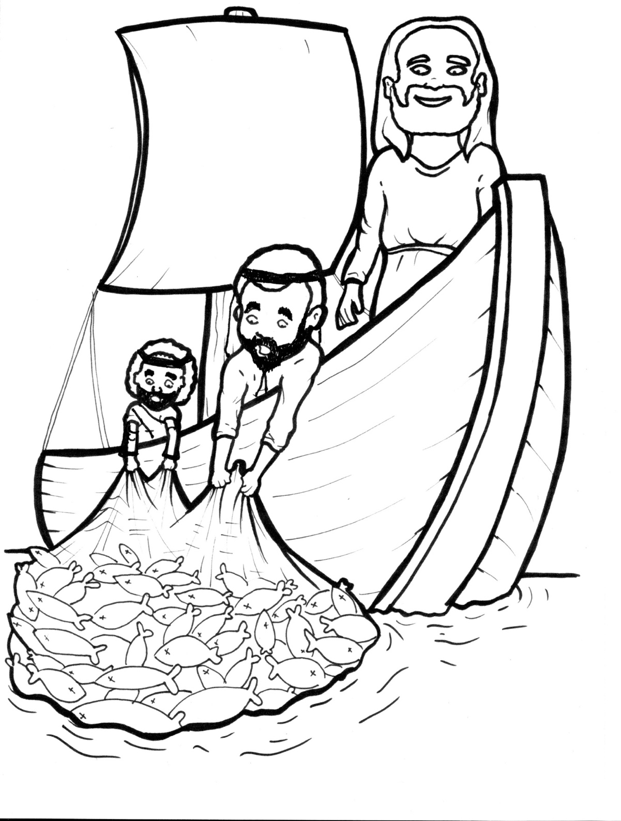
16. Jesus Commands Fish
Part 1
Syllable Charts

Slide 2
Words in Syllable Types

Slide 3
Closed – Short Vowel
A closed syllable has one vowel
followed by one or more consonants,
and the vowel is short.
st
o
p
˘

Slide 4
swam
catch
flash
splash
Mas-
-gan

Slide 5
fell
-dred
went
west
emp-

Slide 6
quick
wig-
sin-
with
sil-
fish

Slide 7
on
not
fol-

Slide 8
up
jump
hun-
-un
bub-
-sus

Slide 9
Open – Long Vowel
An open syllable has one vowel
with no consonant after it,
and the vowel is long.
−
go

Slide 10
we
be gan
Je sus
Pe ter

Slide 11
Si mon
fi nally

Slide 12
go
so
o bey

Slide 13
why

Slide 14
final ly
emp ty
ear ly

Slide 15
Silent e – Long Vowel
A silent e syllable has one vowel,
followed by one consonant
and a silent e at the end.
The vowel is long.
−
ca
e
v

Slide 16
gave
lake
race
scale

Slide 17
Vowel Teams – Long Vowel
Many vowel teams follow this rule:
When two vowels get together,
the first one names its letter.
So the first vowel will make its long sound,
and the second vowel is silent.
−
e
a
t

Slide 18
a way

Slide 19
tail
a fraid

Slide 20
o bey
they

Slide 21
deep
feet

Slide 22
sea
east

Slide 23
sigh
night

Slide 24
boat

Slide 25
throw
fol low

Slide 26
threw

Slide 27
moon

Slide 28
Vowel Teams – Other Sounds
Sometimes vowel teams make other sounds.
oil

Slide 29
all

Slide 30
south
our
out

Slide 31
now
down
crowd

Slide 32
joy

Slide 33
wa ter
wash

Slide 34
R - Controlled
R-controlled syllables have one or more vowels
followed by an “r.”
The “r” changes the sound of the vowel.
o
r
ange

Slide 35
dark
spar kle
sar dine
bar bel

Slide 36
Pe ter
sil ver
un der
Mas ter

Slide 37
first

Slide 38
ear ly

Slide 39
for
morn ing
north
Lord

Slide 40
shore

Slide 41
Consonant – l-e
When you see consonant l-e at the end of a word,
count back three.
The “l-e” makes the /–le/ sound.
pur
p
l
e

Slide 42
peo ple

Slide 43
spar kle

Slide 44
wig gle

Slide 45
bub ble

Slide 46
fin al

Slide 47
barb el

Slide 48
sin ful

Slide 49
Other Sounds – -nk/-ng
The “-nk” and “-ng”
change the sound of the vowel.
bank
thing

Slide 50
sink

Slide 51
morn ing

Slide 52
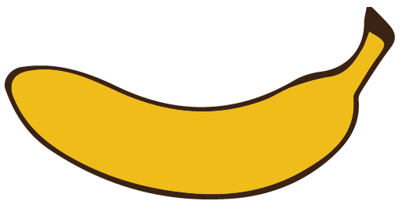
Other Sounds – schwa
The schwa syllable has an “a” that sounds
like the /u/ in banana.
The banana is even shaped like a short u.
ba nan a

Slide 53
a way
a fraid

Slide 54
Si mon

