Slide 1
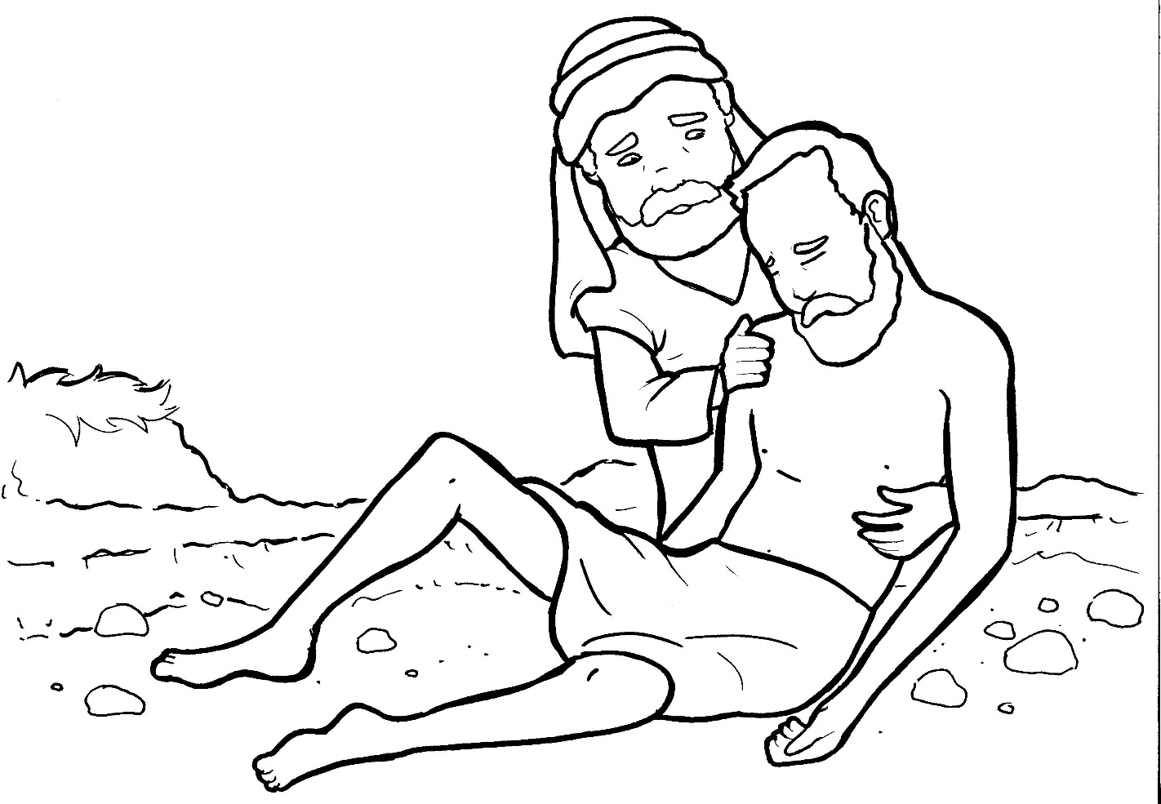
Part 1
25. The Good Samaritan
Syllable Charts

Slide 2
Words in Syllable Types

Slide 3
Closed – Short Vowel
A closed syllable has one vowel
followed by one or more consonants,
and the vowel is short.
st
o
p
˘

Slide 4
Timing
Box
an
and
man
ask
bad
pass

Slide 5
Timing
Box
felt
help
left
when

Slide 6
Timing
Box
-it-
him
inn
-ish
which

Slide 7
Timing
Box
on
rob

Slide 8
Timing
Box
up
but
just
-sus

Slide 9
Open – Long Vowel
An open syllable has one vowel
with no consonant after it,
and the vowel is long.
−
go

Slide 10
Timing
Box
he
Je sus
Le vite
re plied

Slide 11
Timing
Box
so
go ing

Slide 12
Timing
Box
by
my
ly ing

Slide 13
Timing
Box
stor y

Slide 14
Silent e – Long Vowel
A silent e syllable has one vowel,
followed by one consonant
and a silent e at the end.
The vowel is long.
−
ca
e
v

Slide 15
Timing
Box
gave
same
care

Slide 16
Timing
Box
side
Le vite

Slide 17
Timing
Box
stole
sore

Slide 18
Vowel Teams – Long Vowel
Many vowel teams follow this rule:
When two vowels get together,
the first one names its letter.
So the first vowel will make its long sound,
and the second vowel is silent.
−
e
a
t

Slide 19
Timing
Box
beat
clean
teach er

Slide 20
Timing
Box
don key

Slide 21
Timing
Box
priest

Slide 22
Timing
Box
neigh bor

Slide 23
Timing
Box
re plied

Slide 24
Timing
Box
road

Slide 25
Timing
Box
true

Slide 26
Timing
Box
Jew ish

Slide 27
Vowel Teams – Other Sounds
Sometimes vowel teams make other sounds.
oil

Slide 28
Timing
Box
saw

Slide 29
Timing
Box
dead

Slide 30
Timing
Box
took
good

Slide 31
R - Controlled
R-controlled syllables have one or more vowels
followed by an “r.”
The “r” changes the sound of the vowel.
o
r
ange

Slide 32
Timing
Box
or
for
stor y

Slide 33
Timing
Box
sore

Slide 34
Timing
Box
hurt

Slide 35
Timing
Box
rob ber

Slide 36
Timing
Box
neigh bor

Slide 37
Timing
Box
Sa mar it an

Slide 38
Other Sounds – Long Vowel
These syllables or words are closed,
so the vowel should be short,
but the vowel is long.
−
cold

Slide 39
Timing
Box
told

Slide 40
Timing
Box
al most

Slide 41
Other Sounds – -nk/-ng
The “-nk” and “-ng”
change the sound of the vowel.
bank
thing

Slide 42
Timing
Box
donk ey

Slide 43
Timing
Box
ly ing

Slide 44
Other Sounds – schwa
The schwa syllable has an “a” that sounds
like the /u/ in banana.
The banana is even shaped like a short u.
ba nan a

Slide 45
Timing
Box
Sa mar it an

