Slide 1
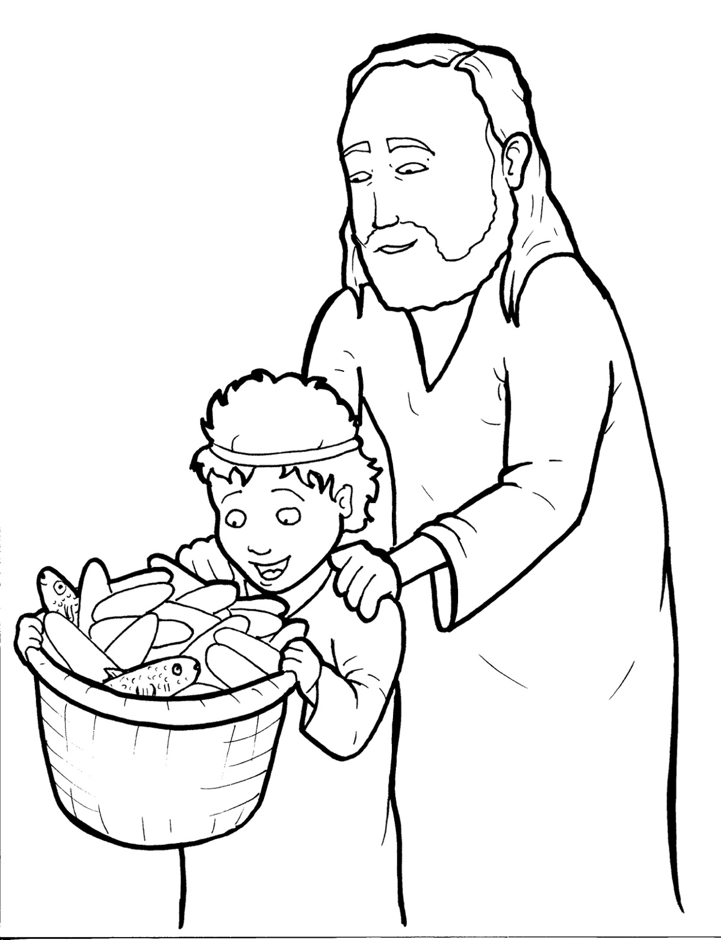
18. Jesus Feeds Five Thousand
Part 1
Syllable Charts

Slide 2
Words in Syllable Types

Slide 3
Closed – Short Vowel
A closed syllable has one vowel
followed by one or more consonants,
and the vowel is short.
st
o
p
˘

Slide 4
An-
ask
af-
-sand
bas-
grass

Slide 5
ex-
-et
fed
-kets
kept
went

Slide 6
lit-
dis-
cit-
-til
Phil-
-ip

Slide 7
God
got
lost

Slide 8
un-
-sus
just
must
much
lunch

Slide 9
Open – Long Vowel
An open syllable has one vowel
with no consonant after it,
and the vowel is long.
−
go

Slide 10
he
we
be
Je sus

Slide 11
ti ny
qui et
dis ci ples

Slide 12
go
so

Slide 13
ti ny
cit y
hung ry

Slide 14
Silent e – Long Vowel
A silent e syllable has one vowel,
followed by one consonant
and a silent e at the end.
The vowel is long.
−
ca
e
v

Slide 15
gave
place

Slide 16
like
five

Slide 17
Vowel Teams – Long Vowel
Many vowel teams follow this rule:
When two vowels get together,
the first one names its letter.
So the first vowel will make its long sound,
and the second vowel is silent.
−
e
a
t

Slide 18
heal

Slide 19
feed
sheep

Slide 20
night

Slide 21
loaves

Slide 22
soon
food

Slide 23
knew
An drew

Slide 24
Vowel Teams – Other Sounds
Sometimes vowel teams make other sounds.
oil

Slide 25
out
thou sand

Slide 26
how
crowd

Slide 27
taught

Slide 28
bread

Slide 29
boy

Slide 30
R - Controlled
R-controlled syllables have one or more vowels
followed by an “r.”
The “r” changes the sound of the vowel.
o
r
ange

Slide 31
far

Slide 32
af ter
per son

Slide 33
for

Slide 34
more

Slide 35
Consonant – l-e
When you see consonant l-e at the end of a word,
count back three.
The “l-e” makes the /–le/ sound.
pur
p
l
e

Slide 36
dis ci ple
peo ple

Slide 37
mir a cle

Slide 38
lit tle

Slide 39
Other Sounds – Long Vowel
These syllables or words are closed,
so the vowel should be short,
but the vowel is long.
−
cold

Slide 40
kind

Slide 41
child

Slide 42
Other Sounds – -nk/-ng
The “-nk” and “-ng”
change the sound of the vowel.
bank
thing

Slide 43
hung ry

Slide 44
giv ing

Slide 45
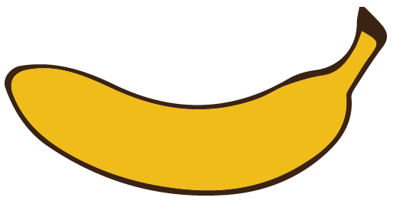
Other Sounds – schwa
The schwa syllable has an “a” that sounds
like the /u/ in banana.
The banana is even shaped like a short u.
ba nan a

Slide 46
ex tra

Slide 47
per son

