Slide 1
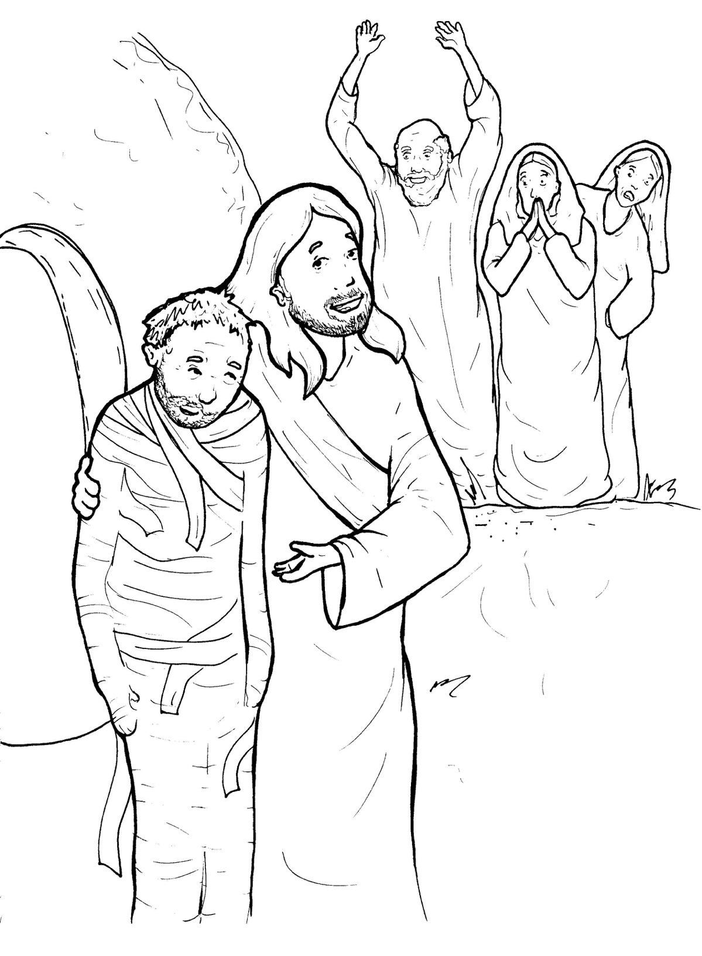
Part 2
33. Lazarus Lives Again
New Words
Rule Breakers

Slide 2
Other Sounds – Soft C
ce, ci, cy make the soft sound
cent
city
fancy

Slide 3
voice

Slide 4
Silent Letters
tomb
wrapped

Slide 5
Possessives
Timing
Box
Jesus’ friend

Slide 6
New Words
Lazarus
tomb
clothes
resurrection

Slide 7
Contractions
The first word stays the same,
and the apostrophe takes the place
of the missing letters in the second word.
do
n’t
=
do
not

Slide 8
Contractions
you’ll = you will

Slide 9
Rule Breakers
Words like these do not follow phonetic patterns.
to
you
said
could
two
f
from

Slide 10
of
the
do
his
to
was

Slide 11
are
you
son
your
many
four

Slide 12
have
friend
live
buried
very
were

Slide 13
said
tomb
been
front
come
would

Slide 14
clothes
whoever
brother
walked
again

