Slide 1

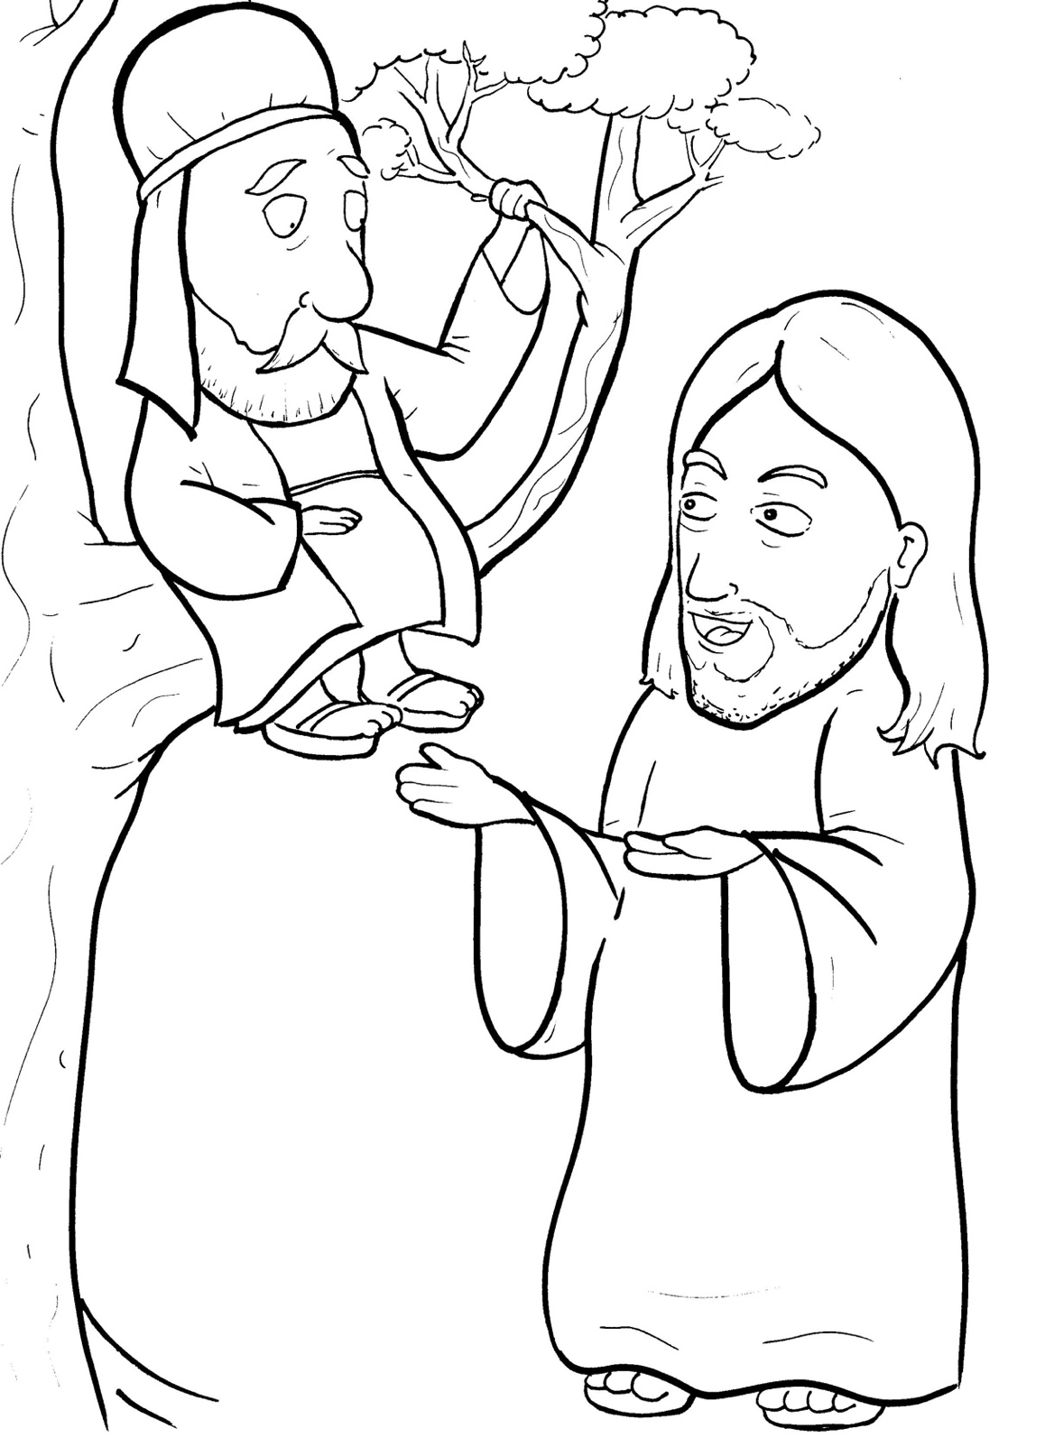
11. Jesus Loves a Short, Bad Man
Part 3
Syllable Divisions

Slide 2
Dividing Words
Into Syllables

Slide 3
Rabbit Words
When you see two consonants
between two vowels,
divide between the consonants.
ra it
bb
rab bit

Slide 4
fol low
follow

Slide 5

col lec tors
collectors

Slide 6
hap py
happy

Slide 7
hur ry
hurry

Slide 8
sel fish
selfish

Slide 9
sin ner
sinner

Slide 10
Tiger Words
When you see one consonant
between two vowels,
divide after the first vowel.
Try this pattern first.
ti er
g
ti ger

Slide 11
Je sus
Jesus

Slide 12
o ver
over

Slide 13
be came
became

Slide 14
ha ted
hated

Slide 15
be lieve
believe

Slide 16
Turtle Words
When you see consonant-l-e,
count back three and divide.
tur
t
l
e
tur tle

Slide 17
grum ble
grumble

Slide 18
peo ple
people

Slide 19
Lion Words
If a word has two vowels together
that make two different sounds,
divide between the two vowels.
lion
li on

Slide 20
Zac chae us
Zacchaeus

Slide 21
Hamster Words
When you see three consonants between two vowels,
divide after the first consonant.
ha
mst
er
ham ster

Slide 22
Zac chae us
Zacchaeus

Slide 23

Anteater Words
These compound words are made up of two smaller words.
ant
eater
1
2
ant eater

Slide 24
in to
into

Slide 25
to day
today

Slide 26
any one
anyone

Slide 27

Foxes Suffixes
Focus on your base word.
fox es
fox es

Slide 28
followed
followed

Slide 29
tried
tried

Slide 30
saved
saved

Slide 31
jumped
jumped

Slide 32
stopped
stopped

Slide 33
ha ted
hated

Slide 34
cheat ed
cheated

Slide 35
quick ly
quickly

Slide 36
go ing
going

Slide 37
self ish
selfish

