Slide 1
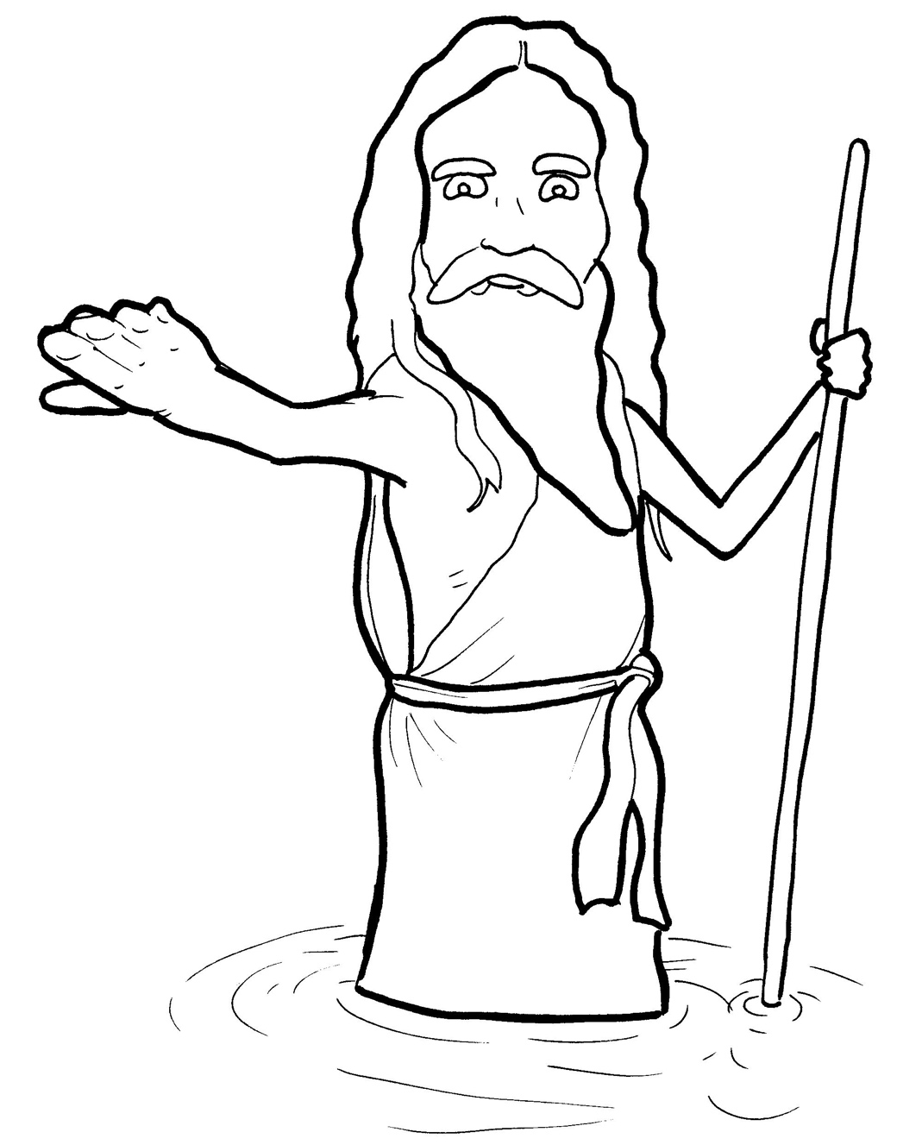
8. John the Baptist Points to Jesus
Part 1
Syllable Charts

Slide 2
Words in Syllable Types

Slide 3
Closed – Short Vowel
A closed syllable has one vowel
followed by one or more consonants,
and the vowel is short.
st
o
p
˘

Slide 4
bap-
ask
san-
-tant

Slide 5
Mes-
-ven
them
-pent
des-
-dreds

Slide 6
im-
-tist
riv-
skin
itch
-ish

Slide 7
job
John

Slide 8
bugs
un-
lunch
hun-
crunch

Slide 9
Open – Long Vowel
An open syllable has one vowel
with no consonant after it,
and the vowel is long.
−
go

Slide 10
he
e ven
we
Je sus
re pent

Slide 11
Mes si ah

Slide 12
no
so
ho ly

Slide 13
why

Slide 14
crunch y
itch y
ho ly

Slide 15
Silent e – Long Vowel
A silent e syllable has one vowel,
followed by one consonant
and a silent e at the end.
The vowel is long.
−
ca
e
v

Slide 16
ate
made
came

Slide 17
here

Slide 18
time
shine
bap tize

Slide 19
Vowel Teams – Long Vowel
Many vowel teams follow this rule:
When two vowels get together,
the first one names its letter.
So the first vowel will make its long sound,
and the second vowel is silent.
−
e
a
t

Slide 20
wait

Slide 21
pay
way
say

Slide 22
teach ers

Slide 23
meet

Slide 24
priests

Slide 25
mon ey

Slide 26
un tie

Slide 27
light

Slide 28
Jew ish

Slide 29
Vowel Teams – Other Sounds
Sometimes vowel teams make other sounds.
oil

Slide 30
call

Slide 31
our
out
shout ed

Slide 32
crowd
pow er ful

Slide 33
points
voice

Slide 34
heav en
read y

Slide 35
R - Controlled
R-controlled syllables have one or more vowels
followed by an “r.”
The “r” changes the sound of the vowel.
o
r
ange

Slide 36
teach er
riv er
des ert
wil der ness

Slide 37
shirt

Slide 38
burn ing

Slide 39
for
Lord
im por tant

Slide 40
more
wore

Slide 41
Consonant – l-e
When you see consonant l-e at the end of a word,
count back three.
The “l-e” makes the /–le/ sound.
pur
p
l
e

Slide 42
peo ple

Slide 43
san dals

Slide 44
cam el

Slide 45
Other Sounds – Long Vowel
These syllables or words are closed,
so the vowel should be short,
but the vowel is long.
−
cold

Slide 46
find

Slide 47
wild

Slide 48
al most

Slide 49
Other Sounds – -nk/-ng
The “-nk” and “-ng”
change the sound of the vowel.
bank
thing

Slide 50
king dom
wait ing

Slide 51
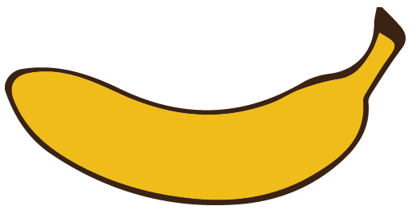
Other Sounds – schwa
The schwa syllable has an “a” that sounds
like the /u/ in banana.
The banana is even shaped like a short u.
ba nan a

Slide 52
Mes si ah

Slide 53
king dom

