Slide 1
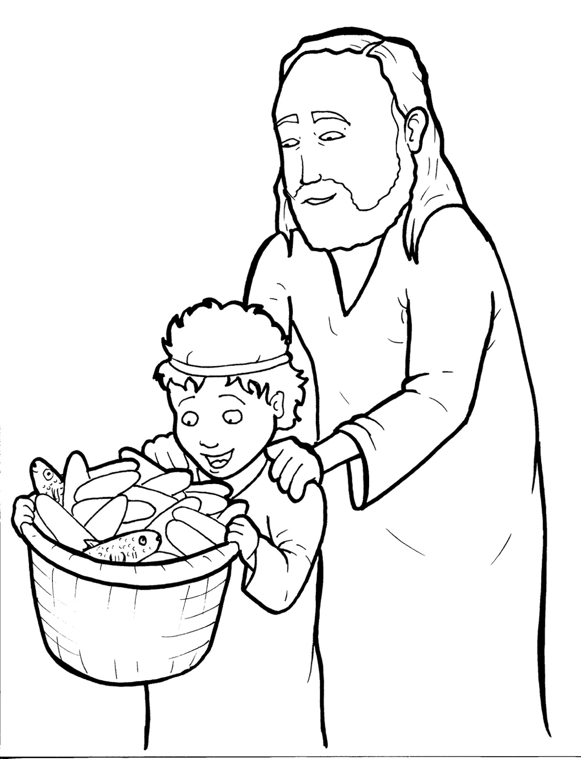
18. Jesus Feeds Five Thousand
Part 4
Story in Easy Read English
Questions
Story in Phrases

Slide 2
Jesus went to rest in a quiet place far from the city.

Slide 3
A crowd ran after him.

Slide 4
He healed them.

Slide 5
He taught them.

Slide 6
They loved Jesus.

Slide 7
The people sat on the grass and listened until night.

Slide 8
They were like lost sheep.

Slide 9
Soon, they got hungry.

Slide 10
Jesus felt sorry for them.

Slide 11
“We can’t feed so many people,” Philip said.

Slide 12
A kind person gave up his lunch.

Slide 13
The food was five little loaves of bread and two tiny fish.

Slide 14
It wasn’t much, but it was all he had.

Slide 15
“How far will this go with such a big crowd?” Andrew asked.

Slide 16
He was another disciple.

Slide 17
Jesus took the food and thanked God.

Slide 18
The disciples gave out the bread and fish.

Slide 19
Food just kept coming and coming out of the baskets!

Slide 20
More than five thousand people were fed.

Slide 21
They were full. There were 12 baskets of extra food.

Slide 22
“This man must be from God,” some people said.

Slide 23
They knew it was a miracle.

Slide 24
Who gave Jesus his lunch?

Slide 25
It was a little boy.

Slide 26
This child had a big heart and giving hands.

Slide 27
Question 1
What did Jesus do with the little lunch?

Slide 28
Question 2
Who gave the fish and bread to Jesus?

Slide 29
Question 3
What can Jesus do when we give him what we have?

Slide 30
Question 4
What can you give to Jesus?

Slide 31
Prayer
Dear Jesus,
You can take what I give you and make it grow. I would like to give you my time, my heart, my talents, and my money. Make my gifts to you grow for the kingdom of God.
Amen

Slide 32
Jesus Feeds Five Thousand
Phrased for Fluency

Slide 33
Jesus went to rest
in a quiet place
far from the city.

Slide 34
A crowd
ran after him. He
healed them.
He taught them.

Slide 35
They loved Jesus.

Slide 36
The people
sat on the grass
and listened
until night.

Slide 37
They were like lost sheep.

Slide 38
Soon,
they got hungry.

Slide 39
Jesus
felt sorry
for them.

Slide 40
"We can't feed
so many people,"
Philip said.

Slide 41
A kind person
gave up
his lunch.

Slide 42
The food
was five little loaves
of bread
and two tiny fish.

Slide 43
It wasn't much,
but it was
all he had.

Slide 44
"How far
will this go
with such a big crowd?"
Andrew asked.

Slide 45
He
was another disciple.

Slide 46
Jesus
took the food
and thanked God.

Slide 47
The disciples
gave out the
bread and fish.

Slide 48
Food just kept
coming and coming
out of the baskets!

Slide 49
More than
five thousand people
were fed.

Slide 50
They were full.

Slide 51
There were
12 baskets
of extra food.

Slide 52
“This man
must be from God,"
some people said.

Slide 53
The knew
it was a miracle.

Slide 54
Who gave Jesus
his lunch?

Slide 55
It was
a little boy.

Slide 56
This child
had
a big heart
and giving hands.

