Slide 1
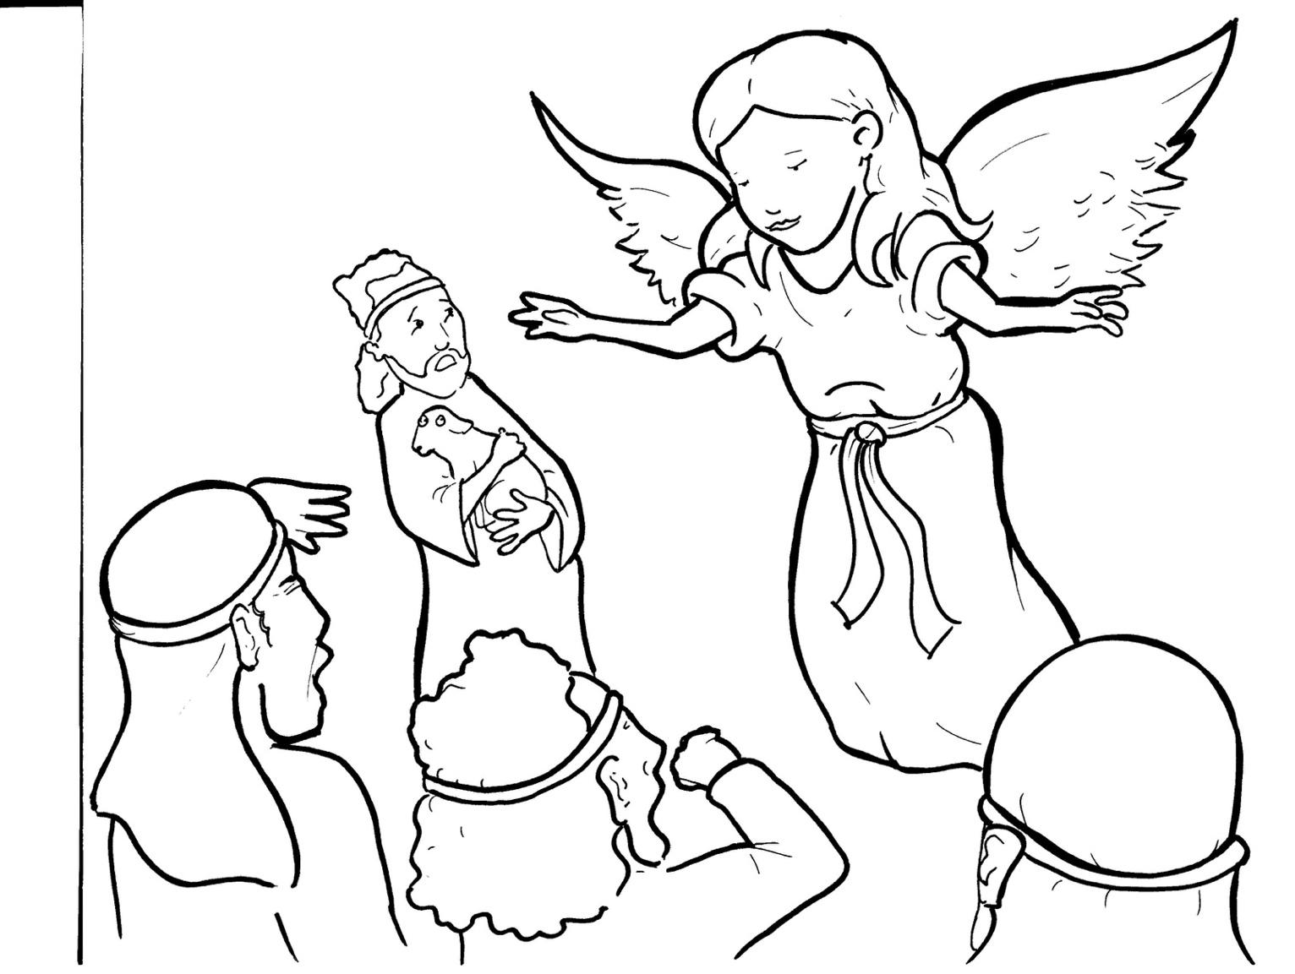
3. Shepherds Share the Good News
Part 1
Syllable Charts

Slide 2
Words in Syllable Types

Slide 3
Closed – Short Vowel
A closed syllable has one vowel
followed by one or more consonants,
and the vowel is short.
st
o
p
˘

Slide 4
hap-
back

Slide 5
pen
-en
kept
-et
shep-

Slide 6
in
with

Slide 7
on
God
soft

Slide 8
-sus

Slide 9
Open – Long Vowel
An open syllable has one vowel
with no consonant after it,
and the vowel is long.
−
go

Slide 10
ba by
Sa vior

Slide 11
he
be
Je sus

Slide 12
qui et

Slide 13
Jo seph

Slide 14
Mar y
ba by
glor y
bright ly
ar my

Slide 15
Silent e – Long Vowel
A silent e syllable has one vowel,
followed by one consonant
and a silent e at the end.
The vowel is long.
−
ca
e
v

Slide 16
share
a mazed

Slide 17
like
side
fire

Slide 18
Vowel Teams – Long Vowel
Many vowel teams follow this rule:
When two vowels get together,
the first one names its letter.
So the first vowel will make its long sound,
and the second vowel is silent.
−
e
a
t

Slide 19
praised

Slide 20
say ing

Slide 21
see
sheep
sleep ing

Slide 22
fear
ap peared
peace

Slide 23
fields

Slide 24
night
bright ly
high est

Slide 25
glow ed

Slide 26
true

Slide 27
flew
news

Slide 28
Vowel Teams – Other Sounds
Sometimes vowel teams make other sounds.
oil

Slide 29
out side
a bout
found

Slide 30
joy
joy ful

Slide 31
joined

Slide 32
all

Slide 33
heav en

Slide 34
good
shook

Slide 35
R - Controlled
R-controlled syllables have one or more vowels
followed by an “r.”
The “r” changes the sound of the vowel.
o
r
ange

Slide 36
dark
ar my

Slide 37
born
Lord
glor y
Sa vior

Slide 38
Mar y

Slide 39
earth
heard

Slide 40
warm

Slide 41
Consonant – l-e
When you see consonant l-e at the end of a word,
count back three.
The “l-e” makes the /–le/ sound.
pur
p
l
e

Slide 42
im pos si ble

Slide 43
Other Sounds – Long Vowel
These syllables or words are closed,
so the vowel should be short,
but the vowel is long.
−
cold

Slide 44
told

Slide 45
Other Sounds – -nk/-ng
The “-nk” and “-ng”
change the sound of the vowel.
bank
thing

Slide 46
sang
ang els

Slide 47
sleep ing

Slide 48
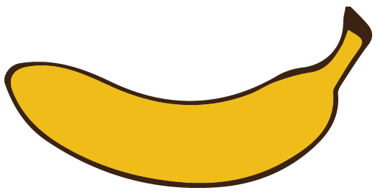
Other Sounds – schwa
The schwa syllable has an “a” that sounds
like the /u/ in banana.
The banana is even shaped like a short u.
ba nan a

Slide 49
a mazed
a ppeared
a bout

