Slide 1
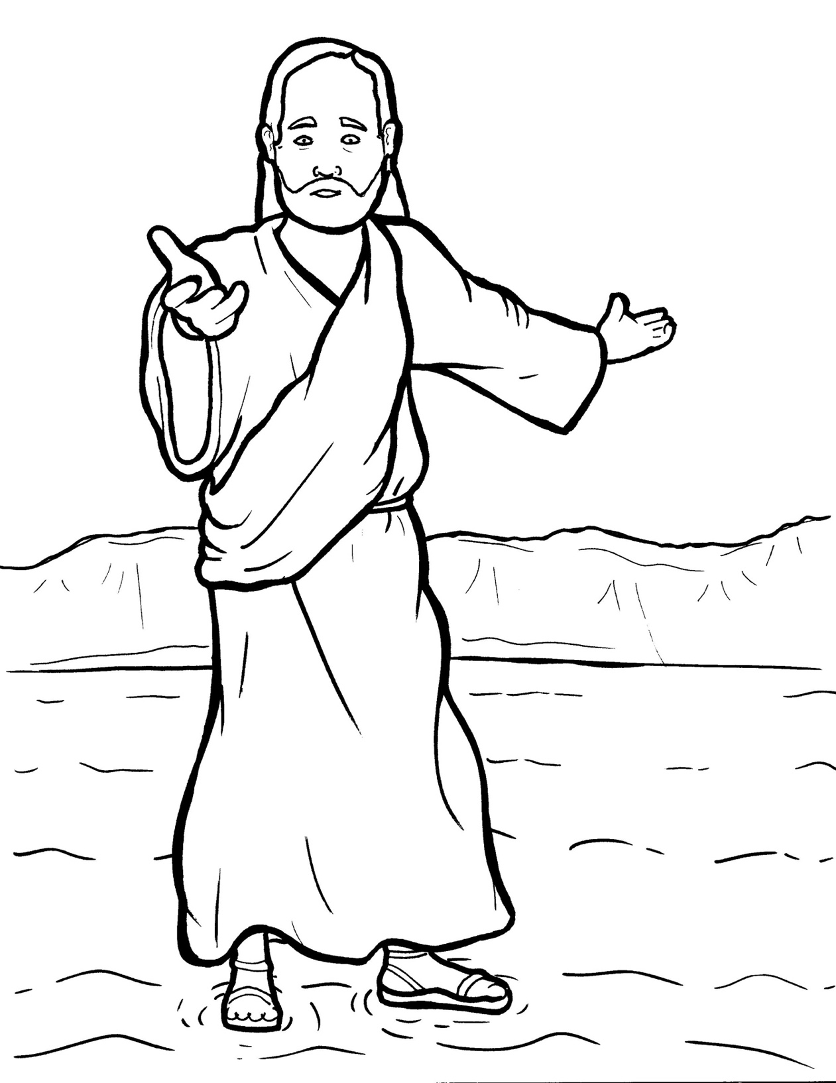
19. Jesus Walks on the Water
Part 2
New Words
Rule Breakers

Slide 2
Other Sounds – Soft C
ce, ci, cy make the soft sound
cent
city
fancy

Slide 3
disciples

Slide 4
Silent Letters
ghost
walk

Slide 5
Change y to i and add a suffix.
cried

Slide 6
New Words
disciples
ghost
Son of God

Slide 7
Rule Breakers
These words do not follow phonetic patterns.
his
were

Slide 8
walked
water
the
into

Slide 9
was
is
pull
pushed

Slide 10
their
they
of
very

Slide 11
said
do
you
come

Slide 12
to
saw
are
son

