Slide 1
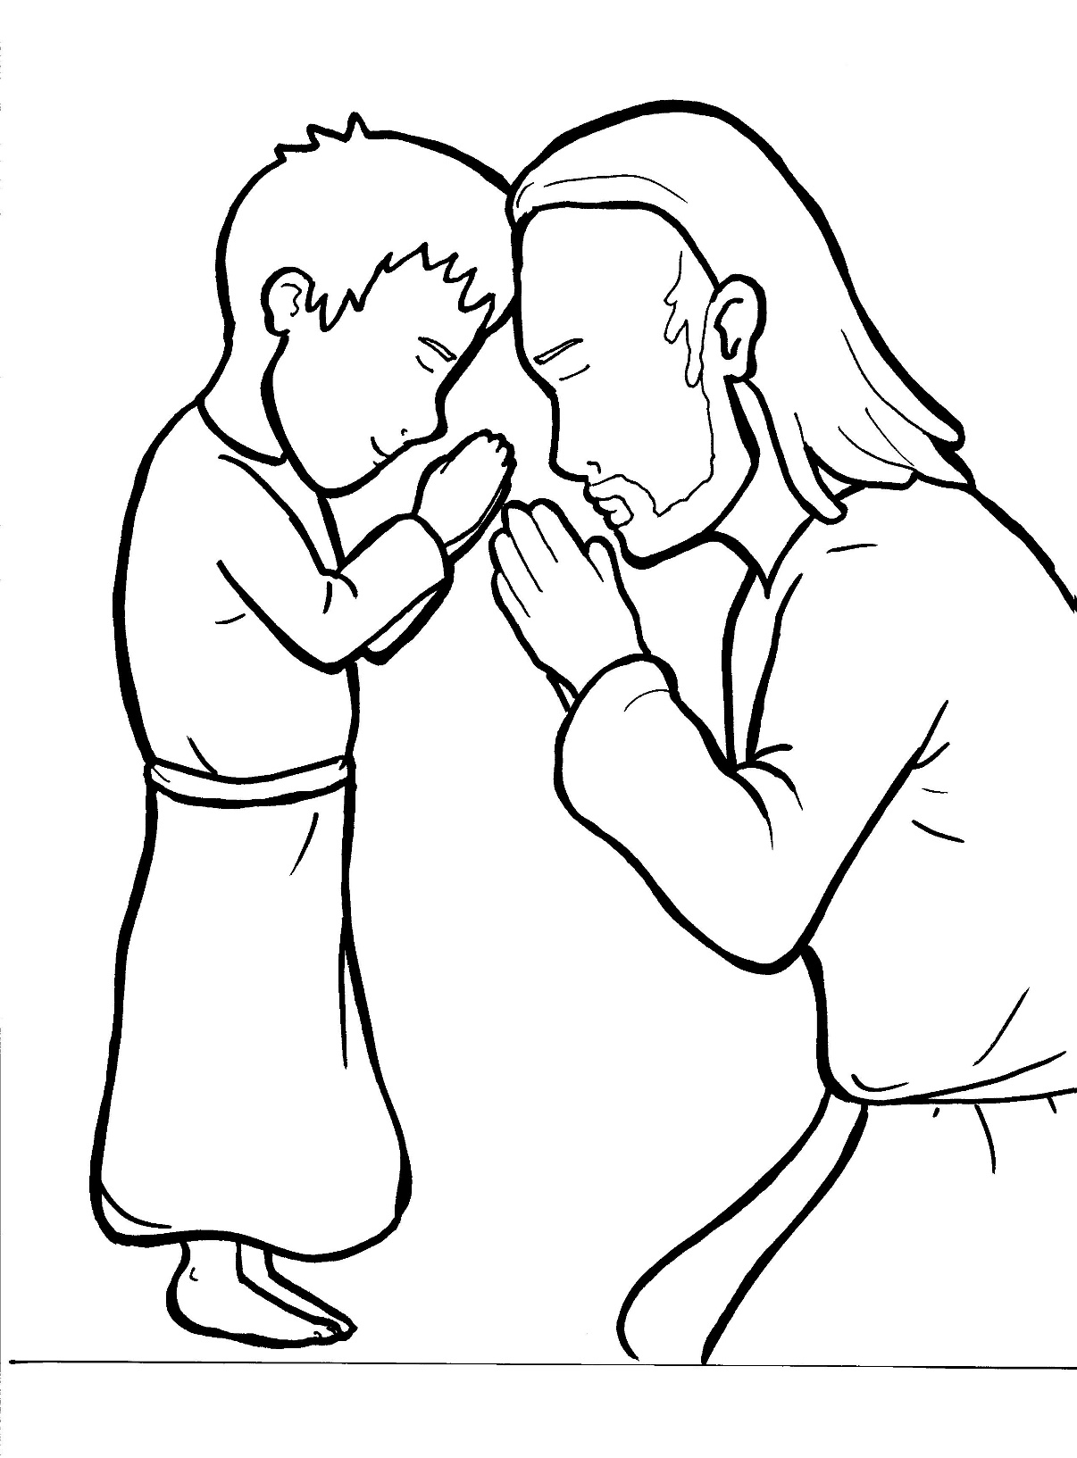
Part 1
26. The Lord’s Prayer
Syllable Charts

Slide 2
Words in Syllable Types

Slide 3
Closed – Short Vowel
A closed syllable has one vowel
followed by one or more consonants,
and the vowel is short.
st
o
p
˘

Slide 4
Timing
Box
ask
and
hap-
that

Slide 5
Timing
Box
ev-
-en
set
-pen

Slide 6
Timing
Box
when
-men
tempt

Slide 7
Timing
Box
dis -
-vil
this
will

Slide 8
Timing
Box
on
not

Slide 9
Timing
Box
us
-sus
just

Slide 10
Open – Long Vowel
An open syllable has one vowel
with no consonant after it,
and the vowel is long.
−
go

Slide 11
Timing
Box
a men

Slide 12
Timing
Box
be
we
Je sus
e vil

Slide 13
Timing
Box
disci ples

Slide 14
Timing
Box
so
ho ly

Slide 15
Timing
Box
ho ly
glor y
real ly
ever y

Slide 16
Silent e – Long Vowel
A silent e syllable has one vowel,
followed by one consonant
and a silent e at the end.
The vowel is long.
−
ca
e
v

Slide 17
Timing
Box
save
same
name

Slide 18
Timing
Box
like

Slide 19
Timing
Box
those

Slide 20
Vowel Teams – Long Vowel
Many vowel teams follow this rule:
When two vowels get together,
the first one names its letter.
So the first vowel will make its long sound,
and the second vowel is silent.
−
e
a
t

Slide 21
Timing
Box
say
day
way
may
pray

Slide 22
Timing
Box
eat
teach
real ly

Slide 23
Vowel Teams – Other Sounds
Sometimes vowel teams make other sounds.
oil

Slide 24
Timing
Box
our

Slide 25
Timing
Box
pow er

Slide 26
Timing
Box
bread
heav en

Slide 27
R - Controlled
R-controlled syllables have one or more vowels
followed by an “r.”
The “r” changes the sound of the vowel.
o
r
ange

Slide 28
Timing
Box
a part

Slide 29
Timing
Box
for
Lord
glor y

Slide 30
Timing
Box
pow er
ev er y

Slide 31
Timing
Box
earth

Slide 32
Consonant – l-e
When you see consonant l-e at the end of a word,
count back three.
The “l-e” makes the /–le/ sound.
pur
p
l
e

Slide 33
Timing
Box
disci ples

Slide 34
Other Sounds – -nk/-ng
The “-nk” and “-ng”
change the sound of the vowel.
bank
thing

Slide 35
Timing
Box
king dom

Slide 36
Other Sounds – schwa
The schwa syllable has an “a” that sounds
like the /u/ in banana.
The banana is even shaped like a short u.
ba nan a

Slide 37
Timing
Box
a part
a gainst

