Slide 1
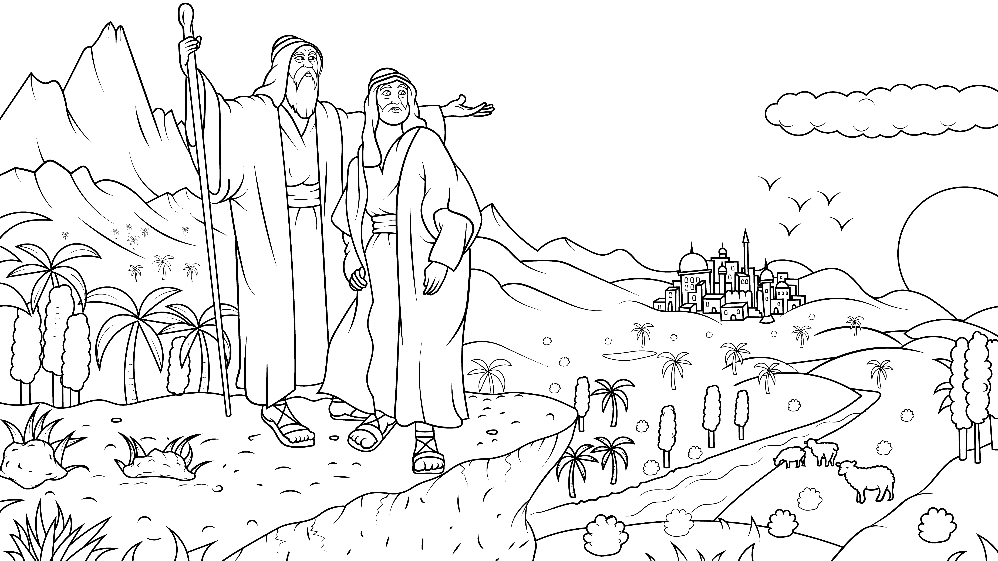
1.4 Story: Lot Got a Lot
Genesis 13:1-18

Slide 2
New Words to Read
Lot lots spot
got not pots

Slide 3
New Words to Read
dogs God boss
ox top stop

Slide 4
Rule Breakers (Read and Spell)
the of have his
to do said was

Slide 5
Sight Words
but with Abram
go so
he we

Slide 6
Lot Got a Lot
I Read, You Read Story

Slide 7
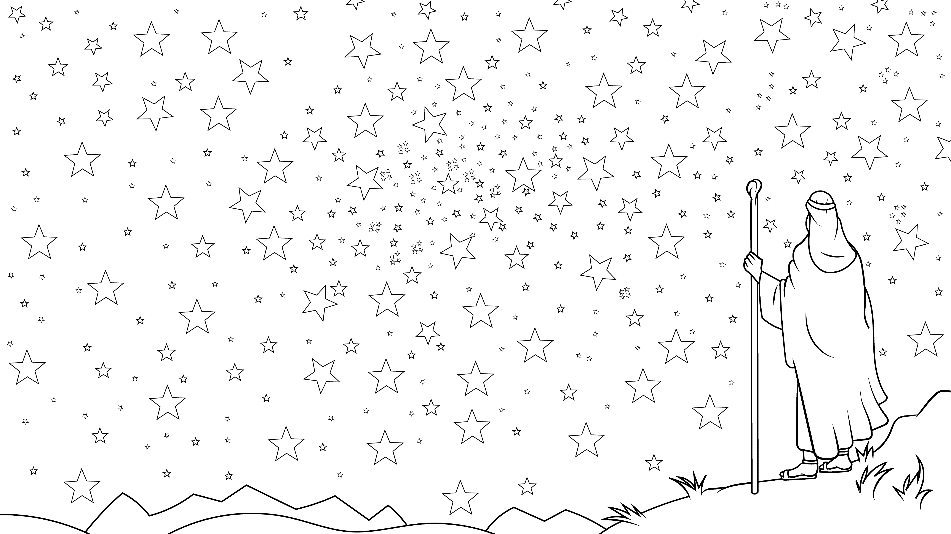
God said to Abram, “Go.”

Slide 8
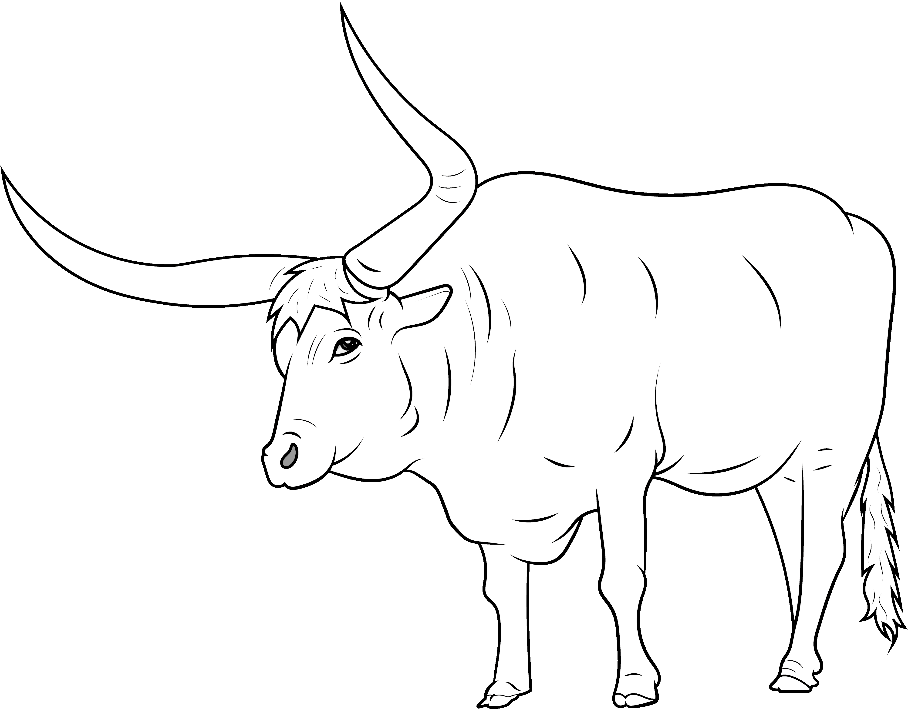
Abram had a lot.
He had an ox.

Slide 9
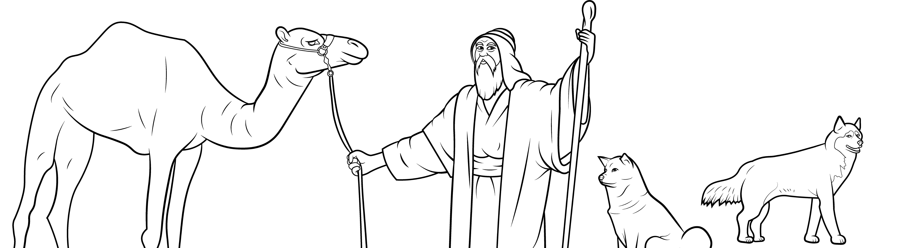
He had a lot of dogs

Slide 10
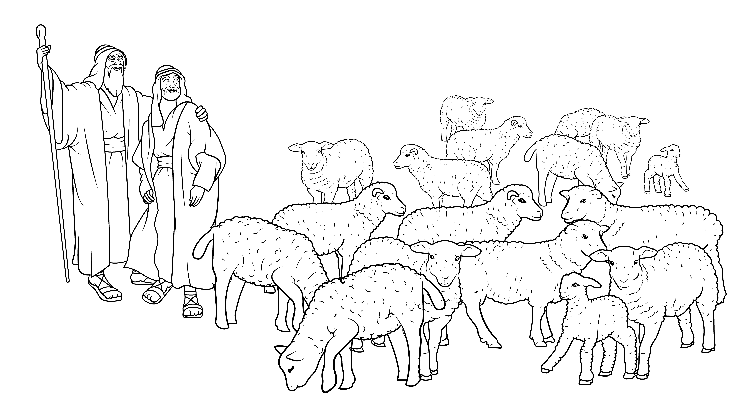
and a lot of sheep, cows, goats, and silver.

Slide 11
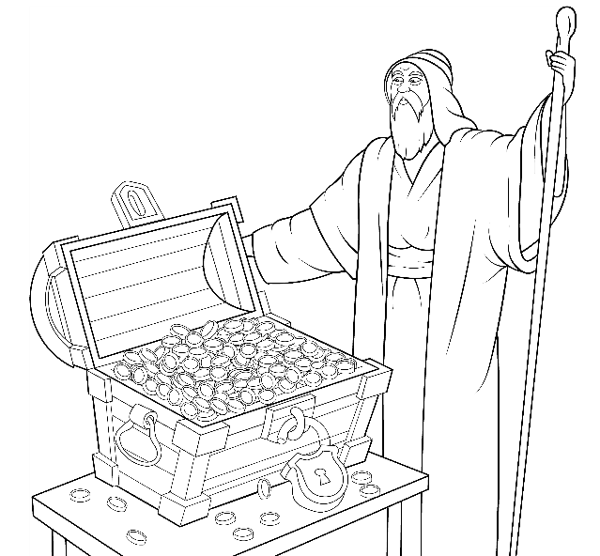
He had pots of gold!

Slide 12
His nephew, Lot, had a lot.

Slide 13
He had an ox.

Slide 14
He had a lot of dogs

Slide 15
and a lot of sheep,
cows, and goats.

Slide 16
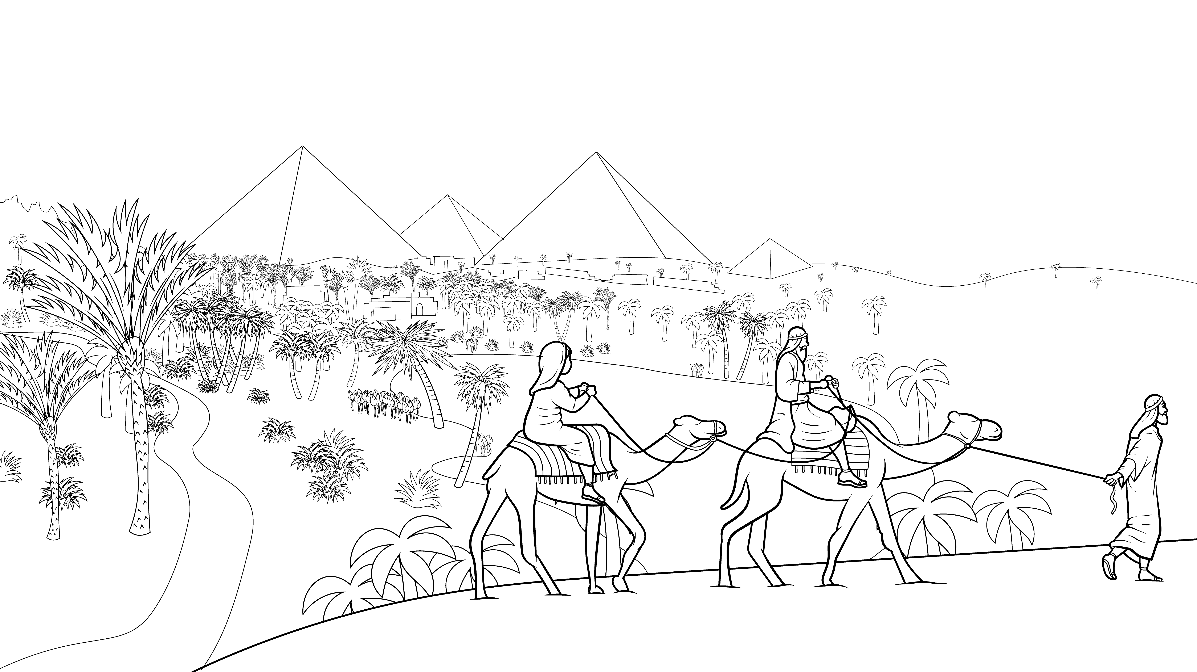
Abram said, “Let’s go.”

Slide 17
So, Abram and his wife and
Lot and all they owned moved.

Slide 18
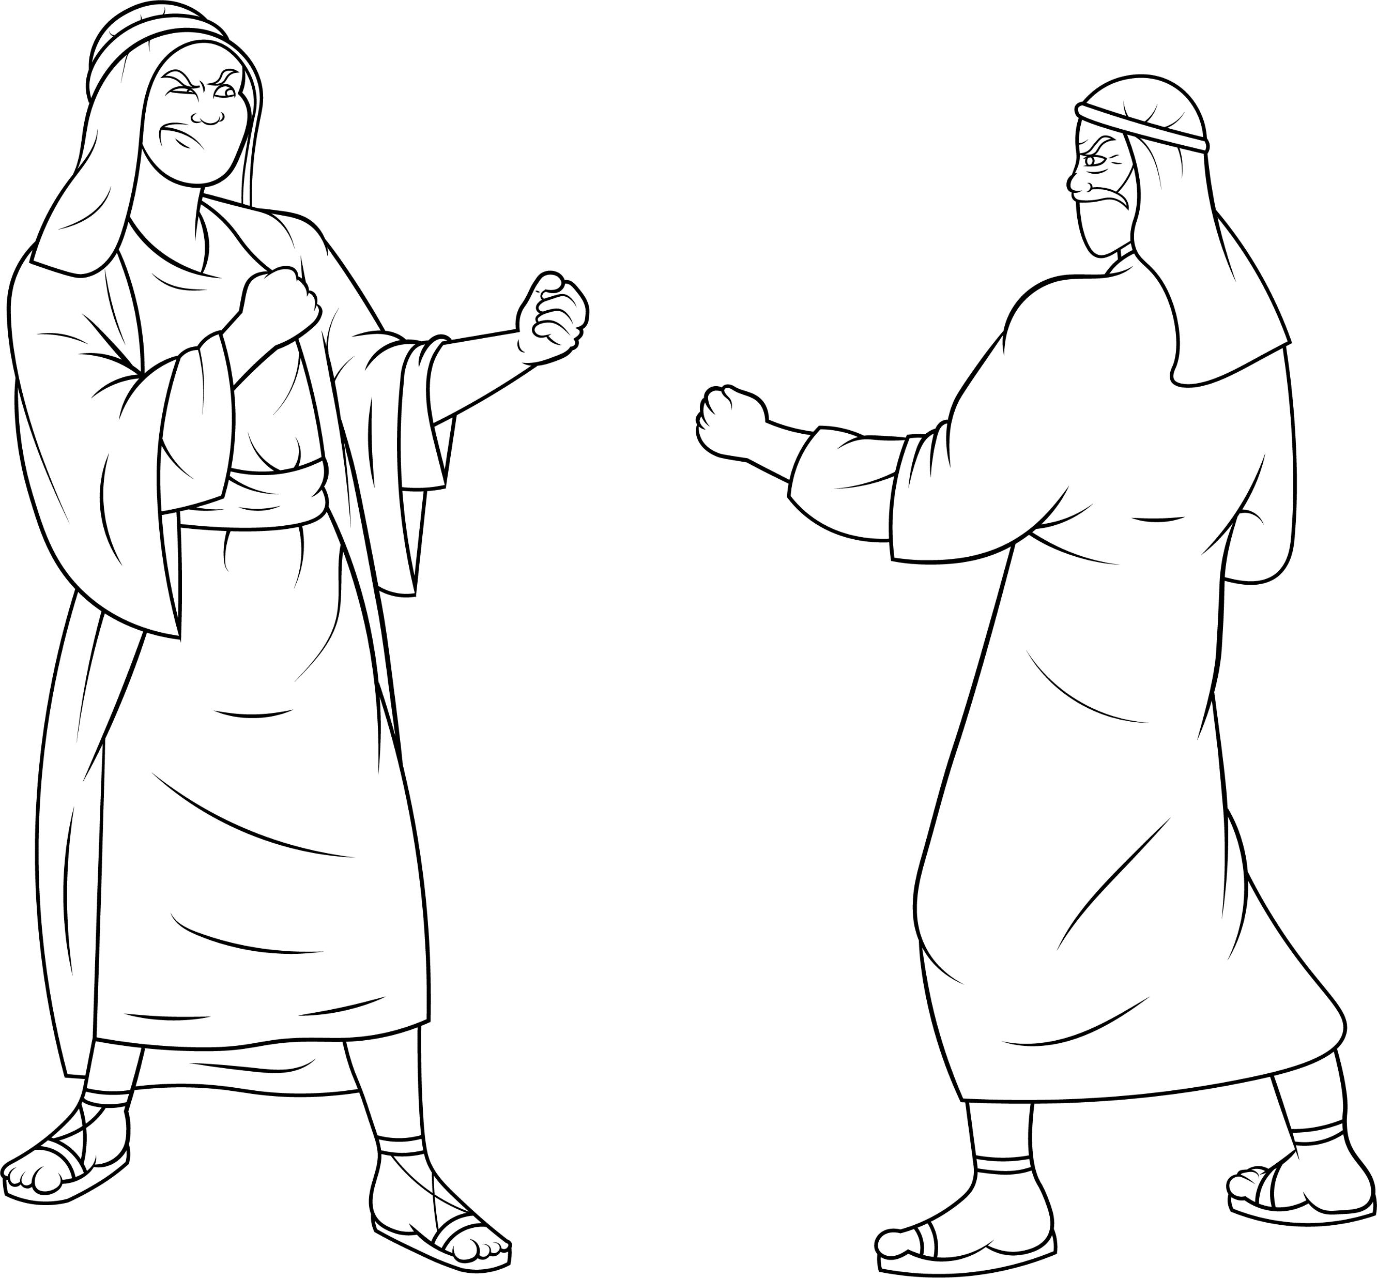
Their men fought.

Slide 19
They were sad about their cows.

Slide 20
“We do not have a lot of grass.

Slide 21
We do not have a lot of water for our kids.”

Slide 22
Their men all fought.

Slide 23
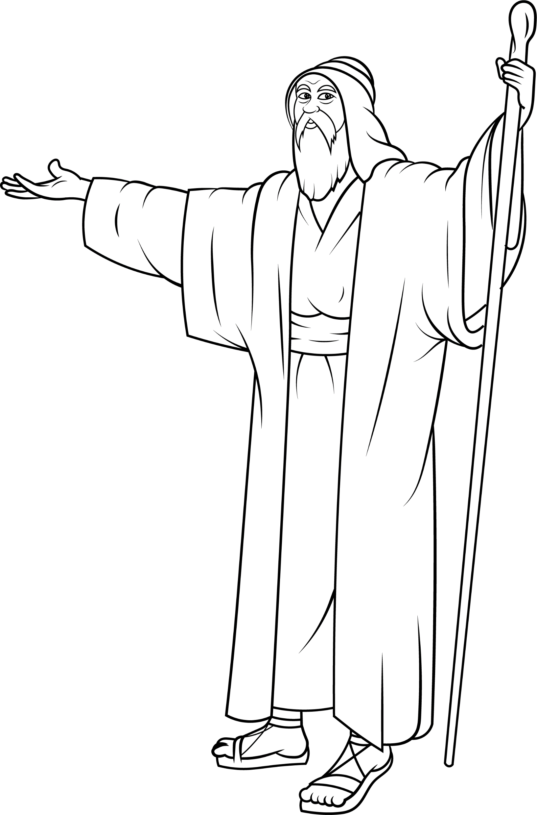
Abram said, “Stop!”

Slide 24
He went with Lot to the top of a hill.

Slide 25
Abram was the boss but he let Lot
pick his land.

Slide 26
Lot got the best land.
It had lots of hills

Slide 27
and lots of water and even cities.

Slide 28
Abram went to a spot in the west.

Slide 29
Now, both families were happy.

Slide 30
The End

Slide 31
1.4 Story Without Illustrations
Lot Got a Lot

Slide 32
God said to Abram, “Go.”
Abram had a lot.

Slide 33
He had an ox.
He had a lot of dogs and a lot of sheep, cows, goats, and silver.
He had pots of gold!

Slide 34
His nephew Lot had a lot.
He had an ox.
He had a lot of dogs and a lot of
sheep, cows, and goats.

Slide 35
Abram said, “Let’s go.”
So, Abram and his wife and Lot
and all they owned moved.

Slide 36
Their men fought.
They were sad about their cows. “We do not have a lot of grass.
We do not have a lot of water for our kids.” Their men all fought.

Slide 37
Abram said, “Stop!”
He went with Lot to the top of a hill.
Abram was the boss but he let Lot
pick his land.

Slide 38
Lot got the best land.
It had lots of hills and lots of water and even cities.

Slide 39
Abram went to a spot in the west.
Now, both families were happy.

Slide 40
The End

Slide 41
Story: Carol Hale
Illustrations: Ivan Mader
Power Point arrangements: Steve March
www.EasyReadEnglish.com
www.EZReadEnglish.org/lower-levels

