Slide 1

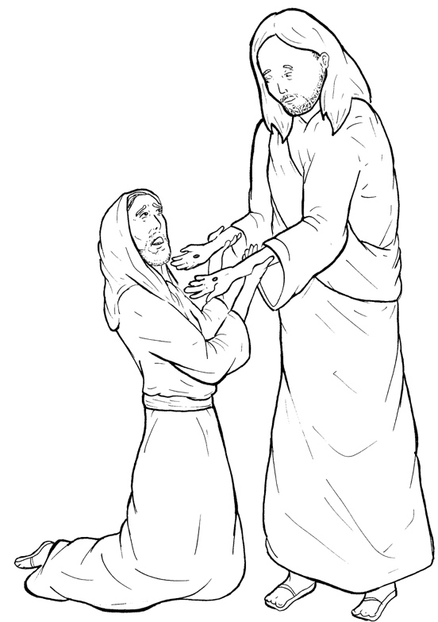
Part 3
43. Jesus Appears to Thomas
Syllable Divisions

Slide 2

Dividing Words
Into Syllables

Slide 3
Rabbit Words
When you see two consonants
between two vowels,
divide between the consonants.
ra it
bb
rab bit

Slide 4
un less
unless

Slide 5
ap pear
appear

Slide 6
dis ci ples
disciples

Slide 7
Tiger Words
When you see one consonant
between two vowels,
divide after the first vowel.
Try this pattern first.
ti er
g
ti ger

Slide 8
la ter
later

Slide 9
Je sus
Jesus

Slide 10
be cause
because

Slide 11
be lieve
believe

Slide 12
Camel Words
When you see one consonant
between two vowels,
divide after the first consonant.
Try this pattern second.
ca el
m
cam el

Slide 13
Thom as
Thomas

Slide 14

Anteater Words
These compound words are made up of two smaller words.
ant
eater
1
2
ant eater

Slide 15
in to
into

Slide 16
Turtle Words
When you see consonant-l-e,
count back three and divide.
tur
t
l
e
tur tle

Slide 17
dis ci ples
disciples

Slide 18

Foxes Suffixes
Focus on your base word.
fox es
fox es

Slide 19
doubt ing
doubting

Slide 20
locked
locked

Slide 21
blessed
blessed

Slide 22
appeared
appeared

Slide 23
Other Syllable Divisions
Some words don’t fit so neatly
into standard syllable division patterns.

Slide 24
fing ers
fingers

Slide 25
a head
ahead

Slide 26
ap pear
appear

