Slide 1

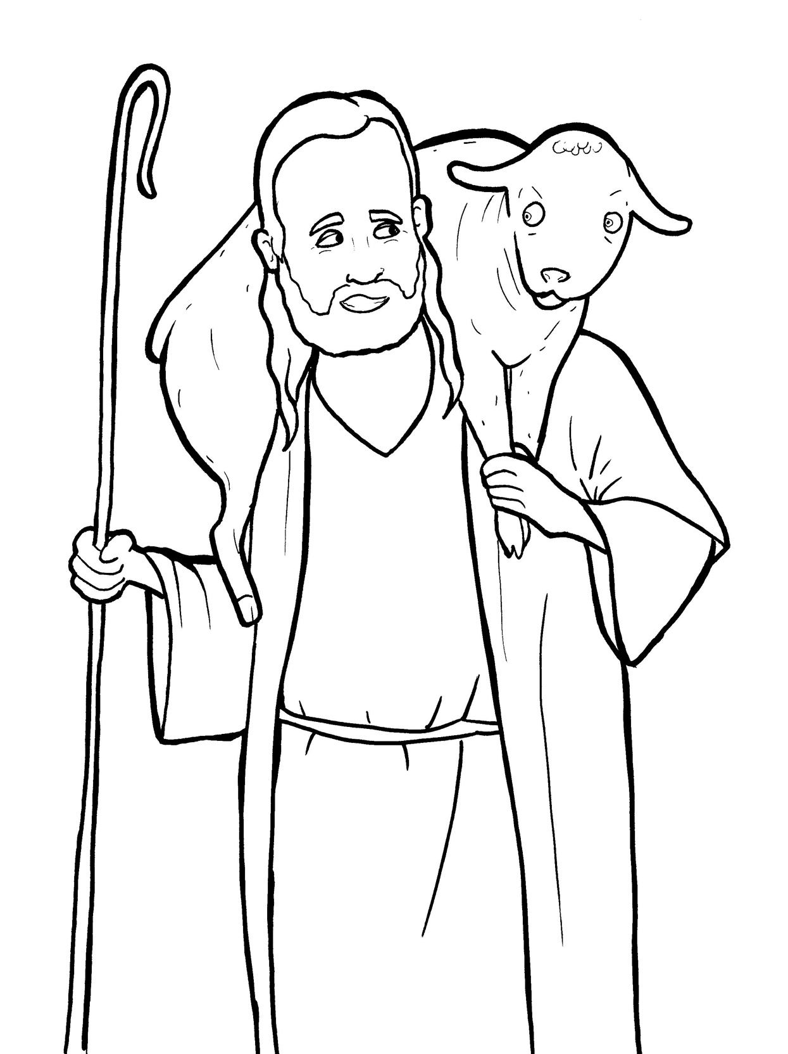
Part 3
22. The Lost Sheep
Syllable Divisions

Slide 2

Dividing Words
Into Syllables

Slide 3
Rabbit Words
When you see two consonants
between two vowels,
divide between the consonants.
ra it
bb
rab bit

Slide 4
un til
until

Slide 5
sin ners
sinners

Slide 6
wel come
welcome

Slide 7
sor ry
sorry

Slide 8
hap pi ness
happiness

Slide 9
wan der
wander

Slide 10
un der stand
understand

Slide 11
shep herd
shepherd

Slide 12
moun tains
mountains

Slide 13
Tiger Words
When you see one consonant
between two vowels,
divide after the first vowel.
Try this pattern first.
ti er
g
ti ger

Slide 14
Je sus
Jesus

Slide 15
re joice
rejoice

Slide 16
e ven
even

Slide 17
Camel Words
When you see one consonant
between two vowels,
divide after the first consonant.
Try this pattern second.
ca el
m
cam el

Slide 18
Jew ish
Jewish

Slide 19
stor y
story

Slide 20
heav en
heaven

Slide 21
Turtle Words
When you see consonant-l-e,
count back three and divide.
tur
t
l
e
tur tle

Slide 22
lit tle
little

Slide 23
grum ble
grumble

Slide 24
Hamster Words
When you see three consonants between two vowels,
divide after the first consonant.
ha
mst
er
ham ster

Slide 25
under stand
understand

Slide 26

Foxes Suffixes
Focus on your base word.
fox es
fox es

Slide 27
stor ies
stories

Slide 28
lead ers
leaders

Slide 29
sin ners
sinners

Slide 30
Jew ish
Jewish

Slide 31
happi ness
happiness

Slide 32
wel comed
welcomed

Slide 33
grum bled
grumbled

Slide 34

Anteater Words
These compound words are made up of two smaller words.
ant
eater
1
2
ant eater

Slide 35
under stand
understand

Slide 36
Other Syllable Divisions
Some words don’t fit so neatly
into standard syllable division patterns.

Slide 37
a way
away

Slide 38
ang els
angels

Slide 39
neigh bors
neighbors

