Slide 1
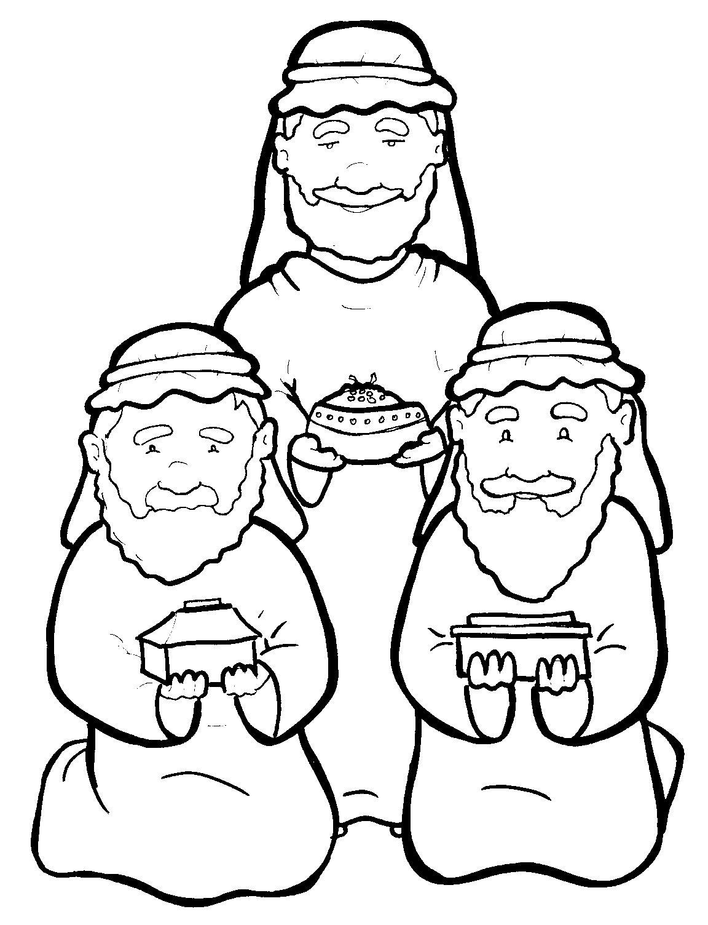
4. Wise Men Give Gifts to Jesus
Part 1
Syllable Charts

Slide 2
Words in Syllable Types

Slide 3
Closed – Short Vowel
A closed syllable has one vowel
followed by one or more consonants,
and the vowel is short.
st
o
p
˘

Slide 4
ask
cam-
past
trav-

Slide 5
men
-el
when
-els
-dreds
Beth-

Slide 6
will
gifts
hill
-ship
with
big

Slide 7
on
fol-

Slide 8
up
-sus
hun-

Slide 9
Open – Long Vowel
An open syllable has one vowel
with no consonant after it,
and the vowel is long.
−
go

Slide 10
we
Je sus

Slide 11
o ver

Slide 12
Jer u salem

Slide 13
my

Slide 14
Mar y
might y
emp ty

Slide 15
Silent e – Long Vowel
A silent e syllable has one vowel,
followed by one consonant
and a silent e at the end.
The vowel is long.
−
ca
e
v

Slide 16
take
save

Slide 17
these

Slide 18
wise
rise
miles

Slide 19
home
shone

Slide 20
per fume

Slide 21
Vowel Teams – Long Vowel
Many vowel teams follow this rule:
When two vowels get together,
the first one names its letter.
So the first vowel will make its long sound,
and the second vowel is silent.
−
e
a
t

Slide 22
in deed
sweet

Slide 23
east

Slide 24
bright
might y

Slide 25
die

Slide 26
low
fol low

Slide 27
grew

Slide 28
Vowel Teams – Other Sounds
Sometimes vowel teams make other sounds.
oil

Slide 29
our
found

Slide 30
down
town

Slide 31
joy

Slide 32
oil

Slide 33
all

Slide 34
read
death
treasures

Slide 35
R - Controlled
R-controlled syllables have one or more vowels
followed by an “r.”
The “r” changes the sound of the vowel.
o
r
ange

Slide 36
star

Slide 37
for
born

Slide 38
af ter
per fume
o ver
Jer u sa lem
des erts

Slide 39
burst
treasure

Slide 40
word
wor ship

Slide 41
Mar y

Slide 42
Consonant – l-e
When you see consonant l-e at the end of a word,
count back three.
The “l-e” makes the /–le/ sound.
pur
p
l
e

Slide 43
Other Sounds – Long Vowel
These syllables or words are closed,
so the vowel should be short,
but the vowel is long.
−
cold

Slide 44
gold

Slide 45
child

Slide 46
Other Sounds – -nk/-ng
The “-nk” and “-ng”
change the sound of the vowel.
bank
thing

Slide 47
bring
kings

Slide 48
strong

Slide 49
frank -

Slide 50
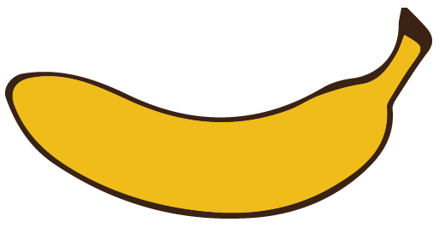
Other Sounds – schwa
The schwa syllable has an “a” that sounds
like the /u/ in banana.
The banana is even shaped like a short u.
ba nan a

Slide 51
Jer u sa lem

