Slide 1
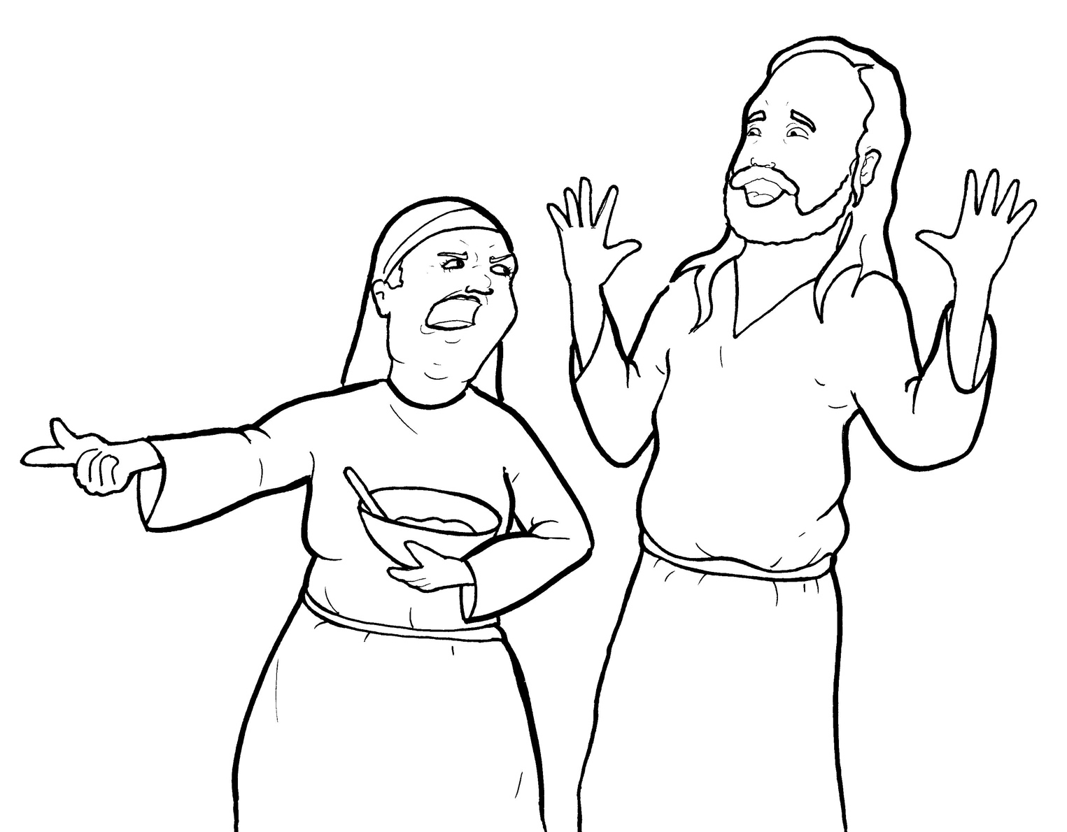
13. Martha Gets Mad
Part 5
Vocabulary
Original Bible Story

Slide 2
Vocabulary

Slide 3
certain
( CER -
tain):
one – but not named

Slide 4
serve
(serve):
to work to help someone

Slide 5
receive
CEIVE):
(re -
to take in

Slide 6
anxious
ious ):
(ANX -
feeling worried

Slide 7
distracted
(dis -
TRACT -
ed):
busy with something else

Slide 8
troubled
(TROU – bled):
upset

Slide 9
Martha Gets Mad
Luke 10:38-42
World English Bible (WEB)

Slide 10
As they went on their way, he entered into a certain village, and a certain woman named Martha received him into her house.

Slide 11
She had a sister called Mary, who also sat at Jesus’ feet, and heard his word.

Slide 12
But Martha was distracted with much serving, and she came up to him, and said, “Lord, don’t you care that my sister has left me to serve alone?

Slide 13
Ask her therefore to help me.”

Slide 14
Jesus answered her, “Martha, Martha, you are anxious and troubled about many things, but only one thing is needed.

Slide 15
Mary has chosen the good part, which will not be taken away from her.”

