Slide 1

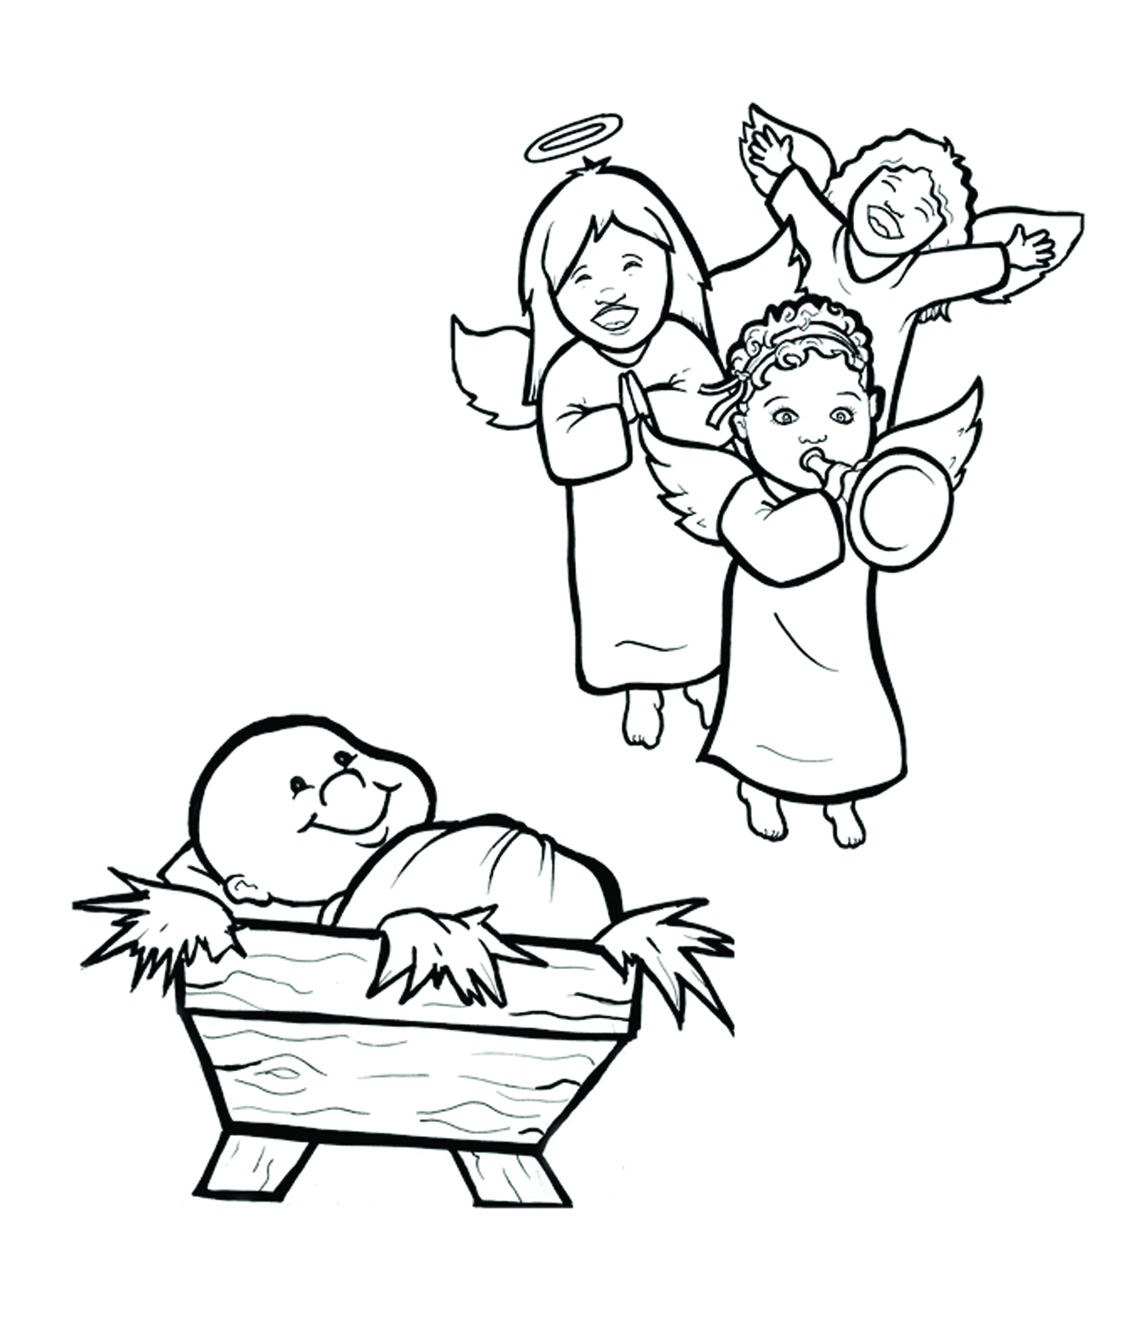
2. Happy Birthday, Jesus!
Part 3
Syllable Divisions

Slide 2
Dividing Words
Into Syllables

Slide 3
Rabbit Words
When you see two consonants
between two vowels,
divide between the consonants.
ra it
bb
rab bit

Slide 4
hap py
happy

Slide 5
bel ly
belly

Slide 6

Tiger Words
When you see one consonant
between two vowels,
divide after the first vowel.
Try this pattern first.
ti er
g
ti ger

Slide 7
Je sus
Jesus

Slide 8
Jo seph
Joseph

Slide 9
ba by
baby

Slide 10
Sa vior
Savior

Slide 11
mo ment
moment

Slide 12
ru lers
rulers

Slide 13
hu man
human

Slide 14
Camel Words
When you see one consonant
between two vowels,
divide after the first consonant.
Try this pattern second.
ca el
m
cam el

Slide 15
trav el
travel

Slide 16
Mar y
Mary

Slide 17
Turtle Words
When you see consonant-l-e,
count back three and divide.
tur
t
l
e
tur tle

Slide 18
peo ple
people

Slide 19
Hamster Words
When you see three consonants between two vowels,
divide after the first consonant.
ha
mst
er
ham ster

Slide 20
wob bly
wobbly

Slide 21
daz zling
dazzling

Slide 22
Lion Words
If a word has two vowels together
that make two different sounds,
divide between the two vowels.
lion
li on

Slide 23
qui et
quiet

Slide 24

Anteater Words
These compound words are made up of two smaller words.
ant
eater
1
2
ant eater

Slide 25
birth day
birthday

Slide 26
in side
inside

Slide 27
be side
beside

Slide 28
every one
everyone

Slide 29

Foxes Suffixes
Focus on your base word.
fox es
fox es

Slide 30
hard ly
hardly

Slide 31
crowd ed
crowded

Slide 32
count ed
counted

Slide 33
traveled
traveled

Slide 34
changed
changed

Slide 35
walked
walked

Slide 36
wrapped
wrapped

Slide 37
asked
asked

Slide 38
sing ing
singing

Slide 39
Other Syllable Divisions
Some words don’t fit so neatly
into standard syllable division patterns.
a way
away

Slide 40
Naz a reth
Nazareth

