Slide 1
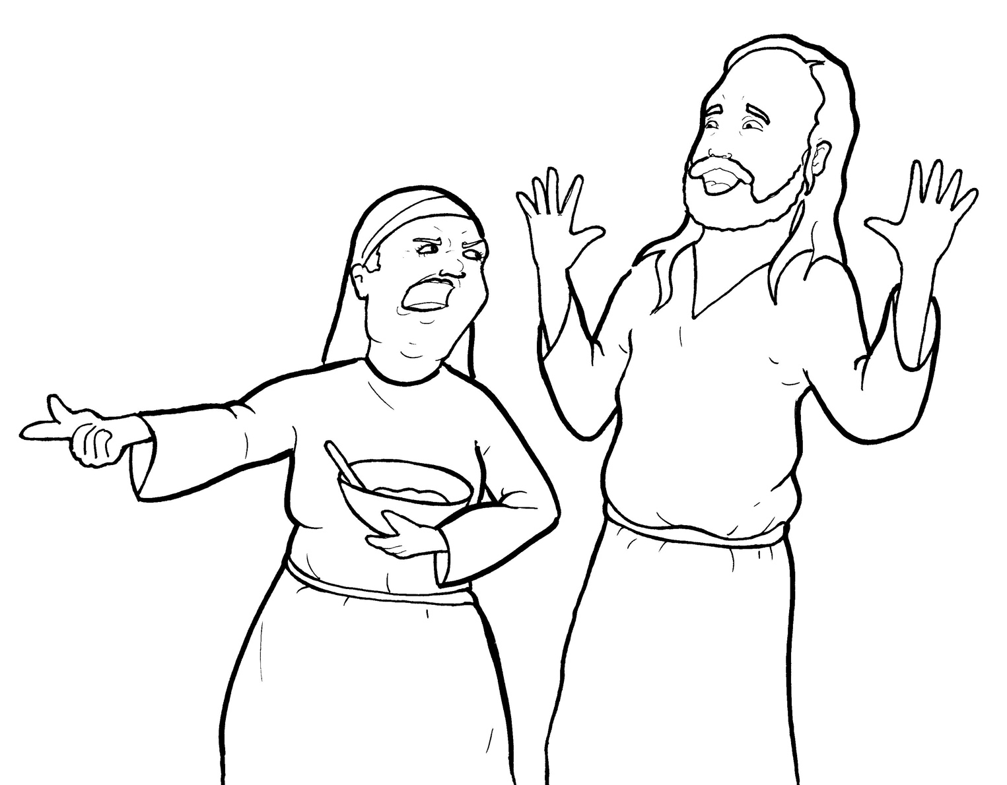
13. Martha Gets Mad
Part 2
New Words
Rule Breakers

Slide 2
Other Sounds – Soft C
ce, ci, cy make the soft sound
cent
city
fancy

Slide 3
dis ci ples

Slide 4
Other Sounds – Soft G
ge, gi, gy often make the soft sound
gentle
giant
gym

Slide 5
vil lage

Slide 6
Silent Letters
listen
talk
answered

Slide 7
Contractions
The first word stays the same,
and the apostrophe takes the place
of the missing letters in the second word.
do
n’t
=
do
not

Slide 8
Change y to i + suffix
worried
replied
fried

Slide 9
Rule Breakers
These words do not follow phonetic patterns.
said
from

Slide 10
do
his
to
was
into
welcome

Slide 11
are
is
the
of
floor
they

Slide 12
there
your
their
who
you
what

Slide 13
one
many
loved
only
busy

