Slide 1
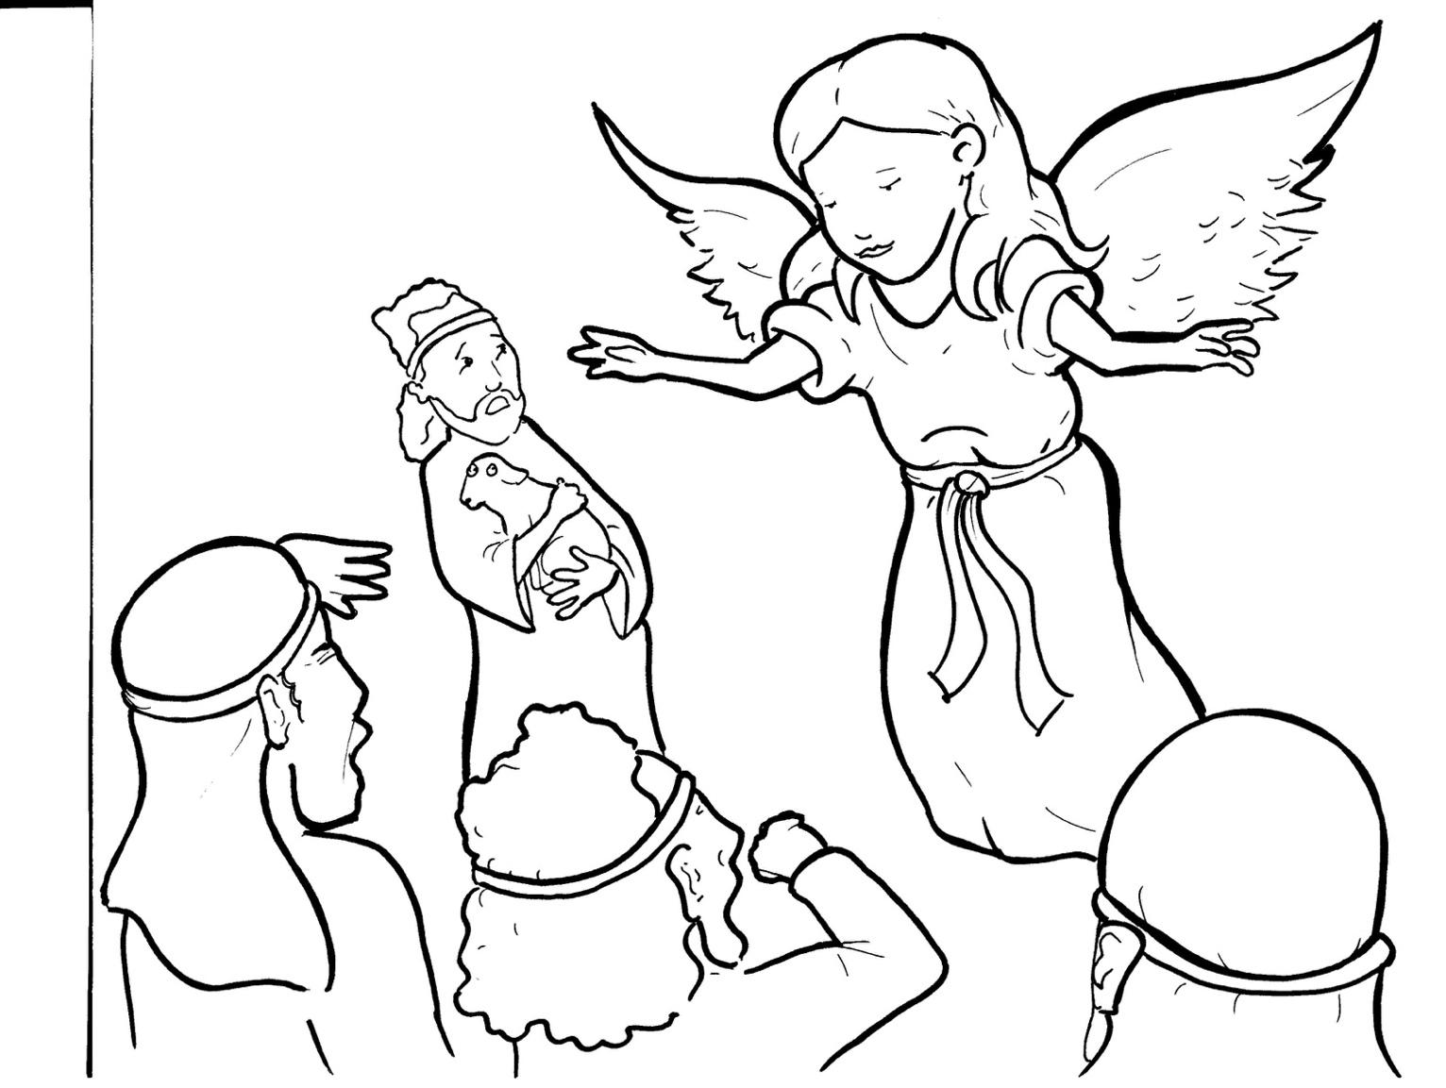
3. Shepherds Share the Good News
Part 2
New Words
Rule Breakers

Slide 2
Other Sounds – Soft C
ce, ci, cy make the soft sound
cent
city
fancy

Slide 3
peace

Slide 4
Other Sounds – Soft G
ge, gi, gy often make the soft sound
gentle
giant
gym

Slide 5
angel

Slide 6
New Words
shepherds
fields
warm
Savior

Slide 7
Bethlehem
Mary
Joseph
Christ

Slide 8
Rule Breakers
These words do not follow phonetic patterns.
the
of

Slide 9
been
said
was
one
to
many

Slide 10
everyone
their
there
great
from
where

Slide 11
were
they
what
who
has
everywhere

