Slide 1
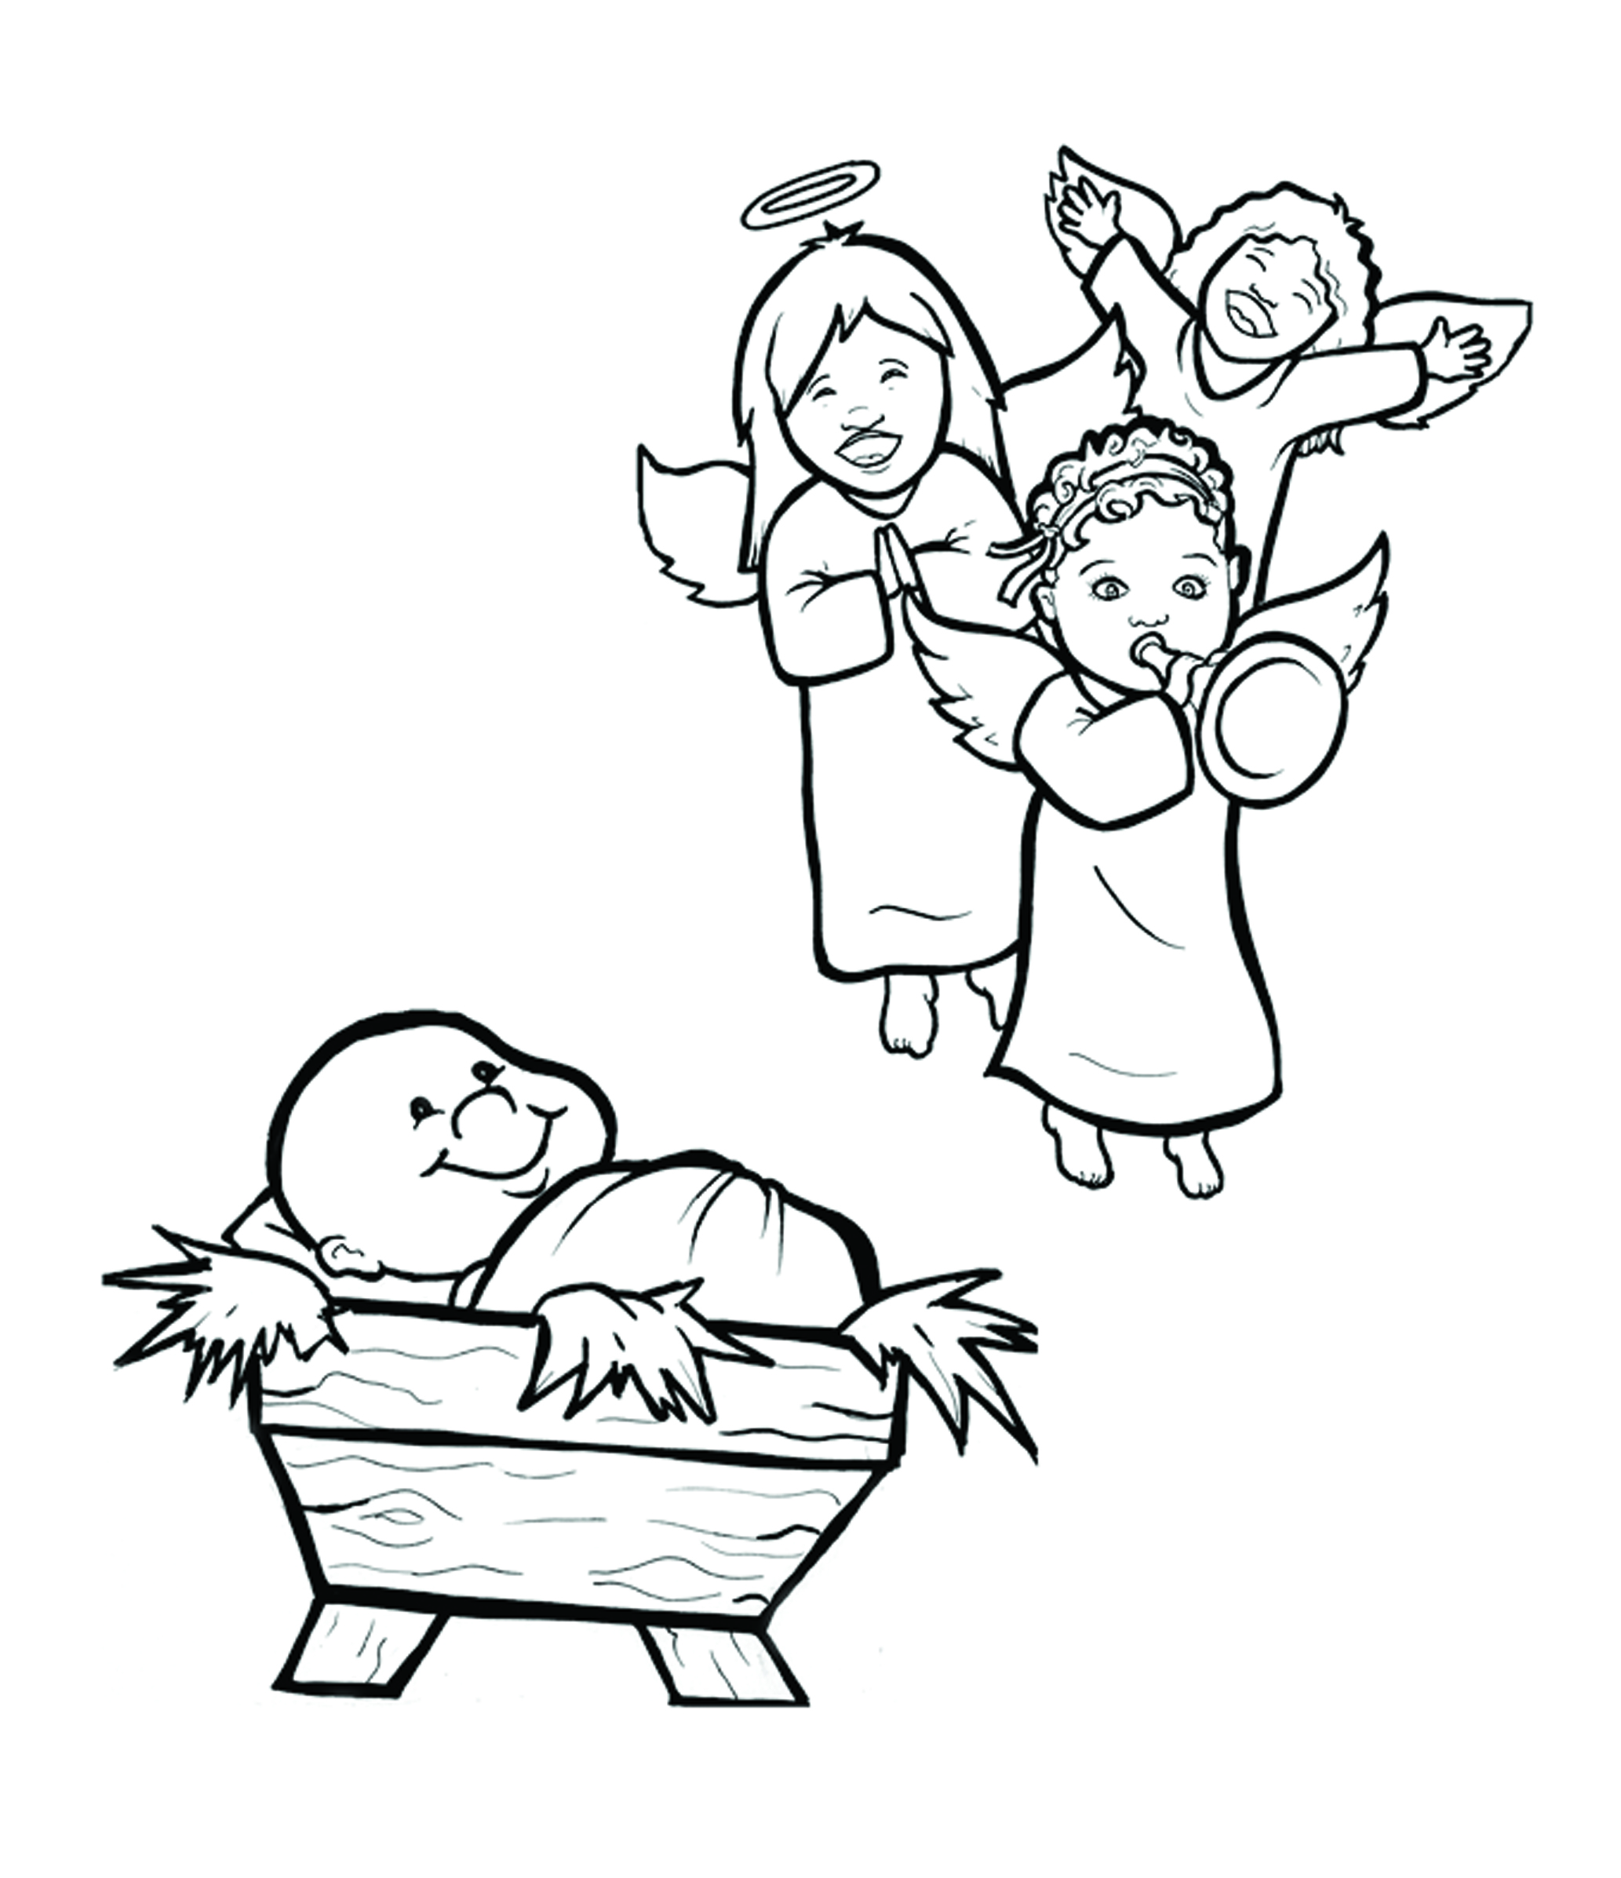
2. Happy Birthday, Jesus!
Part 5
Vocabulary
Original Bible Story

Slide 2
Vocabulary

Slide 3
enroll
(en -
ROLL):
register (sign up)

Slide 4
behold
HOLD):
(be -
see!

Slide 5
trough
(trough):
a box that holds food for barn animals

Slide 6
pledge
(pledge):
promise

Slide 7
Savior
vior):
(SA -
God who saves

Slide 8
multitude
(MUL -
ti -
tude):
a crowd

Slide 9
Happy Birthday, Jesus!
Luke 2:1-14
World English Bible (WEB)

Slide 10
Now in those days, a decree went out from Caesar Augustus that all the world should be enrolled.
It was the first enrollment made when Quirinius was governor of Syria.

Slide 11
All went to enroll themselves, everyone to his own city.
Joseph also went up from Galilee, out of the city of Nazareth, into Judea, to David’s city, which is called Bethlehem, because he was of the house and family of David;

Slide 12
to enroll himself with Mary, who was pledged to be married to him as wife, being pregnant.
While they were there, the day had come for her to give birth.

Slide 13
She gave birth to her firstborn son.
She wrapped him in bands of cloth, and laid him in a feeding trough, because there was no room for them in the inn.

Slide 14
There were shepherds in the same country staying in the field, and keeping watch by night over their flock.
Behold, an angel of the Lord stood by them, and the glory of the Lord shone around them, and they were terrified.

Slide 15
The angel said to them, “Don’t be afraid, for behold, I bring you good news of great joy which will be to all the people.
For there is born to you today, in David’s city, a Savior, who is Christ the Lord.

Slide 16
This is the sign to you: you will find a baby wrapped in strips of cloth, lying in a feeding trough.”
Suddenly, there was with the angel a multitude of the heavenly army praising God, and saying,

Slide 17
“Glory to God in the highest, on earth peace, good will toward men.”

