Slide 1
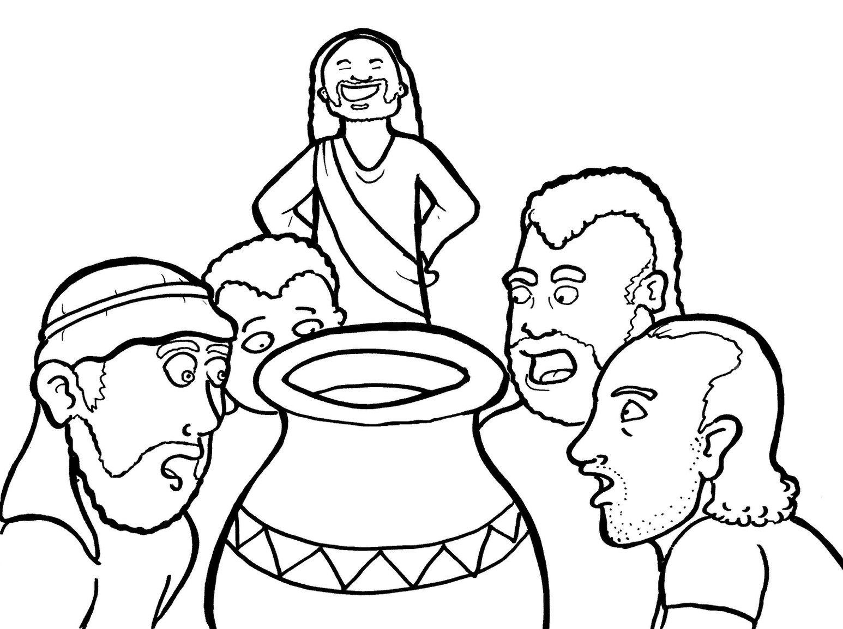
15. Jesus Saves a Wedding
Part 2
New Words
Rule Breakers

Slide 2
Other Sounds – Soft C
ce, ci, cy make the soft sound
cent
city
fancy

Slide 3
dis ci ples

Slide 4
dance

Slide 5
Other Sounds – Soft G
ge, gi, gy often make the soft sound
gentle
giant
gym

Slide 6
charge

Slide 7
Silent Letters
sign

Slide 8
New Words
Cana
bride
miracle
groom

Slide 9
Rule Breakers
These words do not follow phonetic patterns.

Slide 10
some
said

Slide 11
to
into
do
of
is
has

Slide 12
was
the
you
what
love
would

Slide 13
they
there
mother
everyone
people
water

