Slide 1

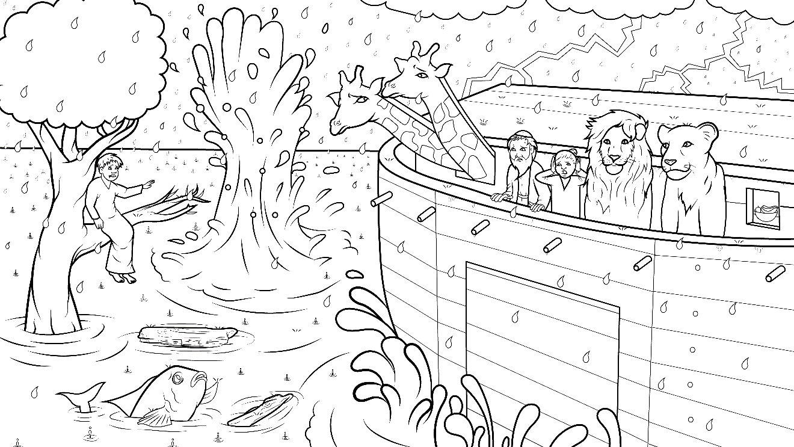
Story 1.7 Splish Splash
Noah’s Ark, Part 1
Genesis 6-7 (sh)

Slide 2
New Words to Read
shock shut
ship Shem shelf
fresh slosh

Slide 3
New Words to Read
dash crash
flash smash trash
slpash stash (to put away)

Slide 4
New Words to Read
wish fish dish
swish splish squish

Slide 5
New Words to Read
hush gush
rush crush

Slide 6
Rule Breakers
(Read and Spell)
was said is
the into of

Slide 7
Sight Words
so begin
Noah

Slide 8
Story1.7 Splish Splash
I Read, You Read Bible Story
Noah’s Ark, Part 1 (sh)
Genesis 6-7

Slide 9


As the world filled with people,
God’s heart broke.
God was sad.

Slide 10
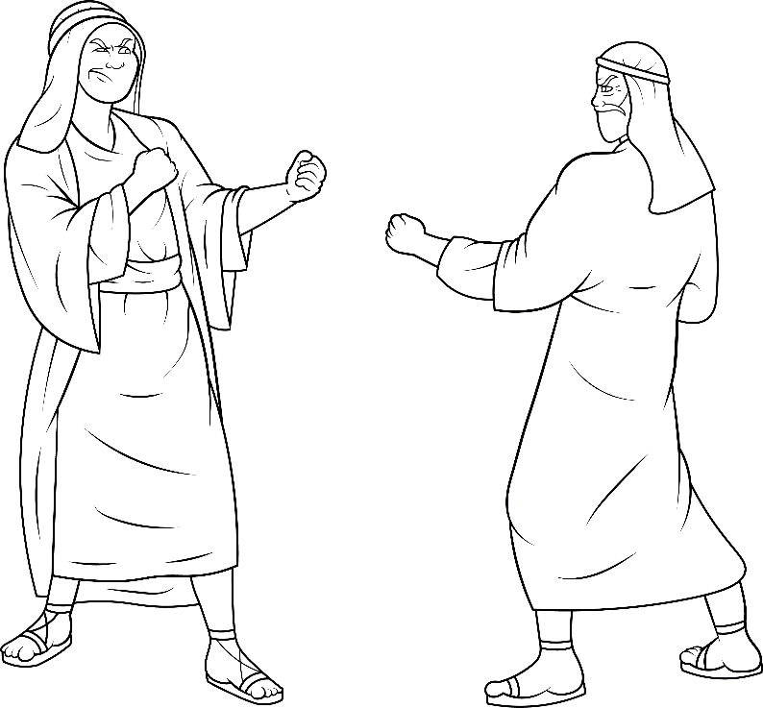
Why?
Because so many of them
had been
bad, bad, bad.

Slide 11
They hurt and killed each other.
Only Noah was good.

Slide 12
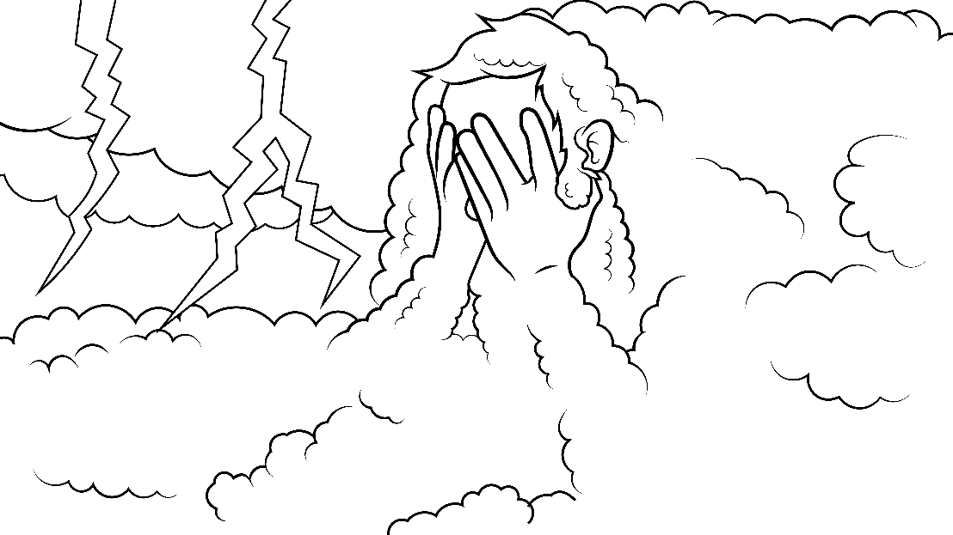
God is all love, but He could not let the badness go on.

Slide 13
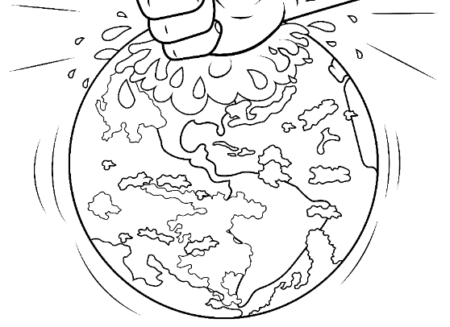
God said, “I must crush men. I am so mad.”
“I will wipe out
every person and animal.”

Slide 14
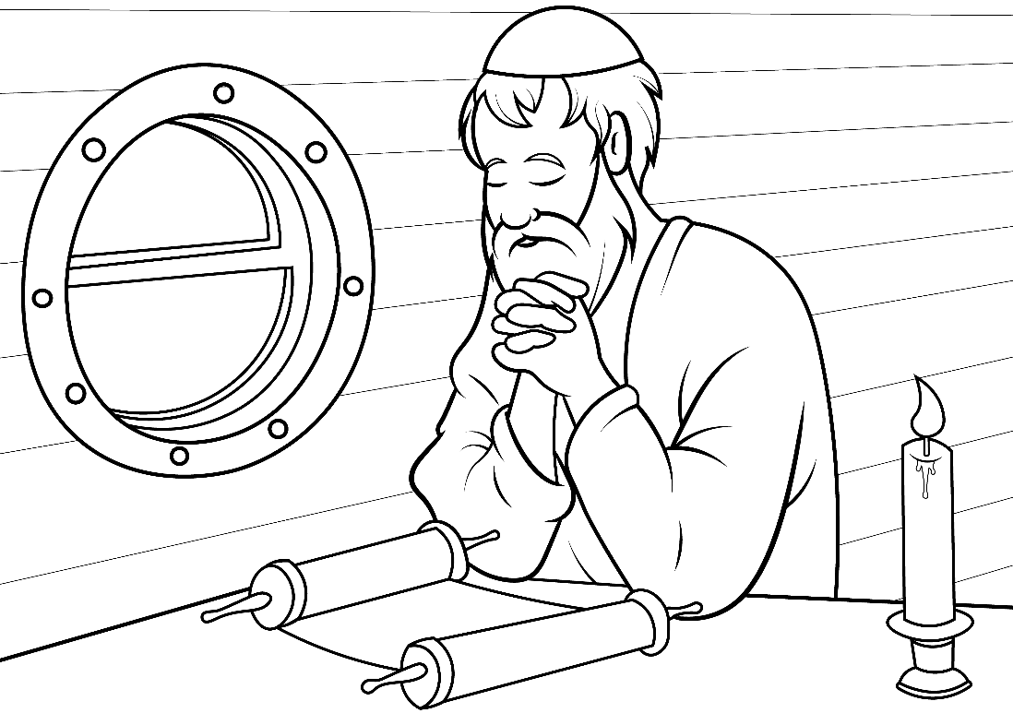
“But I am not mad at Noah.”
Noah had three sons:
Japheth, Ham and Shem.

Slide 15
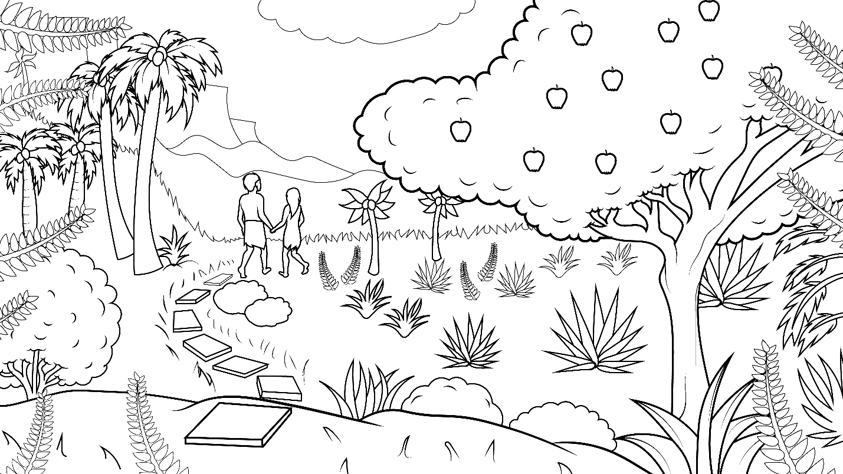
God said, “I wish to begin fresh.”

Slide 16
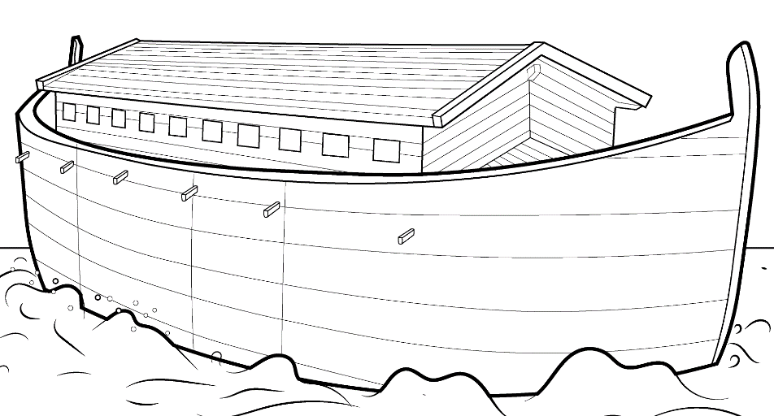
God told Noah to make an ark.
What is an ark?
It is a big, big ship.

Slide 17

Noah said, “Rush, stash. Stash the dish on
the shelf
and food for our
family and the animals that God will bring.”

Slide 18
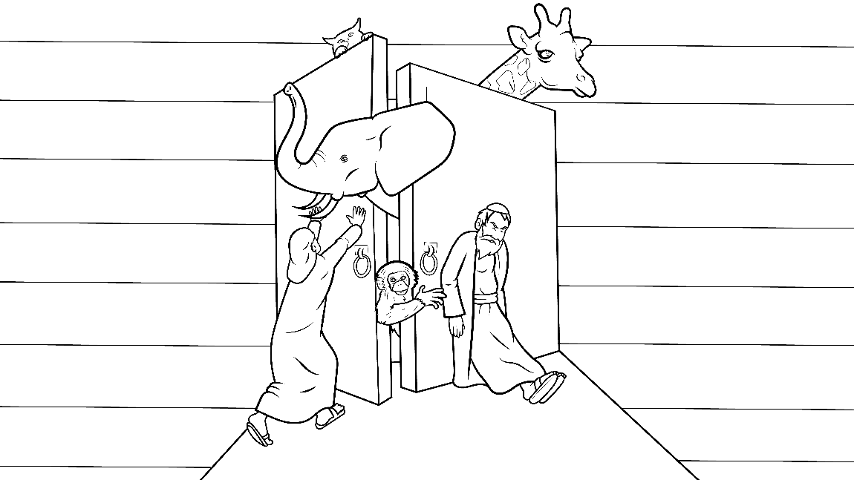
In a dash,
in a rush.
Squish into
the ship.
Crash!
Flash!

Slide 19
Thunder, lightning, and
rain, rain, rain.
God shut the big
door of the ship.
Crash! Rush!

Slide 20
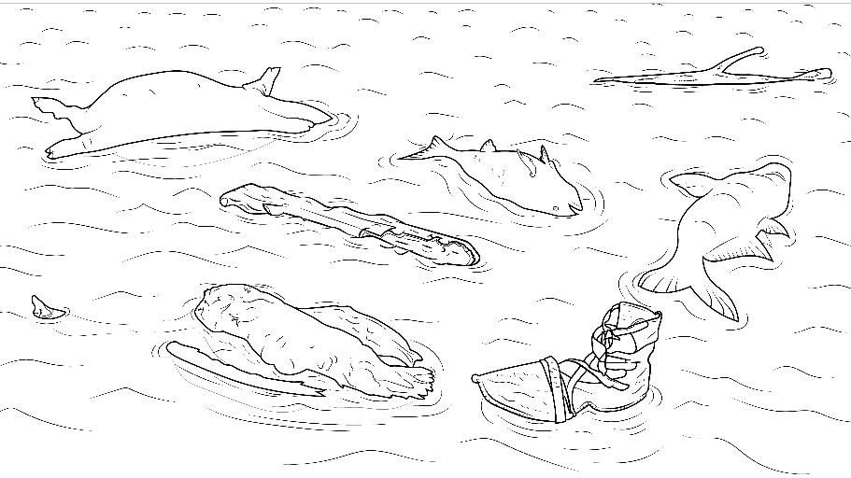
Slosh, gush, smash, trash.
Swish went the fish.
Splish, splash…
up, up, up went the ship. Shock, hushhhh...

Slide 21
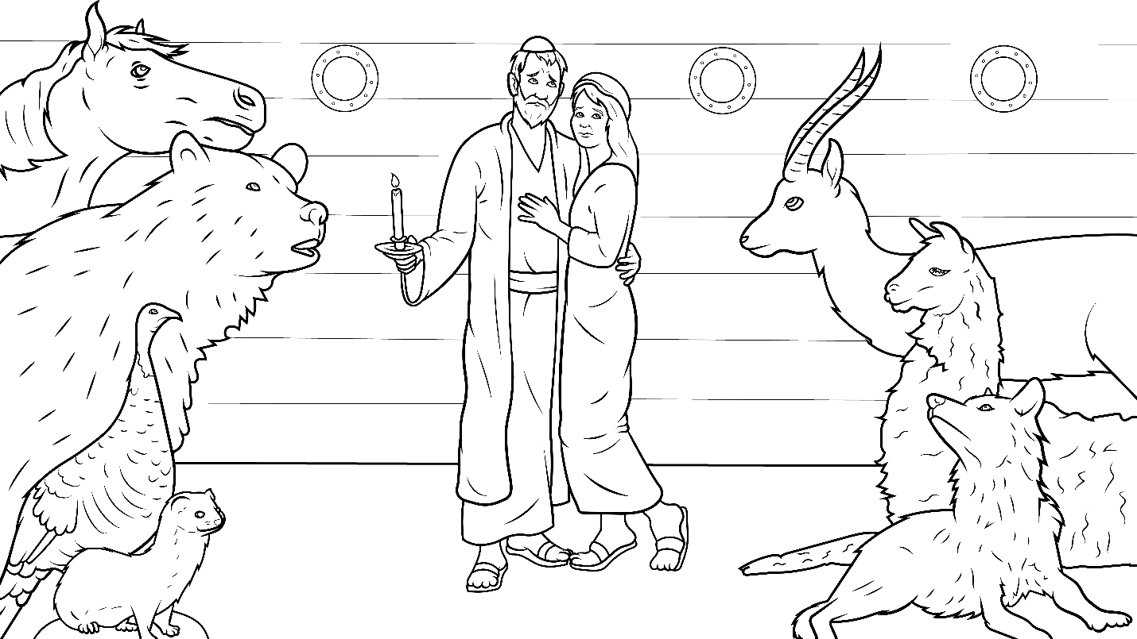
All was quiet.
All was gone,
except for Noah and his family.

Slide 22
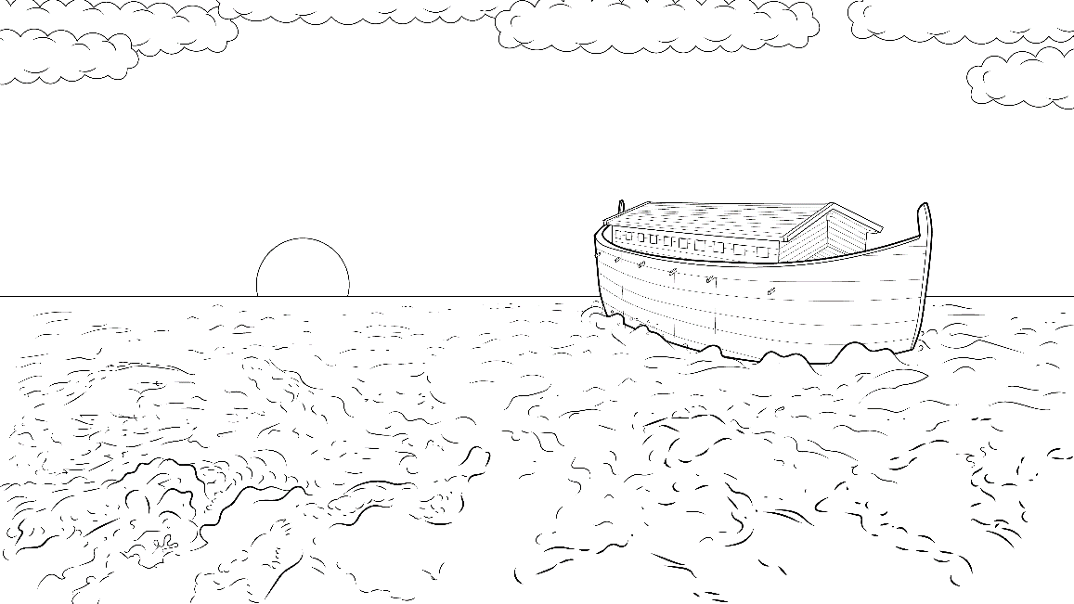
They were safe in the ark while the world floated away.

Slide 23
The End

Slide 24
1.7 Story Without Illustrations
Splish Splash
Genesis 6 - 7

Slide 25
As the world filled with people,
God’s heart broke.
God was sad.
Why? Because so many of them
had been bad, bad, bad.

Slide 26
They hurt and killed each other.
Only Noah was good.
God is all love, but He could not let the badness go on.

Slide 27
God said,
“I must crush men.
I am so mad. I will wipe out every person and animal.”

Slide 28
But I am not mad at Noah.”
Noah had three sons: Japheth,
Ham and Shem. God said, “I wish to begin fresh.”

Slide 29
God told Noah to make an ark.
What is an ark?
It is a big, big ship.

Slide 30
Noah said, “Rush, stash. Stash the dish on the shelf
and food for our family and the animals that God will bring.”

Slide 31
In a dash, in a rush. Squish into the ship. Crash! Flash!
Thunder, lightning, and rain, rain, rain.
God shut the big door of the ship. Crash! Rush!

Slide 32
Slosh, gush, smash, trash. Swish went the fish.
Splish, splash… up, up, up went the ship. Shock, hushhhh...

Slide 33
All was quiet. All was gone, except for Noah and his family.
They were safe in the ark while the world floated away.

Slide 34
The End

Slide 35
Story: Carol Hale
Illustrations: Ivan Mader
Power Point arrangements: Steve March
www.EasyReadEnglish.com
www.EZReadEnglish.org/lower-levels

