Slide 1

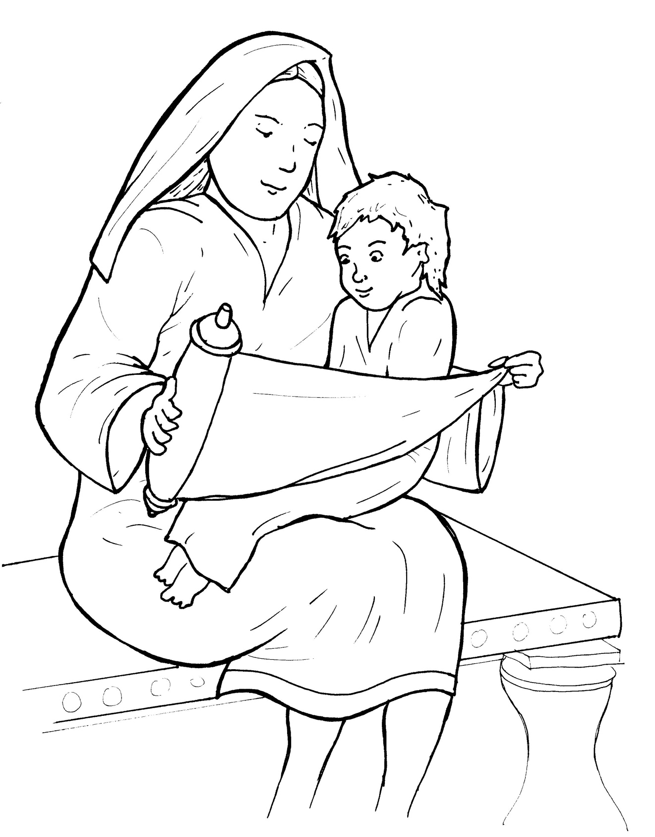
6. Jesus Grows Up
Part 3
Syllable Divisions

Slide 2
Dividing Words
Into Syllables

Slide 3
Rabbit Words
When you see two consonants
between two vowels,
divide between the consonants.
ra it
bb
rab bit

Slide 4
Mes si ah
Messiah

Slide 5
hid den
hidden

Slide 6
car pen ter
carpenter

Slide 7
sis ter
sister

Slide 8
Scrip tures
Scriptures

Slide 9
wis dom
wisdom

Slide 10

Tiger Words
When you see one consonant
between two vowels,
divide after the first vowel.
Try this pattern first.
ti er
g
ti ger

Slide 11
Je sus
Jesus

Slide 12
Jo seph
Joseph

Slide 13
ho ly
holy

Slide 14
fa vor
favor

Slide 15
Camel Words
When you see one consonant
between two vowels,
divide after the first consonant.
Try this pattern second.
ca el
m
cam el

Slide 16
nev er
never

Slide 17
Naz a reth
Nazareth

Slide 18
Turtle Words
When you see consonant-l-e,
count back three and divide.
tur
t
l
e
tur tle

Slide 19
peo ple
people

Slide 20
Lion Words
If a word has two vowels together
that make two different sounds,
divide between the two vowels.
lion
li on

Slide 21
qui et
quiet

Slide 22
Mes si ah
Messiah

Slide 23

Anteater Words
These compound words are made up of two smaller words.
ant
eater
1
2
ant eater

Slide 24
every one
everyone

Slide 25

Foxes Suffixes
Focus on your base word.
fox es
fox es

Slide 26
greet ed
greeted

Slide 27
pound ed
pounded

Slide 28
helped
helped

Slide 29
obeyed
obeyed

Slide 30
sinned
sinned

Slide 31
lied
lied

Slide 32
filled
filled

Slide 33
bowed
bowed

Slide 34
loved
loved

Slide 35
Other Syllable Divisions
Some words don’t fit so neatly
into standard syllable division patterns.
a way
away

Slide 36
a bout
about

Slide 37
se cret
secret

