Slide 1

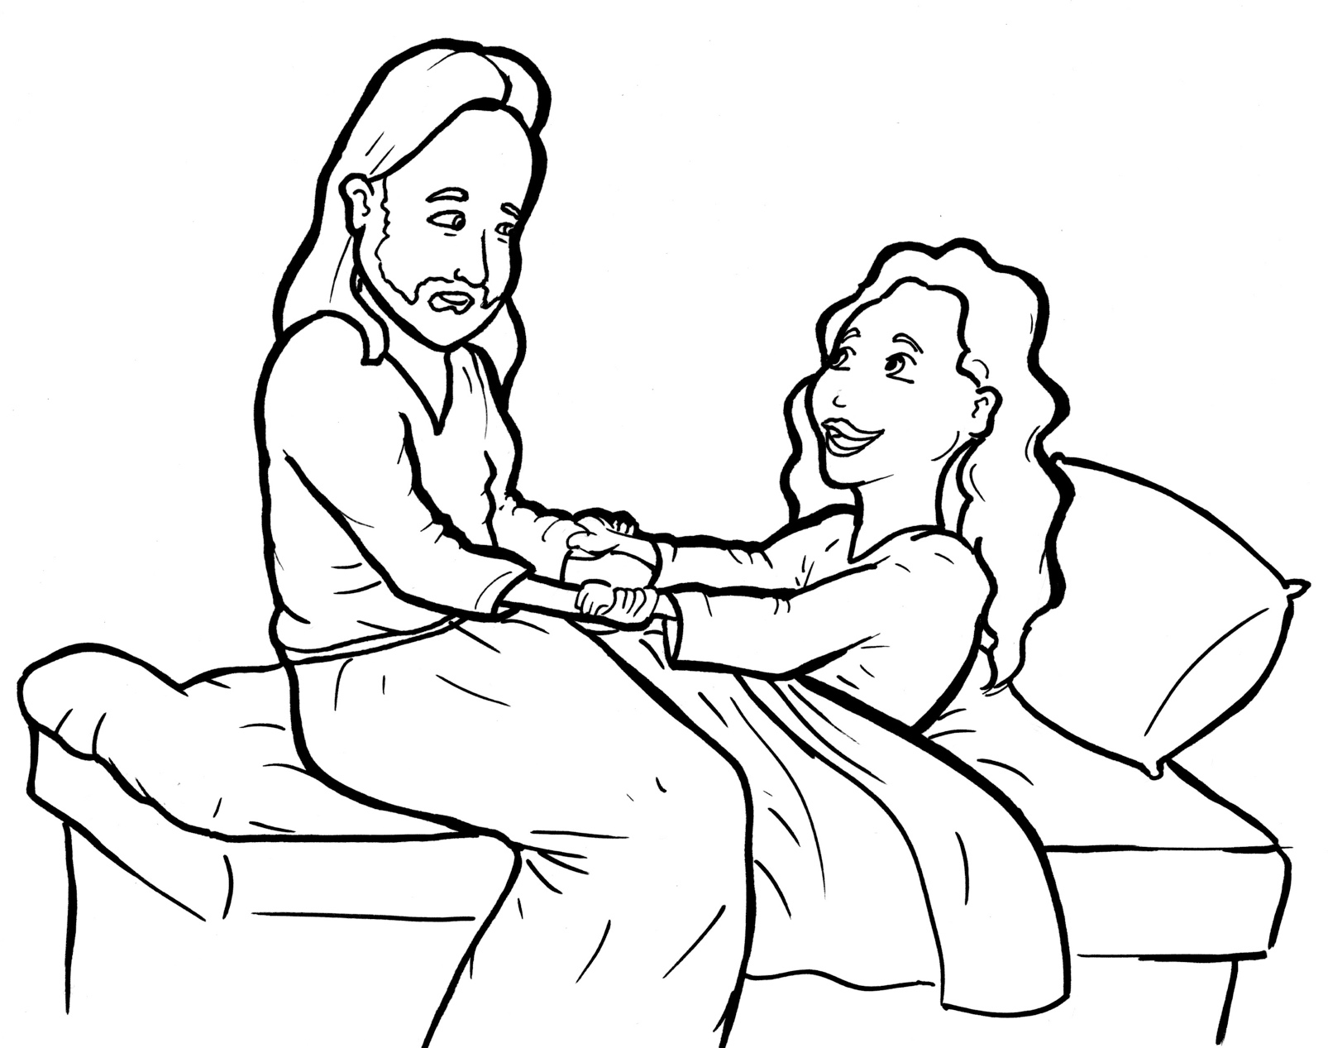
Part 3
30. Jesus Raises a Dead Girl to Life
Syllable Divisions

Slide 2

Dividing Words
Into Syllables

Slide 3
Tiger Words
When you see one consonant
between two vowels,
divide after the first vowel.
Try this pattern first.
ti er
g
ti ger

Slide 4
Je sus
Jesus

Slide 5
be lieve
believe

Slide 6
mu sic
music

Slide 7
fa ces
faces

Slide 8
Camel Words
When you see one consonant
between two vowels,
divide after the first consonant.
Try this pattern second.
ca el
m
cam el

Slide 9
nev er
never

Slide 10
ev er y
every

Slide 11
Jew ish
Jewish

Slide 12
Turtle Words
When you see consonant-l-e,
count back three and divide.
tur
t
l
e
tur tle

Slide 13
peo ple
people

Slide 14
lit tle
little

Slide 15

Anteater Words
These compound words are made up of two smaller words.
ant
eater
1
2
ant eater

Slide 16
in side
inside

Slide 17
any more
anymore

Slide 18
every one
everyone

Slide 19

Foxes Suffixes
Focus on your base word.
fox es
fox es

Slide 20
cry ing
crying

Slide 21
dy ing
dying

Slide 22
lead er
leader

Slide 23
loud ly
loudly

Slide 24
rais es
raises

Slide 25
face s
faces

Slide 26
Jew ish
Jewish

Slide 27
cried
cried

Slide 28
died
died

Slide 29
healed
healed

Slide 30
filled
filled

Slide 31
begged
begged

Slide 32
laughed
laughed

Slide 33
walked
walked

Slide 34
Other Syllable Divisions
Some words don’t fit so neatly
into standard syllable division patterns.

Slide 35
a fraid
afraid

Slide 36
a sleep
asleep

Slide 37
a way
away

Slide 38
a round
around

Slide 39
a mazed
amazed

Slide 40
daught er
daughter

Slide 41
both er
bother

