Slide 1
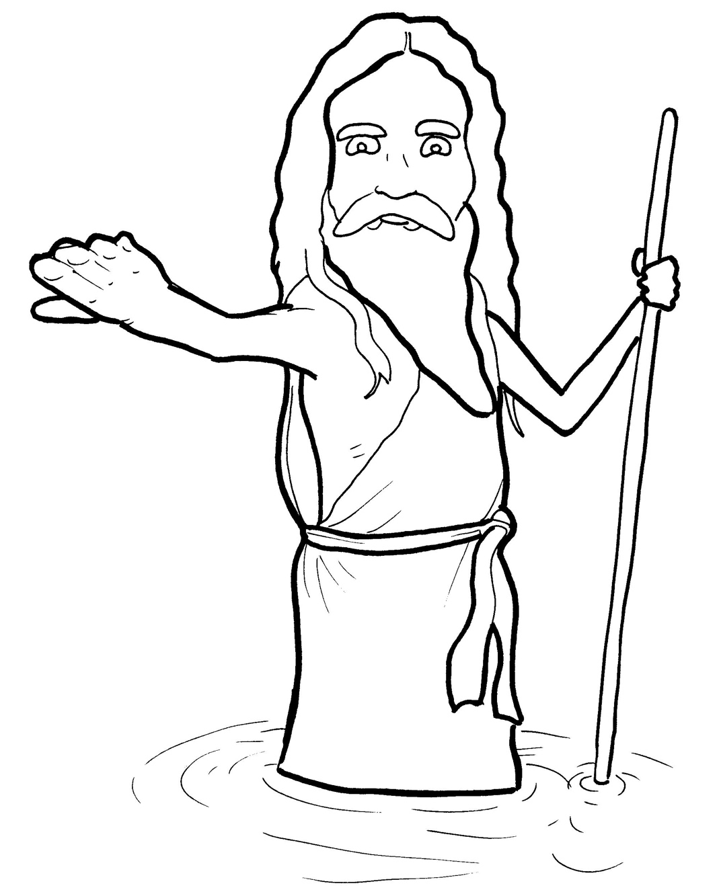
8. John the Baptist Points to Jesus
Part 5
Vocabulary
Original Bible Story

Slide 2
Vocabulary

Slide 3
prophet
(PROPH -
et):
a person who speaks for God

Slide 4
preach
(preach):
to teach about God
through speaking

Slide 5
confess
(con -
FESS):
to tell the truth
about what you did

Slide 6
baptize
(BAP-
tize):
to show the world you follow Jesus using a water custom

Slide 7
repent
PENT):
(re -
to be sorry for your sins

Slide 8
locust
(LO -
cust):
a grasshopper

Slide 9
John the Baptist
Points to Jesus
Mark 1:1-8
World English Bible (WEB)

Slide 10
The beginning of the Good News of Jesus Christ, the Son of God.

Slide 11
As it is written in the prophets, “Behold, I send my messenger before your face, who will prepare your way before you:

Slide 12
the voice of one crying in the wilderness,
‘Make ready the way of the Lord!
^{Make his paths straight!’ ”}

Slide 13
John came baptizing in the wilderness and preaching the baptism of repentance for the forgiveness of sins.

Slide 14
All the country of Judea and all those of Jerusalem went out to him.

Slide 15
They were baptized by him in the Jordan river, confessing their sins.

Slide 16
John was clothed with camel’s hair and a leather belt around his waist.

Slide 17
^{He ate locusts and wild honey.}
He preached, saying, “After me comes he who is mightier than I, the thong of whose sandals I am not worthy to stoop down and loosen.

Slide 18
I baptized you in water, but he will baptize you in the Holy Spirit.”

