Slide 1

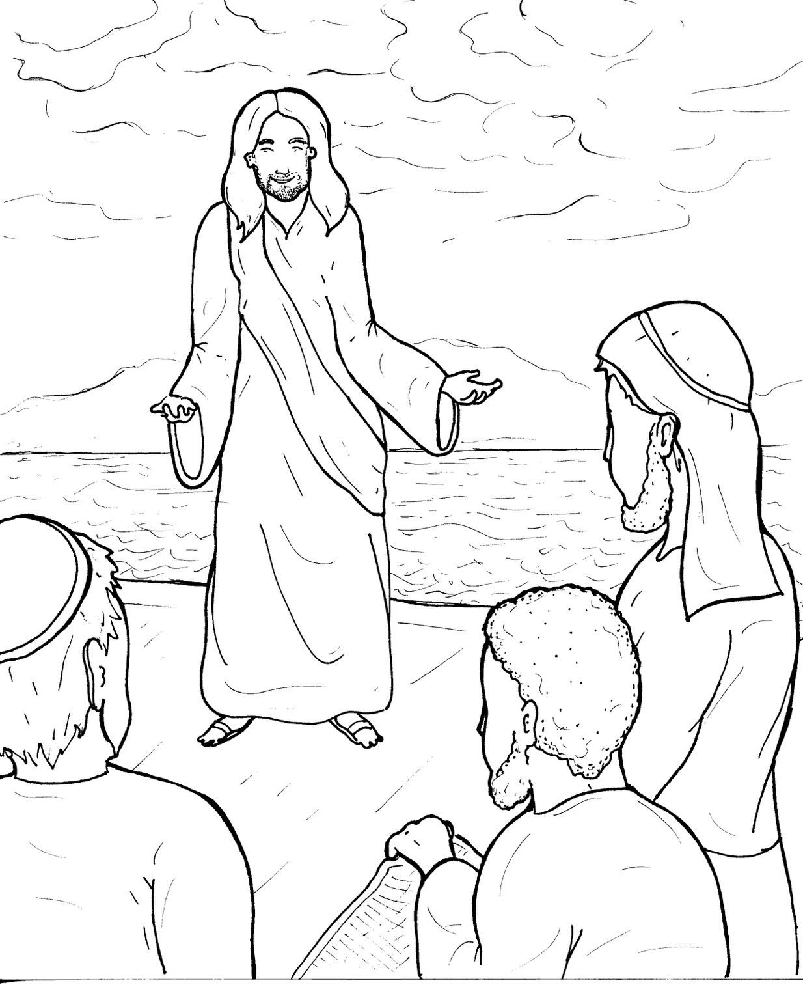
10. Jesus Calls Followers
Part 3
Syllable Divisions

Slide 2
Dividing Words
Into Syllables

Slide 3
Rabbit Words
When you see two consonants
between two vowels,
divide between the consonants.
ra it
bb
rab bit

Slide 4
fol low
follow

Slide 5
col lect
collect

Slide 6
sit ting
sitting

Slide 7
mes sage
message

Slide 8
dis ci ples
disciples

Slide 9
Thad deus
Thaddeus

Slide 10
un til
until

Slide 11

Tiger Words
When you see one consonant
between two vowels,
divide after the first vowel.
Try this pattern first.
ti er
g
ti ger

Slide 12
Je sus
Jesus

Slide 13
Si mon
Simon

Slide 14
Pe ter
Peter

Slide 15
Le vi
Levi

Slide 16
Ju das
Judas

Slide 17
e vil
evil

Slide 18
re turn
return

Slide 19
Camel Words
When you see one consonant
between two vowels,
divide after the first consonant.
Try this pattern second.
ca el
m
cam el

Slide 20
Gal il lee
Gallilee

Slide 21
Phil ip
Philip

Slide 22
Thom as
Thomas

Slide 23
Turtle Words
When you see consonant-l-e,
count back three and divide.
tur
t
l
e
tur tle

Slide 24
dis ci ple
disciple

Slide 25
peo ple
people

Slide 26
Hamster Words
When you see three consonants between two vowels,
divide after the first consonant.
ha
mst
er
ham ster

Slide 27
An drew
Andrew

Slide 28
Lion Words
If a word has two vowels together
that make two different sounds,
divide between the two vowels.
lion
li on

Slide 29
Thadde us
Thaddeus

Slide 30

Anteater Words
These compound words are made up of two smaller words.
ant
eater
1
2
ant eater

Slide 31
be side
beside

Slide 32
fisher man
fisherman

Slide 33
Other Syllable Divisions
Some words don’t fit so neatly
into standard syllable division patterns.
spir its
spirits

Slide 34

Foxes Suffixes
Focus on your base word.
fox es
fox es

Slide 35
walk ing
walking

Slide 36
throw ing
throwing

Slide 37
sit ting
sitting

Slide 38
pray ing
praying

Slide 39
followed
followed

Slide 40
healed
healed

Slide 41
returned
returned

Slide 42
called
called

Slide 43
collect ed
collected

Slide 44
tax es
taxes

Slide 45
follow ers
followers

