Slide 1
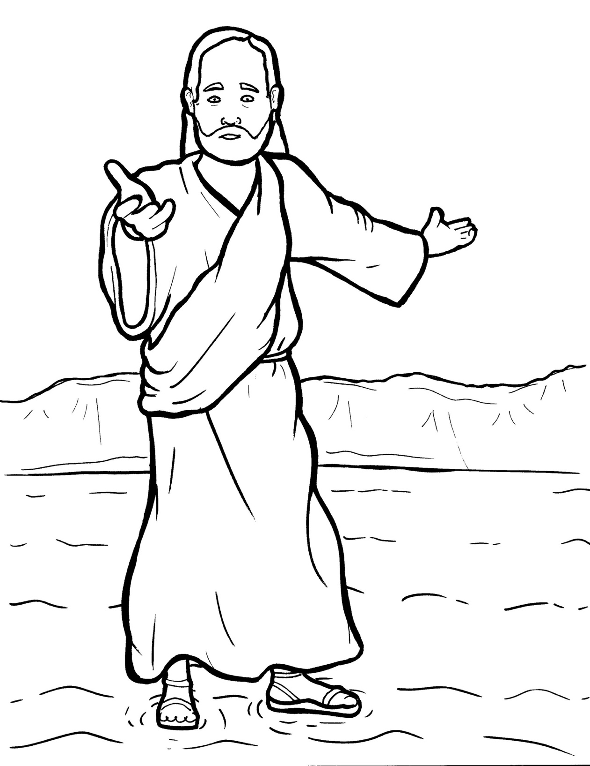
19. Jesus Walks on the Water
Part 4
Story in Easy Read English
Questions
Story in Phrases

Slide 2
Jesus went up into the hills to pray.

Slide 3
He was alone, and it was night.

Slide 4
His disciples were in a boat.

Slide 5
A strong wind pushed their boat across the water.

Slide 6
They had to pull hard on the oars.

Slide 7
Jesus went down to the lake.

Slide 8
He walked right on top of the water!

Slide 9
The disciples were very afraid.

Slide 10
"It is a ghost!" they cried in fear.

Slide 11
"No. It is I," Jesus said. "Be brave. Do not be afraid."

Slide 12
"Lord, if it is really you, tell me to join you on the water," Peter said.

Slide 13
"Come," Jesus said.

Slide 14
Peter got out of the boat and walked on top of the water to Jesus.

Slide 15
But, he saw the waves and felt the wind.

Slide 16
He got afraid and started to sink.

Slide 17
"Lord, save me!" Peter cried.

Slide 18
Jesus reached out his hand and helped him.

Slide 19
The wind died down.

Slide 20
The boat arrived at the shore, just like that.

Slide 21
The disciples were amazed.

Slide 22
They said, "Truly, you are the Son of God."

Slide 23
Question 1
What did Jesus do that made the disciples afraid?

Slide 24
Question 2
When did Peter start to sink?

Slide 25
Question 3
What was Peter's prayer?

Slide 26
Question 4
How can you keep your eyes on Jesus when you get afraid?

Slide 27
Prayer
Dear Jesus,
Sometimes I get afraid. Please help me to keep my eyes on you when fears come over me.
Amen

Slide 28
Jesus Walks on the Water
Phrased for Fluency

Slide 29
Jesus
went up
into the hills
to pray.

Slide 30
He was alone,
and it was night.

Slide 31
His disciples
were
in a boat.

Slide 32
A strong wind
pushed
their boat
across the water.

Slide 33
They had to
pull hard
on the oars.

Slide 34
Jesus went down
to the lake.

Slide 35
He walked
right on top
of the water!

Slide 36
The disciples
were very afraid.

Slide 37
"It is a ghost!"
they cried
in fear.

Slide 38
"No.
It is I,"
Jesus said.

Slide 39
"Be brave.
Do not
be afraid."

Slide 40
"Lord,
if it is
really you,

Slide 41
tell me
to join you
on the water,"
Peter said.

Slide 42
“Come,”
Jesus said.
Peter got out
of the boat
and walked
on top
of the water
to Jesus.

Slide 43
But,
he saw
the waves
and felt the wind.

Slide 44
He got afraid
and started
to sink.

Slide 45
"Lord,
save me!"
Peter cried.

Slide 46
Jesus
reached out
his hand
and helped him.

Slide 47
The wind died down.

Slide 48
The boat arrived
at the shore,
just like that.

Slide 49
The disciples
were amazed.

Slide 50
They said,
"Truly,
you are
the Son of God."

