Slide 1

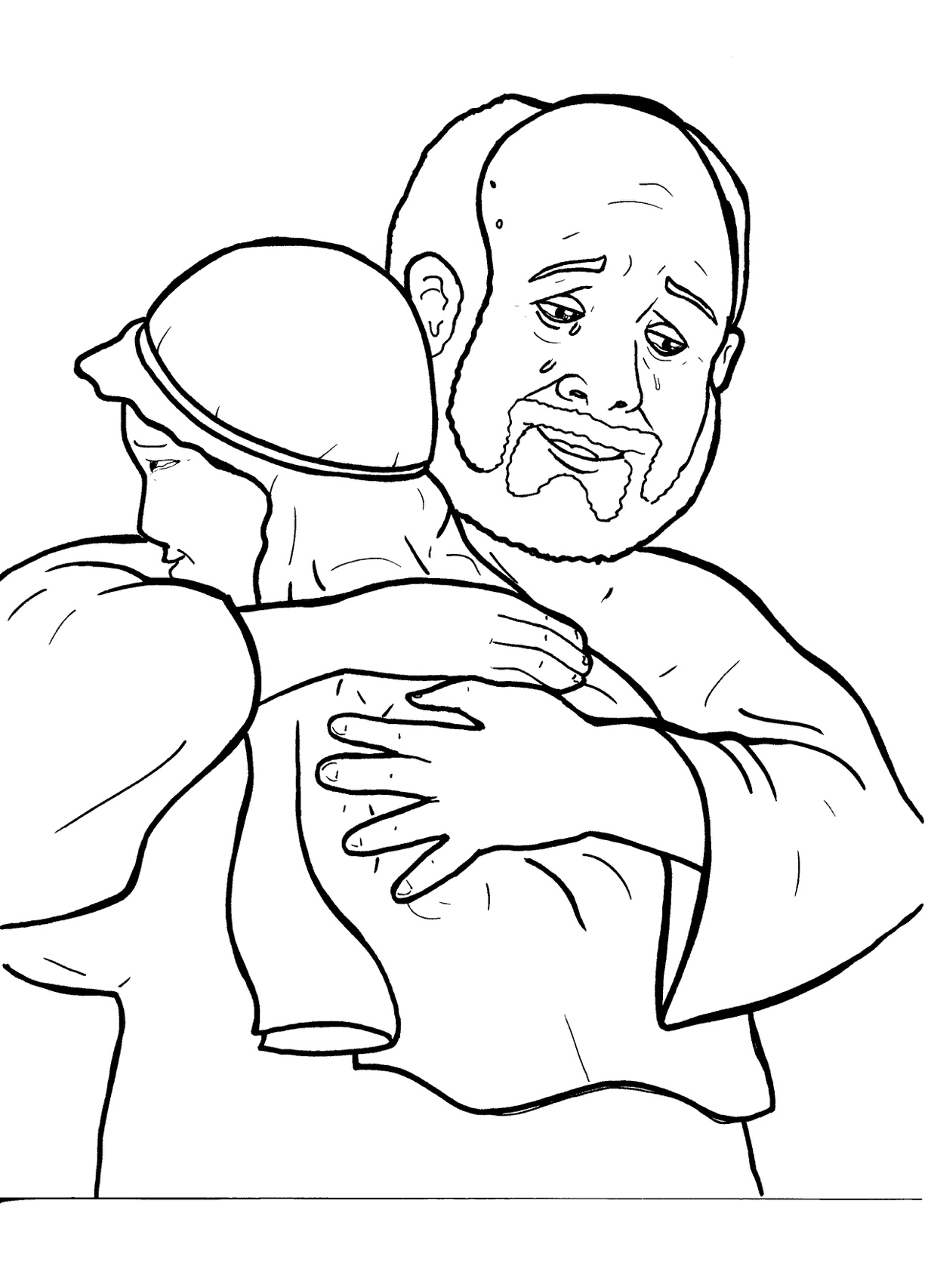
Part 4
24. The Lost Son
Story in Easy Read English
Questions
Story in Phrases

Slide 2
Jesus told this story: A man had two
sons.

Slide 3
The younger son said, “Father, give
me my part of your money right now.

Slide 4
I will not wait until you die.”

Slide 5
So, the father gave the son his
money.

Slide 6
The son ran off to a city far away.

Slide 7
He spent money on parties, drinks,
and women.

Slide 8
Soon his money was gone, and so
were his friends.

Slide 9
The young man got hungry.

Slide 10
No one gave him anything.

Slide 11
He asked a farmer for a job.

Slide 12
He had to feed the pigs.

Slide 13
Even the pigs’ nasty food looked
good to the hungry man.

Slide 14
He thought, “I will go back and ask
my father for a job.”

Slide 15
He walked all the way home.

Slide 16
The father saw him coming down
the road and ran to his son.

Slide 17
The father hugged him.

Slide 18
“Father, I have sinned,” said the son.

Slide 19
The father kissed him and held a big
party.

Slide 20
“I thought my son was dead, but he
is alive!

Slide 21
He was lost and now is found.”

Slide 22
The older son heard the music.

Slide 23
He yelled, “It’s not fair! I have been
a good son.

Slide 24
I never got a party.”

Slide 25
The father said, “Son, all that I have
is yours.

Slide 26
But let’s be happy.

Slide 27
Your brother was dead and is alive.

Slide 28
He was lost and is found!”

Slide 29
Question 1
What happened when the son went to live in a city far away?

Slide 30
Question 2
How did the father act when his son came home?

Slide 31
Question 3
How is the father in the story like our father in heaven?

Slide 32
Question 4
If you have ever been lost and then found, how did you feel?

Slide 33
Prayer
Dear Father in heaven,
Thank you for forgiving me when I sin and wander away from you. Thank you for letting me always return home to your loving, forgiving, happy arms.
Amen

Slide 34
The Lost Son
Phrased for Fluency

Slide 35
Jesus
told this story:
A man
had two sons.

Slide 36
The younger son said,
“Father,
give me my part
of your money
right now.

Slide 37
I will not wait
until you die.”

Slide 38
So,
the father
gave the son
his money.

Slide 39
The son
ran off
to a city
far away.

Slide 40
He spent money
on parties,
drinks,
and women.

Slide 41
Soon
his money was gone,
and so were
his friends.

Slide 42
The young man
got hungry.
No one
gave him anything.

Slide 43
He asked a farmer
for a job.
He had to feed
the pigs.

Slide 44
Even the pigs’
nasty food
looked good
to the hungry man.

Slide 45
He thought,
“I will go back
and ask my father
for a job.”

Slide 46
He walked
all the way home.

Slide 47
The father
saw him coming
down the road
and ran
to his son.

Slide 48
The father hugged him.
“Father,
I have sinned,”
said the son.

Slide 49
The father kissed him
and held a big party.

Slide 50
“I thought my son
was dead,
but he is alive!

Slide 51
He was lost
and now is found.”

Slide 52
The older son
heard the music.
He yelled,
“It’s not fair!

Slide 53
I have been
a good son.
I never got
a party.”

Slide 54
The father said,
“Son,
all that I have
is yours.

Slide 55
But
let’s be happy.

Slide 56
Your brother was dead
and is alive.

Slide 57
He was lost
and is found!”

