Slide 1
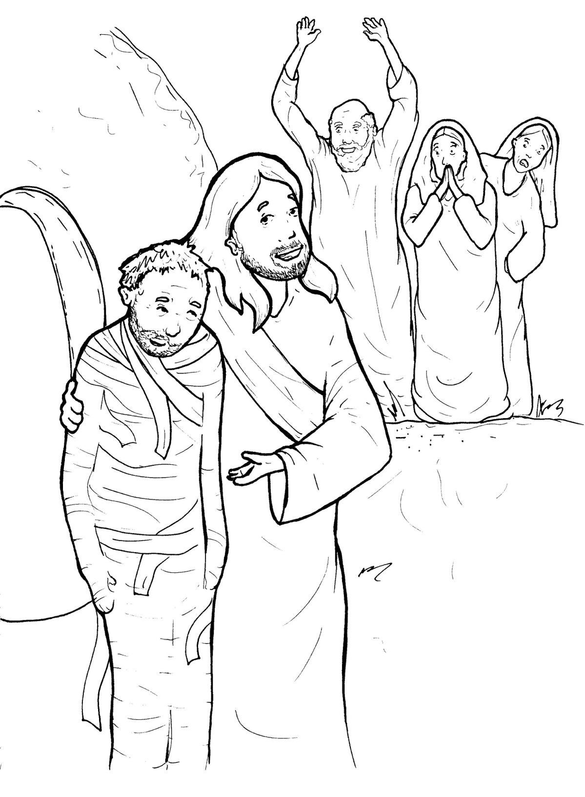
Part 1
33. Lazarus Lives Again
Syllable Charts

Slide 2
Words in Syllable Types

Slide 3
Closed – Short Vowel
A closed syllable has one vowel
followed by one or more consonants,
and the vowel is short.
st
o
p
˘

Slide 4
Timing
Box
af-
that
Laz-
-mand
wrap
and

Slide 5
Timing
Box
men
yes
res-
-rec-
Mes-
end

Slide 6
Timing
Box
when
-ness
wept
ev-

Slide 7
Timing
Box
sick
this
will
still
sis-
with

Slide 8
Timing
Box
bod-
God
rock

Slide 9
Timing
Box
but
-sus
-rus

Slide 10
Open – Long Vowel
An open syllable has one vowel
with no consonant after it,
and the vowel is long.
−
go

Slide 11
Timing
Box
he
be came
me
be lieves
she
Je sus

Slide 12
Timing
Box
I
Mes si ah

Slide 13
Timing
Box
my

Slide 14
Timing
Box
bod y
Mar y
glor y

Slide 15
Silent e – Long Vowel
A silent e syllable has one vowel,
followed by one consonant
and a silent e at the end.
The vowel is long.
−
ca
e
v

Slide 16
Timing
Box
take
cave
grave
be came

Slide 17
Timing
Box
here

Slide 18
Timing
Box
life
rise

Slide 19
Vowel Teams – Long Vowel
Many vowel teams follow this rule:
When two vowels get together,
the first one names its letter.
So the first vowel will make its long sound,
and the second vowel is silent.
−
e
a
t

Slide 20
Timing
Box
days
pray

Slide 21
Timing
Box
see

Slide 22
Timing
Box
be lieves
bur ied

Slide 23
Timing
Box
peo ple

Slide 24
Timing
Box
died

Slide 25
Timing
Box
Jews

Slide 26
Vowel Teams – Other Sounds
Sometimes vowel teams make other sounds.
oil

Slide 27
Timing
Box
called

Slide 28
Timing
Box
dead
death

Slide 29
Timing
Box
out
loud

Slide 30
Timing
Box
pow er ful

Slide 31
Timing
Box
voice

Slide 32
R - Controlled
R-controlled syllables have one or more vowels
followed by an “r.”
The “r” changes the sound of the vowel.
o
r
ange

Slide 33
Timing
Box
Mar tha

Slide 34
Timing
Box
af ter
ev er
sis ters
pow er ful

Slide 35
Timing
Box
for
Lord
glory

Slide 36
Timing
Box
res ur rec tion

Slide 37
Timing
Box
mir a cle

Slide 38
Timing
Box
Mar y

Slide 39
Consonant – l-e
When you see consonant l-e at the end of a word,
count back three.
The “l-e” makes the /–le/ sound.
pur
p
l
e

Slide 40
Timing
Box
peo ple

Slide 41
Timing
Box
mir a cle

Slide 42
Timing
Box
power ful

Slide 43
Other Sounds – Long Vowel
These syllables or words are closed,
so the vowel should be short,
but the vowel is long.
−
cold

Slide 44
Timing
Box
rolled

Slide 45
Other Sounds – -nk/-ng
The “-nk” and “-ng”
change the sound of the vowel.
bank
thing

Slide 46
Timing
Box
bring

Slide 47
Timing
Box
resurrection

Slide 48
Other Sounds – schwa
The schwa syllable has an “a” that sounds
like the /u/ in banana.
The banana is even shaped like a short u.
ba nan a

Slide 49
Timing
Box
a gain
a way
Mar tha

Slide 50
Timing
Box
Messi ah
mir a cle
Laz a rus

Slide 51
Timing
Box
son
com mand ed

