Slide 1

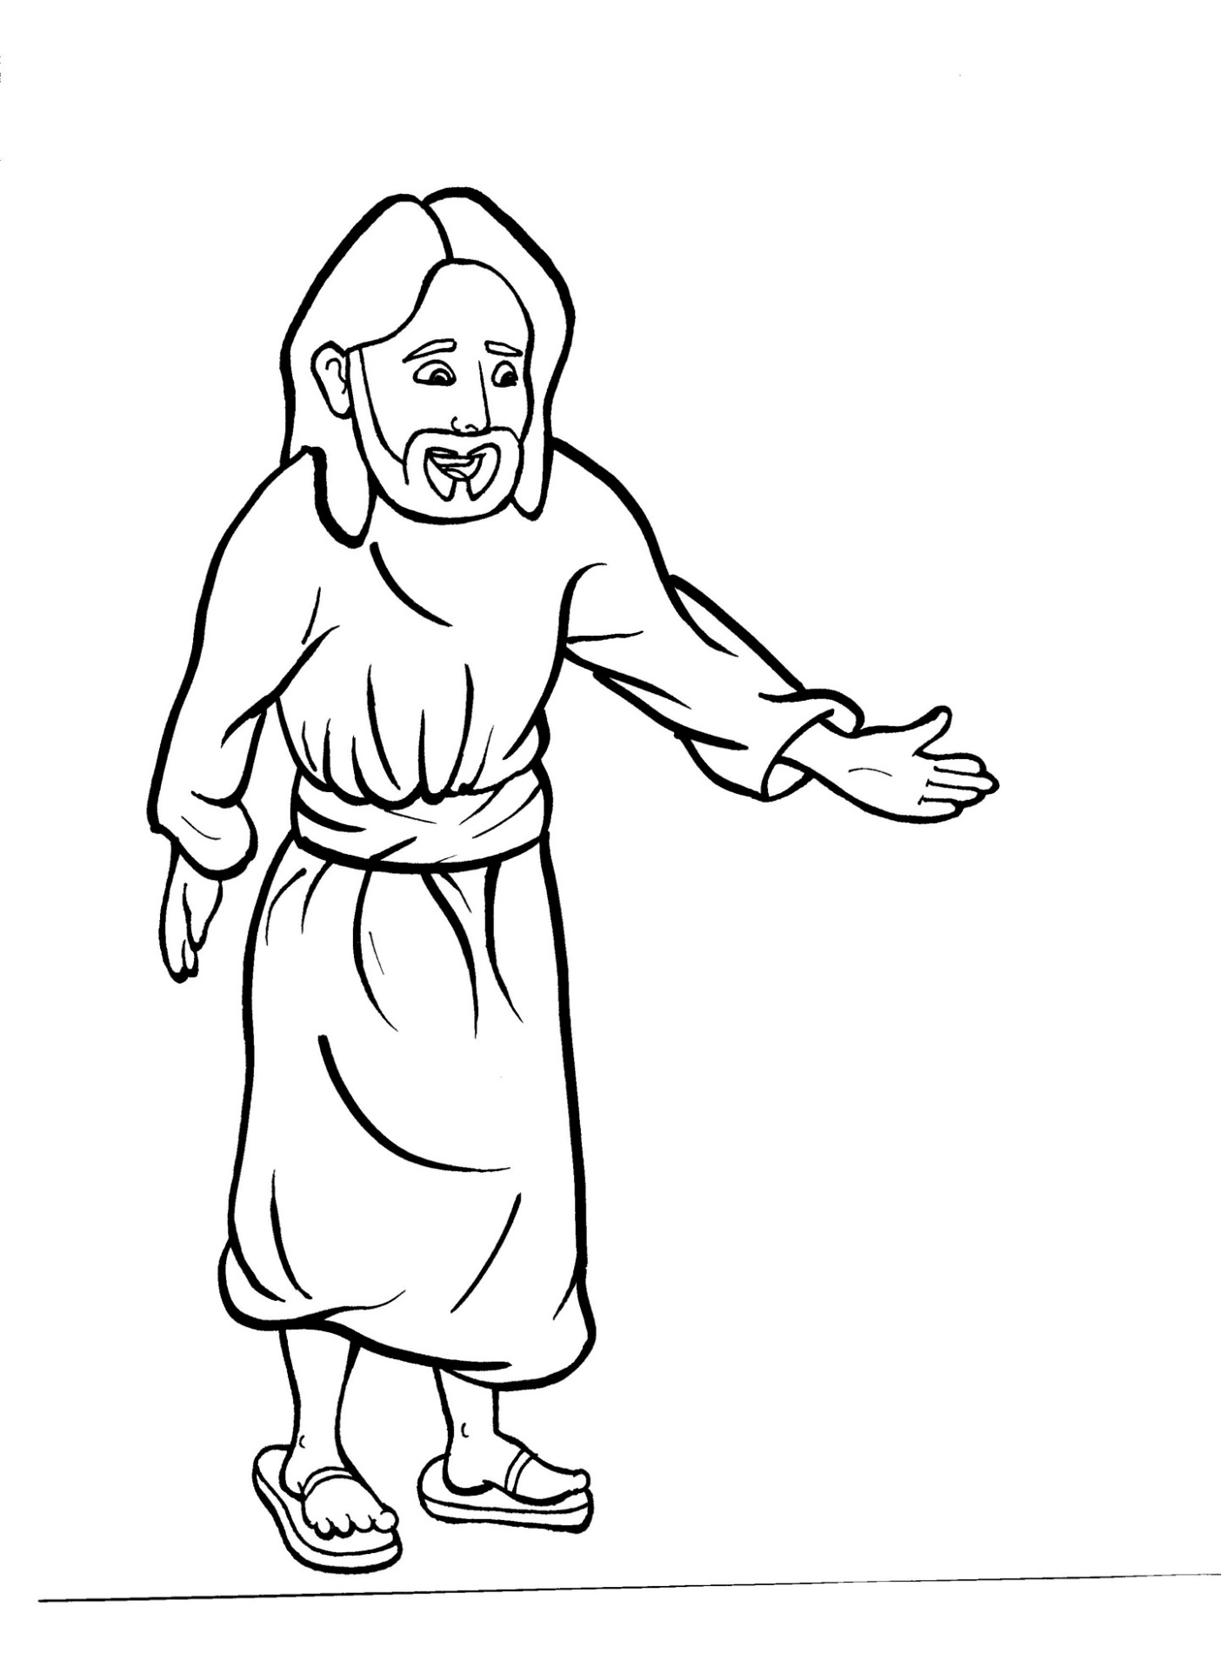
Part 4
42. Jesus Appears to His Disciples
Story in Easy Read English
Questions
Story in Phrases

Slide 2
The disciples hid in a room
together.

Slide 3
The doors were locked tight.

Slide 4
They were praying and
crying.

Slide 5
When the women told the
disciples, “Jesus is alive!”
they didn’t believe.

Slide 6
To them, their words sounded silly.

Slide 7
Two followers walked along
a road going to a village.

Slide 8
Their hearts were heavy.

Slide 9
Each step was hard to take.

Slide 10
Jesus came to them, but they
did not know who he was.

Slide 11
He told them, “The Old
Testament tells the story
of the Messiah.

Slide 12
He had to die and then
come back to life.”

Slide 13
Their eyes were opened.
It was Jesus!

Slide 14
But then, he disappeared.

Slide 15
“Our hearts were burning
within us when he was talking!”
they said.

Slide 16
They told the others, “It is true.

Slide 17
The Lord has risen!”

Slide 18
Just then, Jesus stood
among them and said,
“Peace be with you.”

Slide 19
“It’s a ghost!” they screamed.

Slide 20
“No, it’s me,” Jesus said.

Slide 21
“See, I have flesh and bones.

Slide 22
Why didn’t you believe?”

Slide 23
The men touched his hands
and feet.

Slide 24
Then they believed that
Jesus was the Messiah.

Slide 25
Amazed and full of great joy,
they worshipped him.

Slide 26
Question 1
How did the men react when the women told the news of Jesus’ resurrection?

Slide 27
Question 2
How did they react, even after they saw him alive?

Slide 28
Question 3
It has been said, “The resurrection changes everything.” Why?

Slide 29
Question 4
During Easter, many people celebrate spring with candy and eggs. How do Christians celebrate?

Slide 30
Prayer
Dear Jesus,
The amazing news of your resurrection changed the history of the world. Since you came back to life, millions of people in hundreds of countries believe.
I believe too.
Amen

Slide 31
Jesus Appears to
His Disciples
Phrased for Fluency

Slide 32
The disciples hid
in a room
together.

Slide 33
The doors
were locked tight.

Slide 34
They were praying
and crying.

Slide 35
When the women
told the disciples,
“Jesus is alive!”
they didn’t believe.

Slide 36
To them,
their words
sounded silly.

Slide 37
Two followers
walked along a road
going to a village.

Slide 38
Their hearts
were heavy.

Slide 39
Each step
was hard to take.

Slide 40
Jesus came to them,
but they did not know
who he was.

Slide 41
He told them,
“The Old Testament
tells the story
of the Messiah.

Slide 42
He had to die
and then come back
to life.”

Slide 43
Their eyes
were opened.
It was Jesus!

Slide 44
But then,
he disappeared.

Slide 45
“Our hearts were burning
within us
when he was talking!”
they said.

Slide 46
They told the others,
“It is true.
The Lord has risen!”

Slide 47
Just then,
Jesus stood
among them
and said,
“Peace be with you.”

Slide 48
“It’s a ghost!”
they screamed.

Slide 49
“No,
it’s me,”
Jesus said.

Slide 50
“See, I have
flesh and bones.

Slide 51
Why didn’t
you believe?”

Slide 52
The men
touched his hands
and feet.

Slide 53
Then they believed
that Jesus
was the Messiah.

Slide 54
Amazed
and full of great joy,
they worshipped him.

