Slide 1

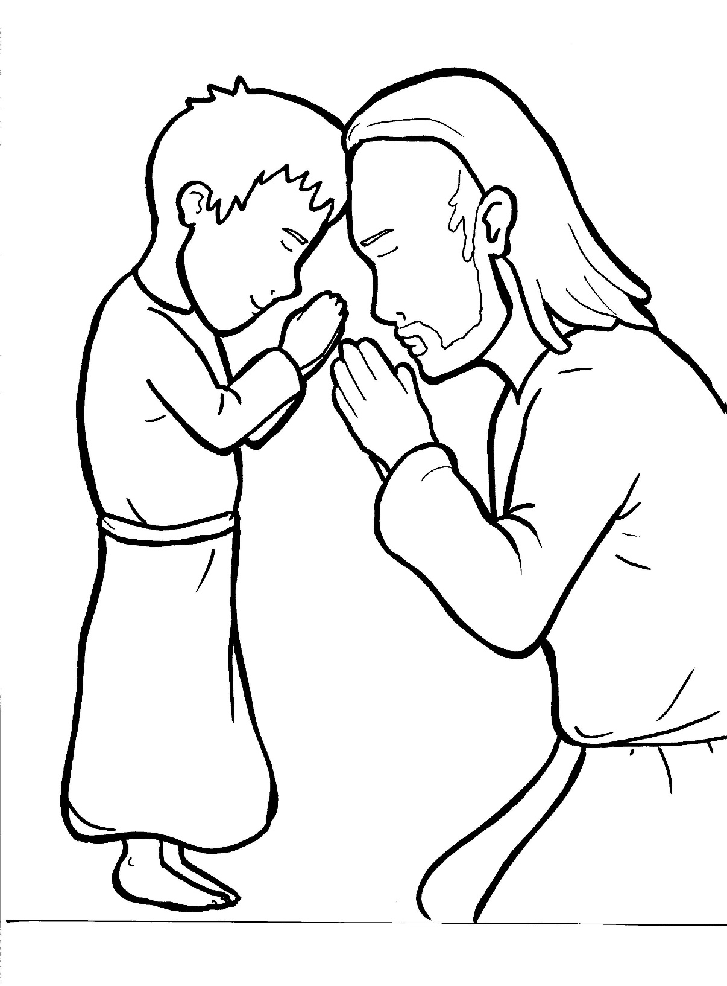
Part 5
26. The Lord’s Prayer
Vocabulary
Original Bible Story

Slide 2

Vocabulary

Slide 3
disciple
(dis - CI - ple)
a follower of Jesus

Slide 4
will
(will)
what you want to happen

Slide 5
indebted
(in - DEBT - ed)
to owe something to someone

Slide 6
temptation
(temp - TA - tion)
feeling like you want to do something that you should not do

Slide 7
deliver
(de - LIV - er)
to rescue or save

Slide 8
evil one
(E - vil)
the devil

Slide 9
The Lord’s Prayer
Luke 11:1-4; Matthew 6:31b
World English Bible (WEB)

Slide 10
When he finished praying
in a certain place,

Slide 11
one of his disciples said to him,
“Lord, teach us to pray,

Slide 12
just as John also taught
his disciples.”

Slide 13
He said to them,
“When you pray, say,

Slide 14
Our Father in heaven,
may your name be kept holy.

Slide 15
May your kingdom come.

Slide 16
May your will be done
on earth, as it is in heaven.

Slide 17
Give us today our daily bread.

Slide 18
Forgive us our sins,
for we also forgive
everyone who is indebted to us.

Slide 19
Bring us not into temptation,
but deliver us from the evil one.

Slide 20
For yours is the kingdom,
and the power, and the glory
forever.
Amen”

