Slide 1
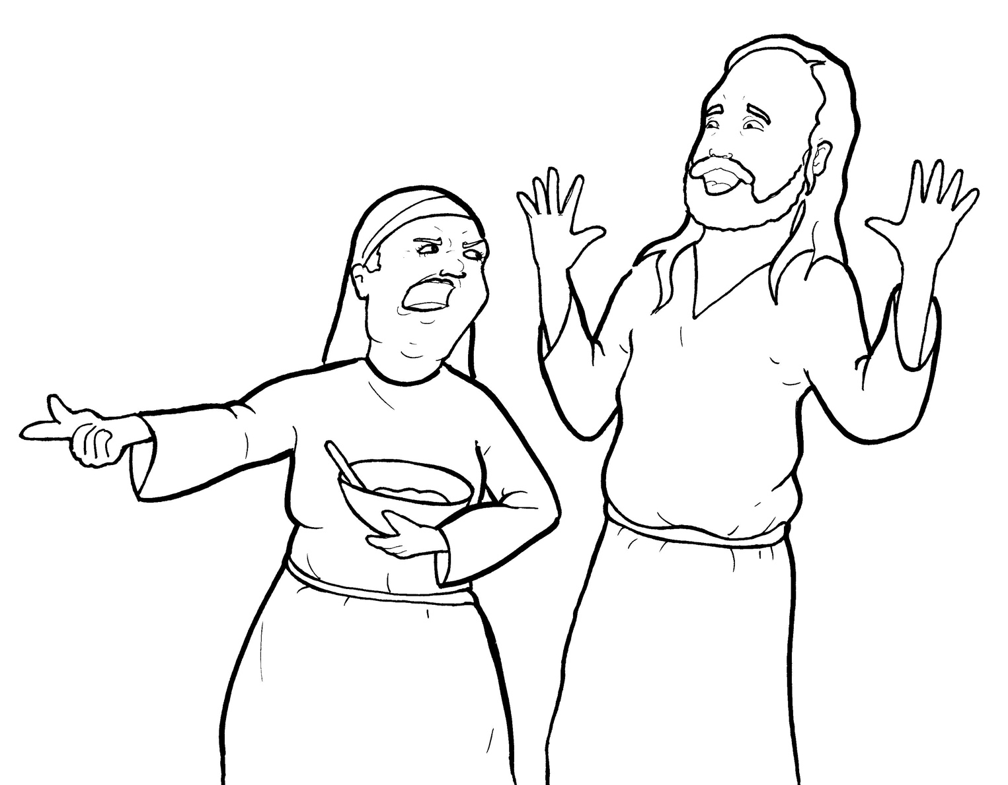
13. Martha Gets Mad
Part 4
Story in Easy Read English
Questions
Story in Phrases

Slide 2
Jesus and his disciples came to a village.

Slide 3
Martha welcomed Jesus into her home.

Slide 4
She had a sister named Mary.

Slide 5
“I will make a nice meal for Jesus,” Martha said.

Slide 6
She swept the floor.
She lit the fire.
She fried the fish.
Her feet hurt.

Slide 7
Martha got tired…and mad.

Slide 8
Mary just sat there at the feet of Jesus.

Slide 9
She loved to listen to Jesus talk.

Slide 10
Mary asked him questions. He answered.
Mary was learning.

Slide 11
Martha had no time to sit and listen.

Slide 12
She was busy working and
serving.

Slide 13
She went to Jesus.

Slide 14
“Lord, my sister has left me to do all the work by myself!” Martha grumbled.

Slide 15
“Don’t you care?
Tell her to help me!”

Slide 16
“Martha, Martha,” Jesus replied, “you are worried and upset about many things.

Slide 17
But only one thing is needed.

Slide 18
Mary has chosen what is best, and it will not be taken away from her.”

Slide 19
Question 1
When Jesus came into the home, what did Mary do?

Slide 20
Question 2
When Jesus came into the home, what did Martha do?

Slide 21
Question 3
Which is the best choice and why?

Slide 22
Question 4
How can you spend more time with
Jesus?

Slide 23
Prayer
Dear Jesus,
Please help me to not get so busy that I forget about you. Please help me make time for you. Help me choose what is best.
Amen

Slide 24
Martha Gets Mad
Phrased for Fluency

Slide 25
Jesus and his disciples
came
to a village.

Slide 26
Martha
welcomed Jesus
into her home.

Slide 27
She
had a sister
named Mary.

Slide 28
"I will make
a nice meal
for Jesus,"
Martha said.

Slide 29
She
swept the floor.

Slide 30
She
lit the fire.

Slide 31
She
fried the fish.

Slide 32
Her feet hurt.

Slide 33
Martha got tired...
and mad.

Slide 34
Mary
just sat there
at the feet
of Jesus.

Slide 35
She
loved to listen
to Jesus
talk.

Slide 36
Mary
asked
him questions.

Slide 37
He
answered.

Slide 38
Mary
was learning.

Slide 39
Martha
had no time
to sit and listen.

Slide 40
She was busy
working and serving.

Slide 41
She went to Jesus.

Slide 42
"Lord,
my sister
has left me to do
all the work
by myself!"
Martha grumbled.

Slide 43
“Don't you care?
Tell her
to help me!"

Slide 44
"Martha,
Martha,"
Jesus replied,
"you are worried and upset
about many things.

Slide 45
But
only one thing
is needed.

Slide 46
Mary has chosen
what is best,
and it will not
be taken
away from her."

