Slide 1
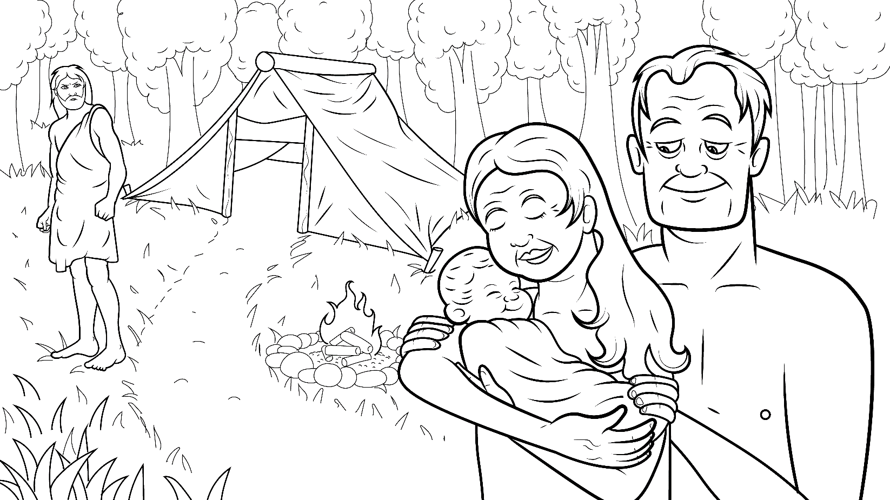
Story 1.6 Thick and Thin
(th) Seth, Adam, Eve
(Genesis 4:1-16; 25-26; 5:3-6)

Slide 2
New Words to Read
them then that
this thick thin
with path Seth

Slide 3
Rule Breakers (Read and Spell)
the are was
of father other

Slide 4
Rule Breakers (Read and Spell)
mother brother
another

Slide 5
Sight Words
be he both
times like Adam
Eve looked

Slide 6
Story1.6
Thick and Thin
I Read, You Read Bible Story (th)
Genesis
4: 1-16;
25-26; 5:3-6 (th)

Slide 7
What does it mean that God promises to be with us through thick and thin?

Slide 8
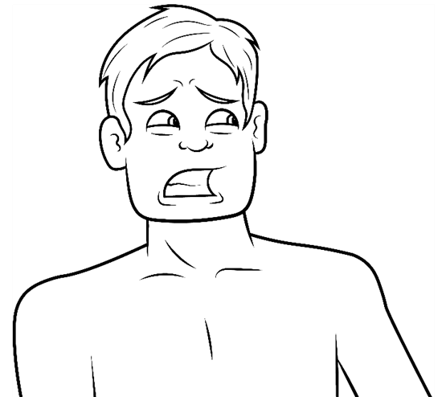
God will be with us in the thick times and in the thin times.

Slide 9
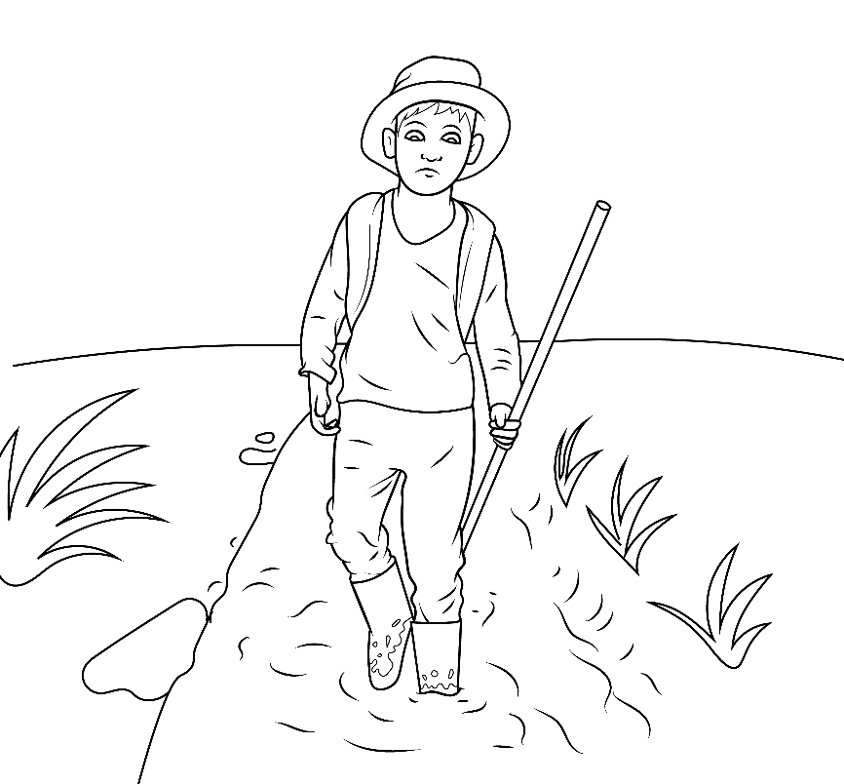
The thick times are like mud…
hard, sad times when we feel stuck.

Slide 10
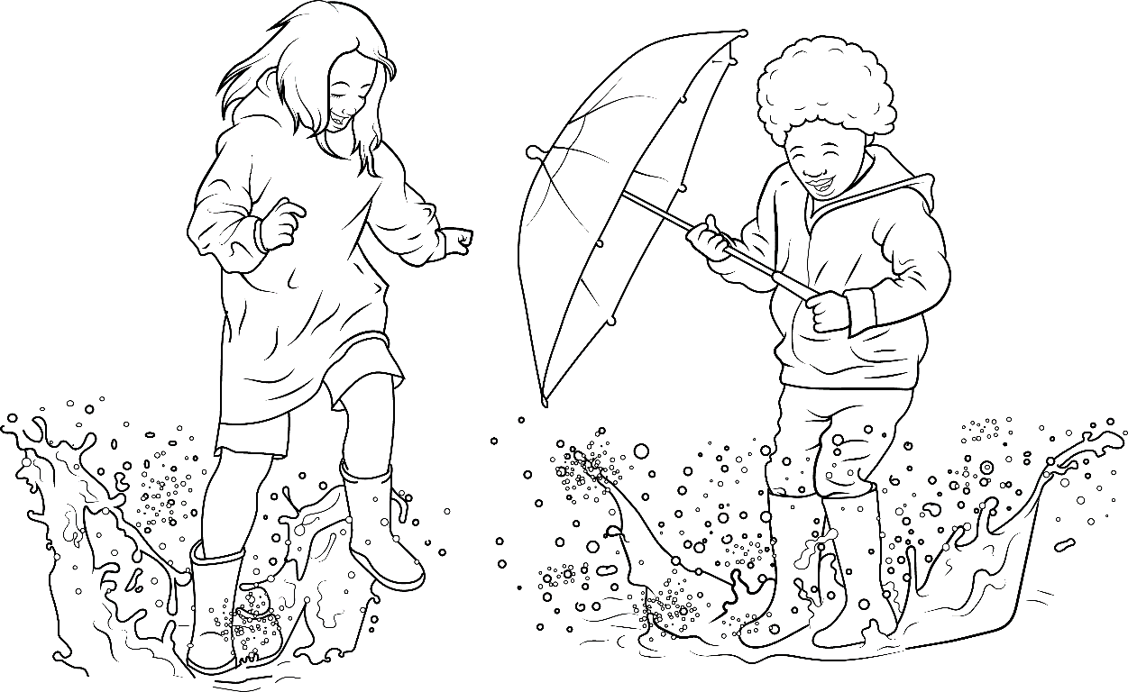
The thin times are like water. It is fun and easy to walk through water.

Slide 11
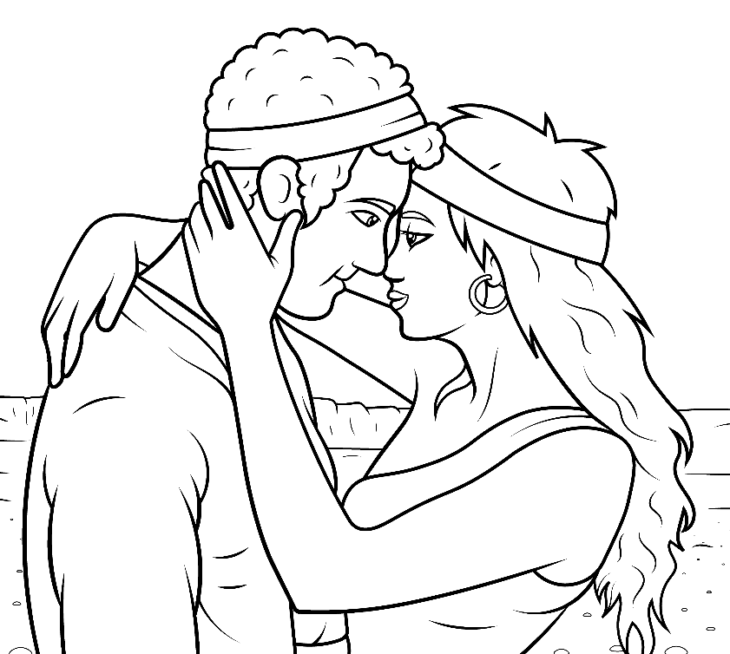
Thin times means when life is easy.

Slide 12
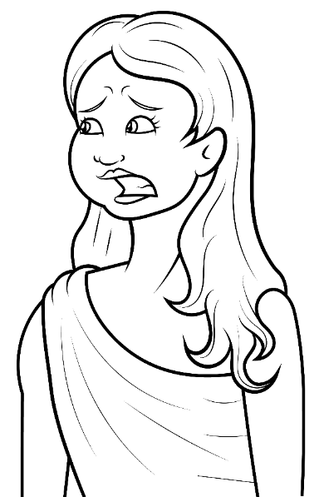
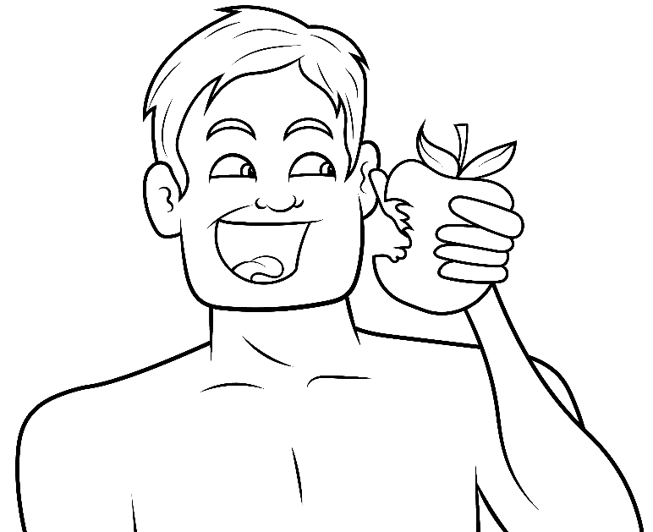
Adam and Eve had thick and thin times.

Slide 13
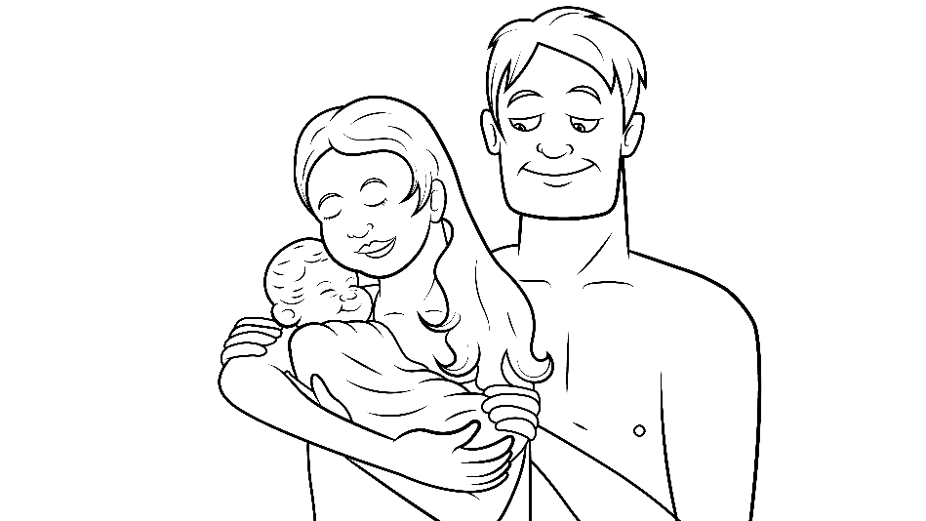
With God’s help, this mother and father had a kid.
His name was Cain.

Slide 14
Then the mother had another kid, another brother.
His name was Abel.

Slide 15
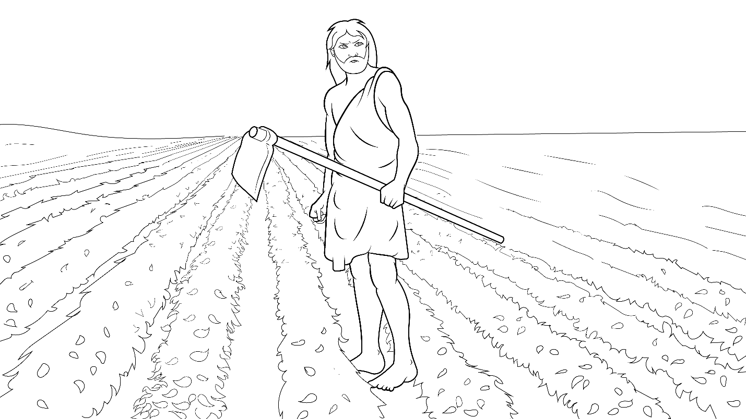
They grew up, but…
Cain killed Abel!

Slide 16
That was a thick time for both of them, mother and father.

Slide 17
Then, the mother and father had another kid… Seth.

Slide 18
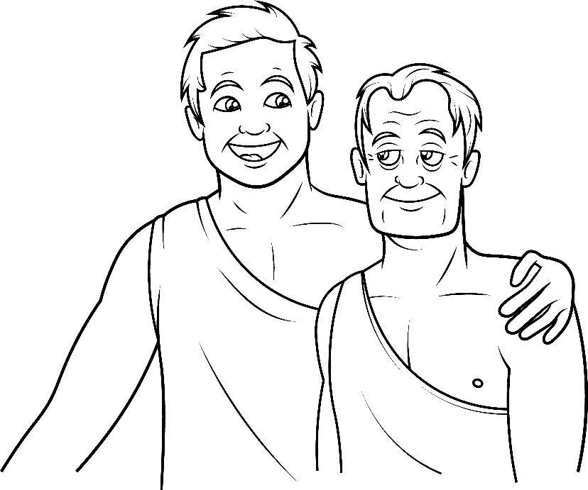
This brother, Seth,
was not like the other brothers.

Slide 19
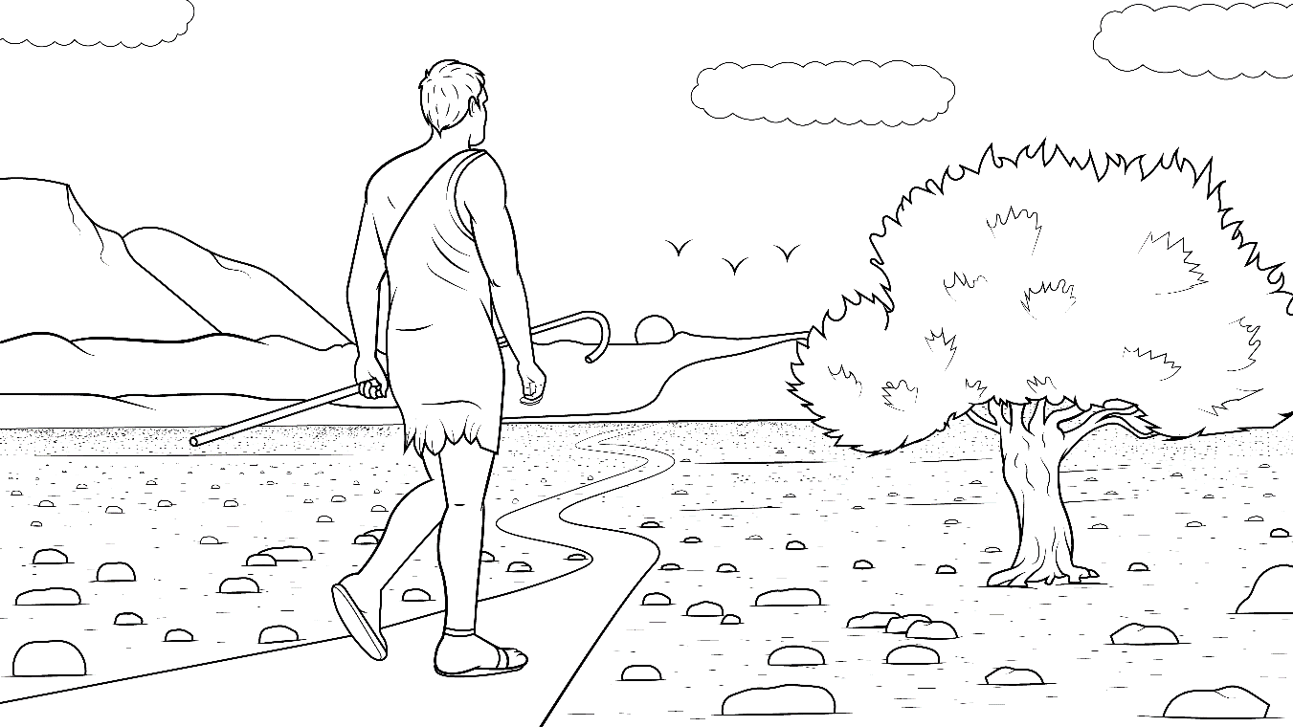
Seth looked like the dad…
and went on the best path.

Slide 20
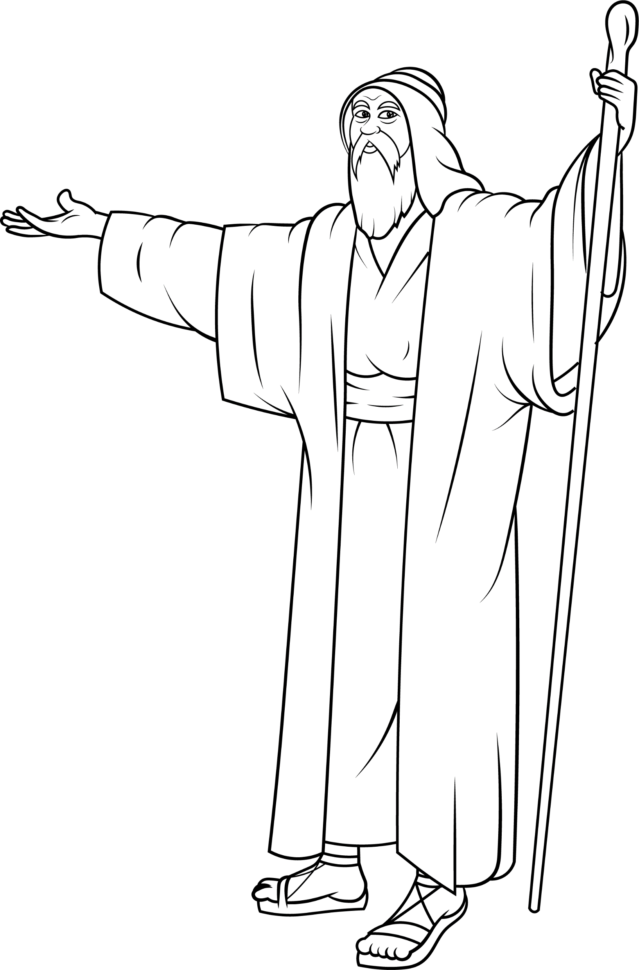
Through thick and thin times, Seth lived to be 930 years old!

Slide 21
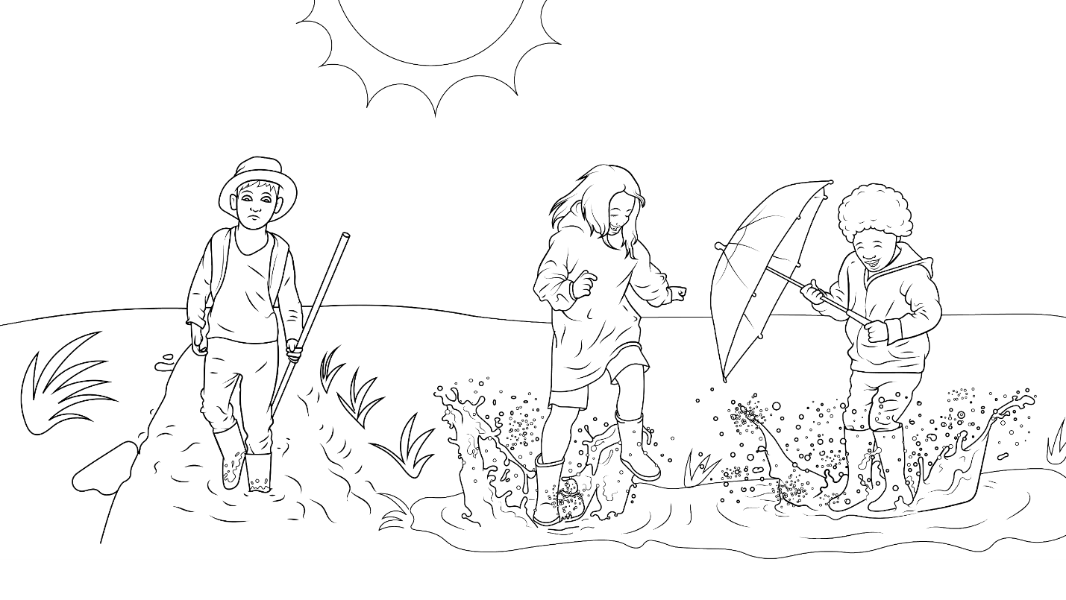
God will be with us in thick and in thin times.

Slide 22
The End

Slide 23
1.6 Story Without Illustrations
Thick and Thin
Genesis 4: 1-16; 25-26; 5:3-6

Slide 24
What does it mean that God
promises to be with us
through thick and thin?
God will be with us in the thick times and in the thin times.

Slide 25
The thick times are like mud… hard, sad times when we feel stuck.
The thin times are like water.
It is fun and easy to walk through water.
Thin times means when life is easy.

Slide 26
Adam and Eve had
thick and thin times.
With God’s help,
this mother and father had a kid.
His name was Cain.

Slide 27
Then the mother had another kid, another brother.
His name was Abel. They grew up, but… Cain killed Abel!

Slide 28
That was a thick time for both of them, mother and father.
Then, the mother and father had another kid… Seth.

Slide 29
This brother, Seth, was not like the other brothers.
Seth looked like the dad and went on the best path.

Slide 30
Through thick and thin times, Seth lived to be 930 years old!
God will be with us in thick and in thin times.

Slide 31
The End

Slide 32
Story: Carol Hale
Illustrations: Ivan Mader
Power Point arrangements: Steve March
www.EasyReadEnglish.com
www.EZReadEnglish.org/lower-levels

