Slide 1

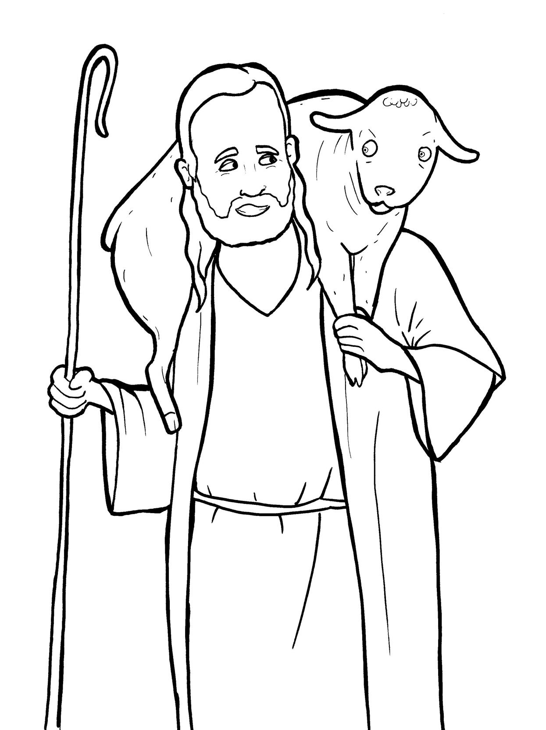
Part 1
22. The Lost Sheep
Syllable Charts

Slide 2

Words in
Syllable Types

Slide 3
Closed – Short Vowel
A closed syllable has one vowel
followed by one or more consonants,
and the vowel is short.
st
o
p
˘

Slide 4
Timing
Box
that
mad
hap-
-stand

Slide 5
Timing
Box
yes
-en
wel-
let
gets
-ven

Slide 6
Timing
Box
tell
-gels
when
them
shep-
-ness

Slide 7
Timing
Box
pick
-til
sin-
-ish
lit-
will

Slide 8
Timing
Box
God
lost

Slide 9
Timing
Box
up
un-
grum-
-sus

Slide 10
Open – Long Vowel
An open syllable has one vowel
with no consonant after it,
and the vowel is long.
−
go

Slide 11
Timing
Box
he
e ven
Je sus
re joice

Slide 12
Timing
Box
I

Slide 13
Timing
Box
so
go

Slide 14
Timing
Box
by
my
why

Slide 15
Timing
Box
stor y
carr y
sor ry

Slide 16
Silent e – Long Vowel
A silent e syllable has one vowel,
followed by one consonant
and a silent e at the end.
The vowel is long.
−
ca
e
v

Slide 17
Timing
Box
name
same

Slide 18
Timing
Box
home

Slide 19
Vowel Teams – Long Vowel
Many vowel teams follow this rule:
When two vowels get together,
the first one names its letter.
So the first vowel will make its long sound,
and the second vowel is silent.
−
e
a
t

Slide 20
Timing
Box
say
a way

Slide 21
Timing
Box
they

Slide 22
Timing
Box
neigh bors

Slide 23
Timing
Box
sheep

Slide 24
Timing
Box
eats
leave
lead ers

Slide 25
Timing
Box
Jew ish

Slide 26
Vowel Teams – Other Sounds
Sometimes vowel teams make other sounds.
oil

Slide 27
Timing
Box
all
call

Slide 28
Timing
Box
look
good

Slide 29
Timing
Box
down

Slide 30
Timing
Box
found
shout
moun tains

Slide 31
Timing
Box
re joice

Slide 32
Timing
Box
joy

Slide 33
Timing
Box
heav en

Slide 34
R - Controlled
R-controlled syllables have one or more vowels
followed by an “r.”
The “r” changes the sound of the vowel.
o
r
ange

Slide 35
Timing
Box
lead ers
sin ners

Slide 36
Timing
Box
wan der
shep herd
un der stand

Slide 37
Timing
Box
for
stor y

Slide 38
Timing
Box
neigh bors

Slide 39
Timing
Box
carr y

Slide 40
Consonant – l-e
When you see consonant l-e at the end of a word,
count back three.
The “l-e” makes the /–le/ sound.
pur
p
l
e

Slide 41
Timing
Box
lit tle
grum ble

Slide 42
Other Sounds – Long Vowel
These syllables or words are closed,
so the vowel should be short,
but the vowel is long.
−
cold

Slide 43
Timing
Box
told

Slide 44
Timing
Box
child

Slide 45
Timing
Box
finds

Slide 46

Other Sounds – schwa
The schwa syllable has an “a” that sounds
like the /u/ in banana.
The banana is even shaped like a short u.
ba nan a

Slide 47
Timing
Box
a way

