Slide 1
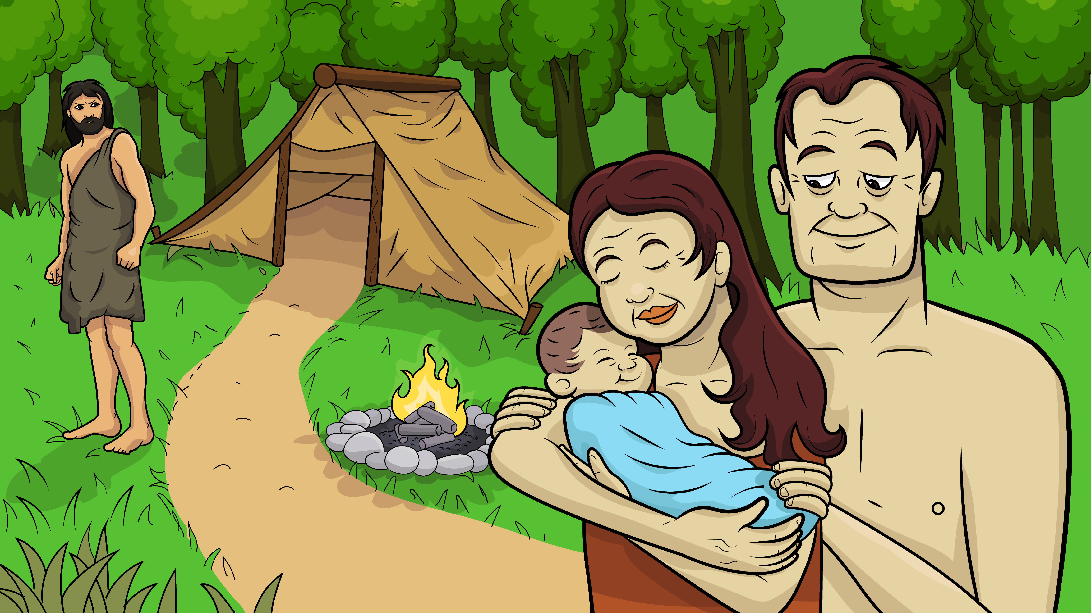
Song 1.6 Thick and Thin
(th) Seth, Adam, Eve
(Genesis 4:1-16; 25-26; 5:3-6)

Slide 2
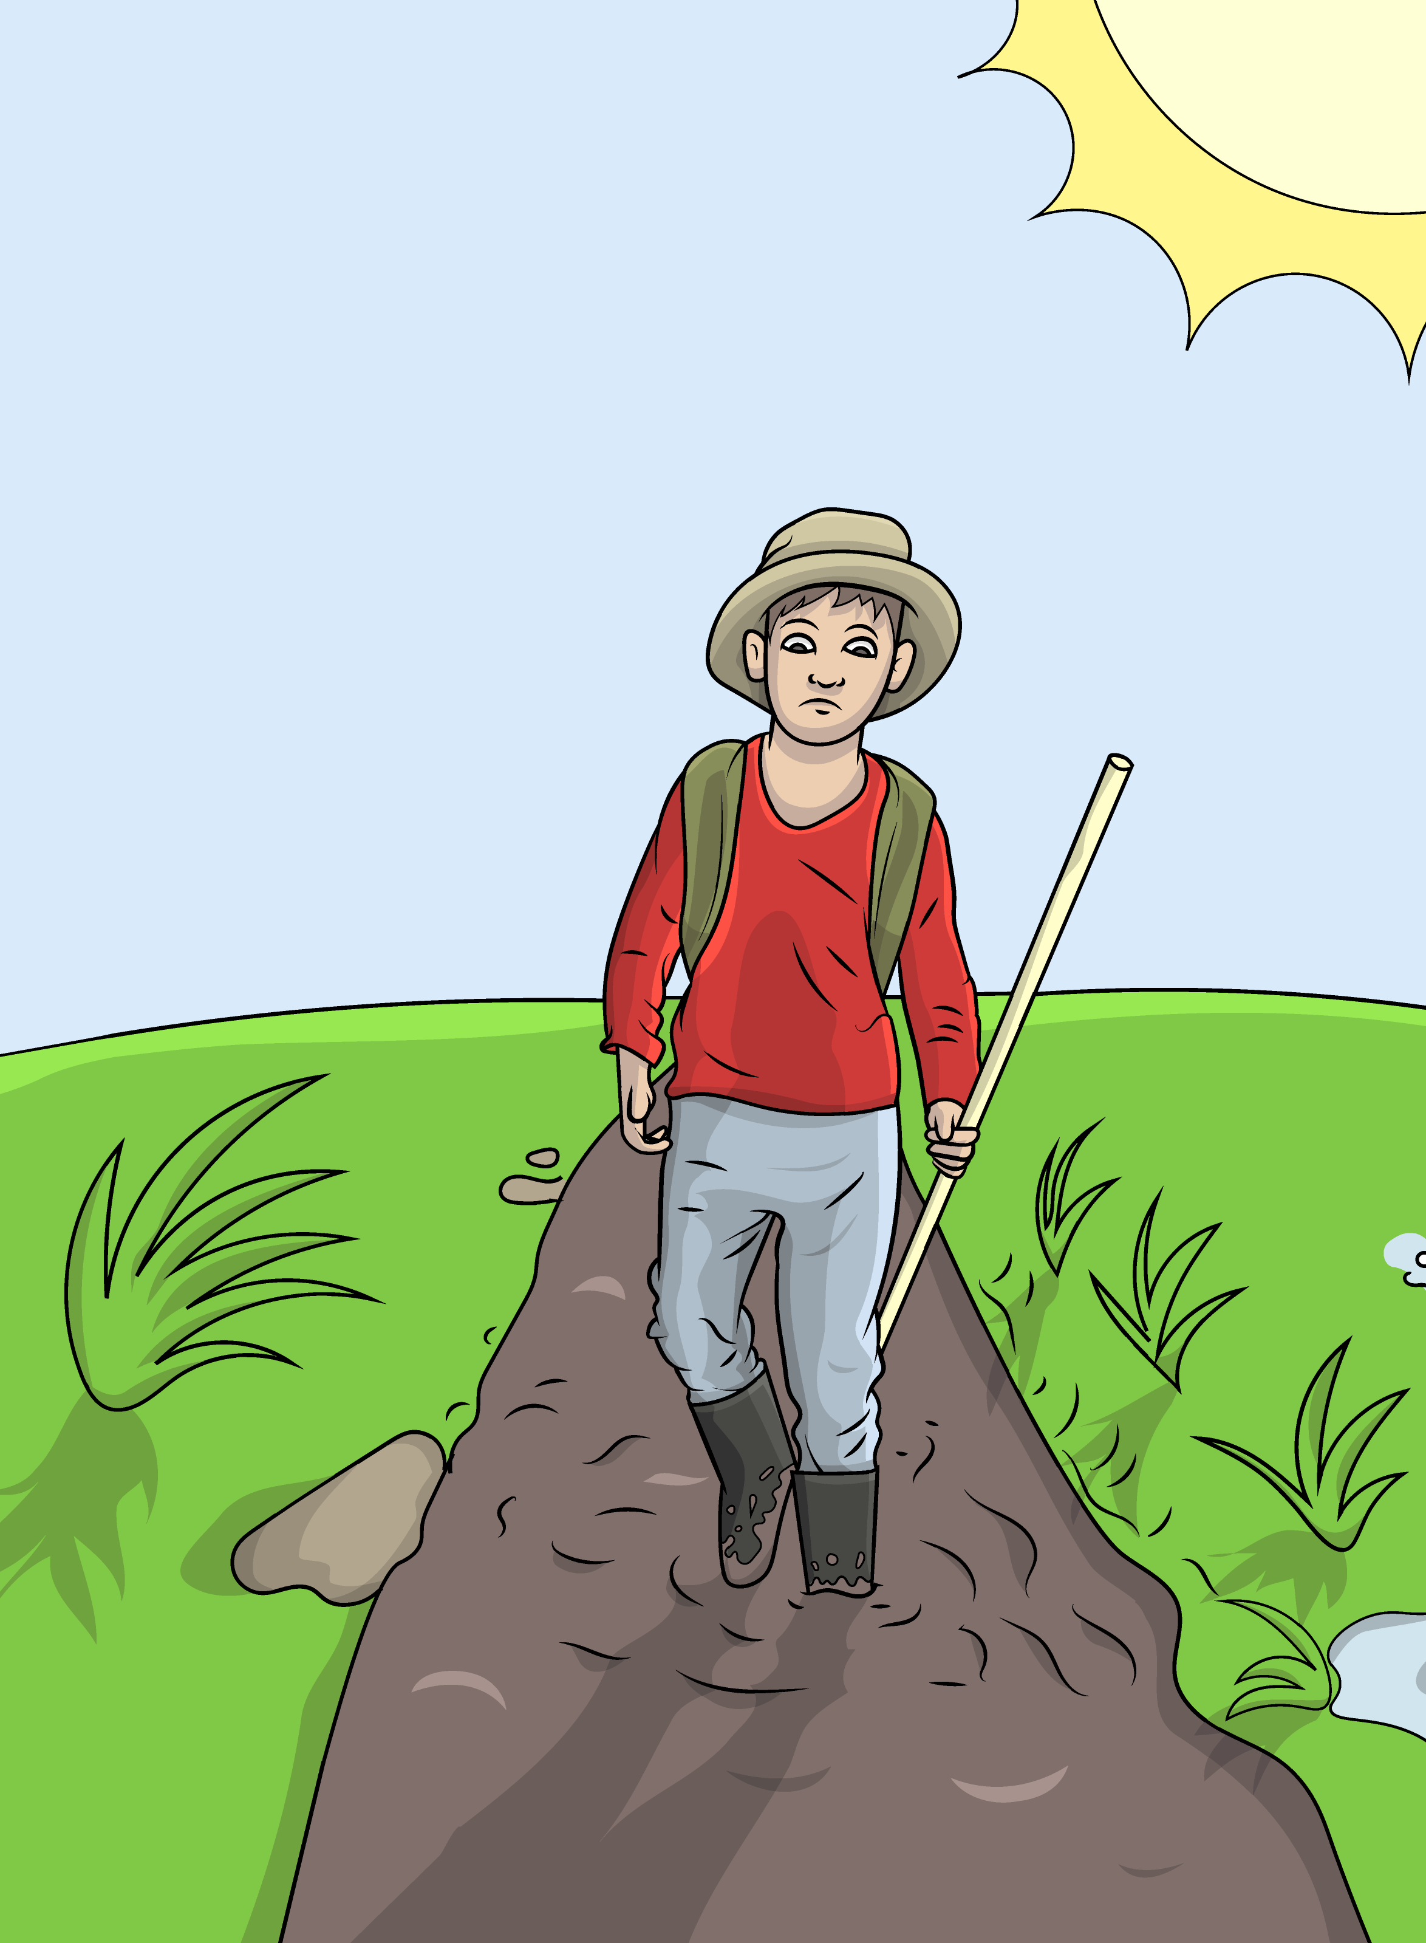
Thick and thin,

Slide 3
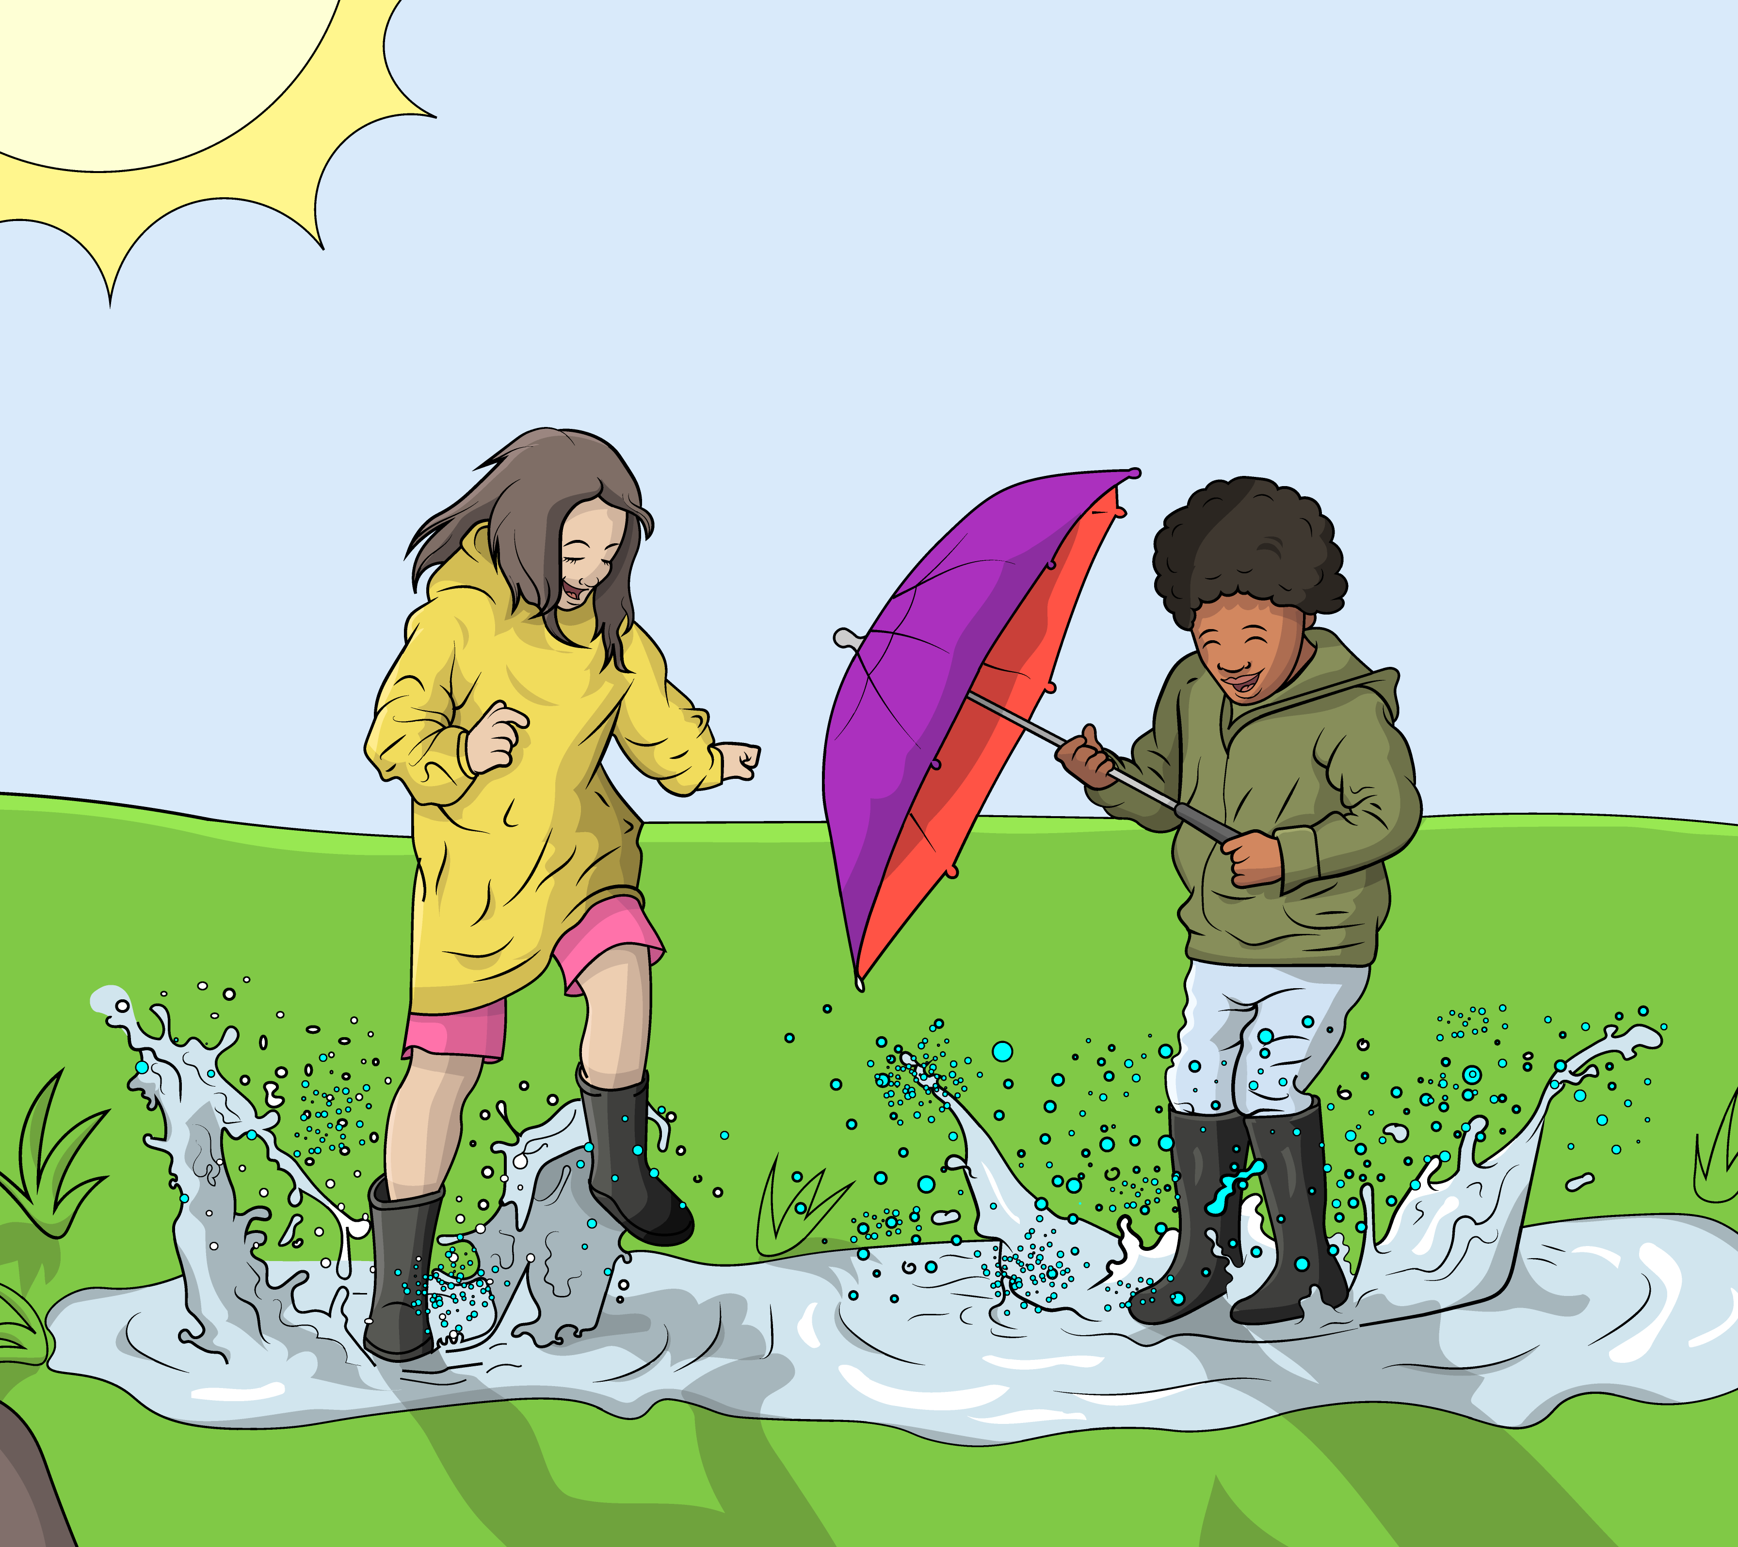
thick and thin,

Slide 4
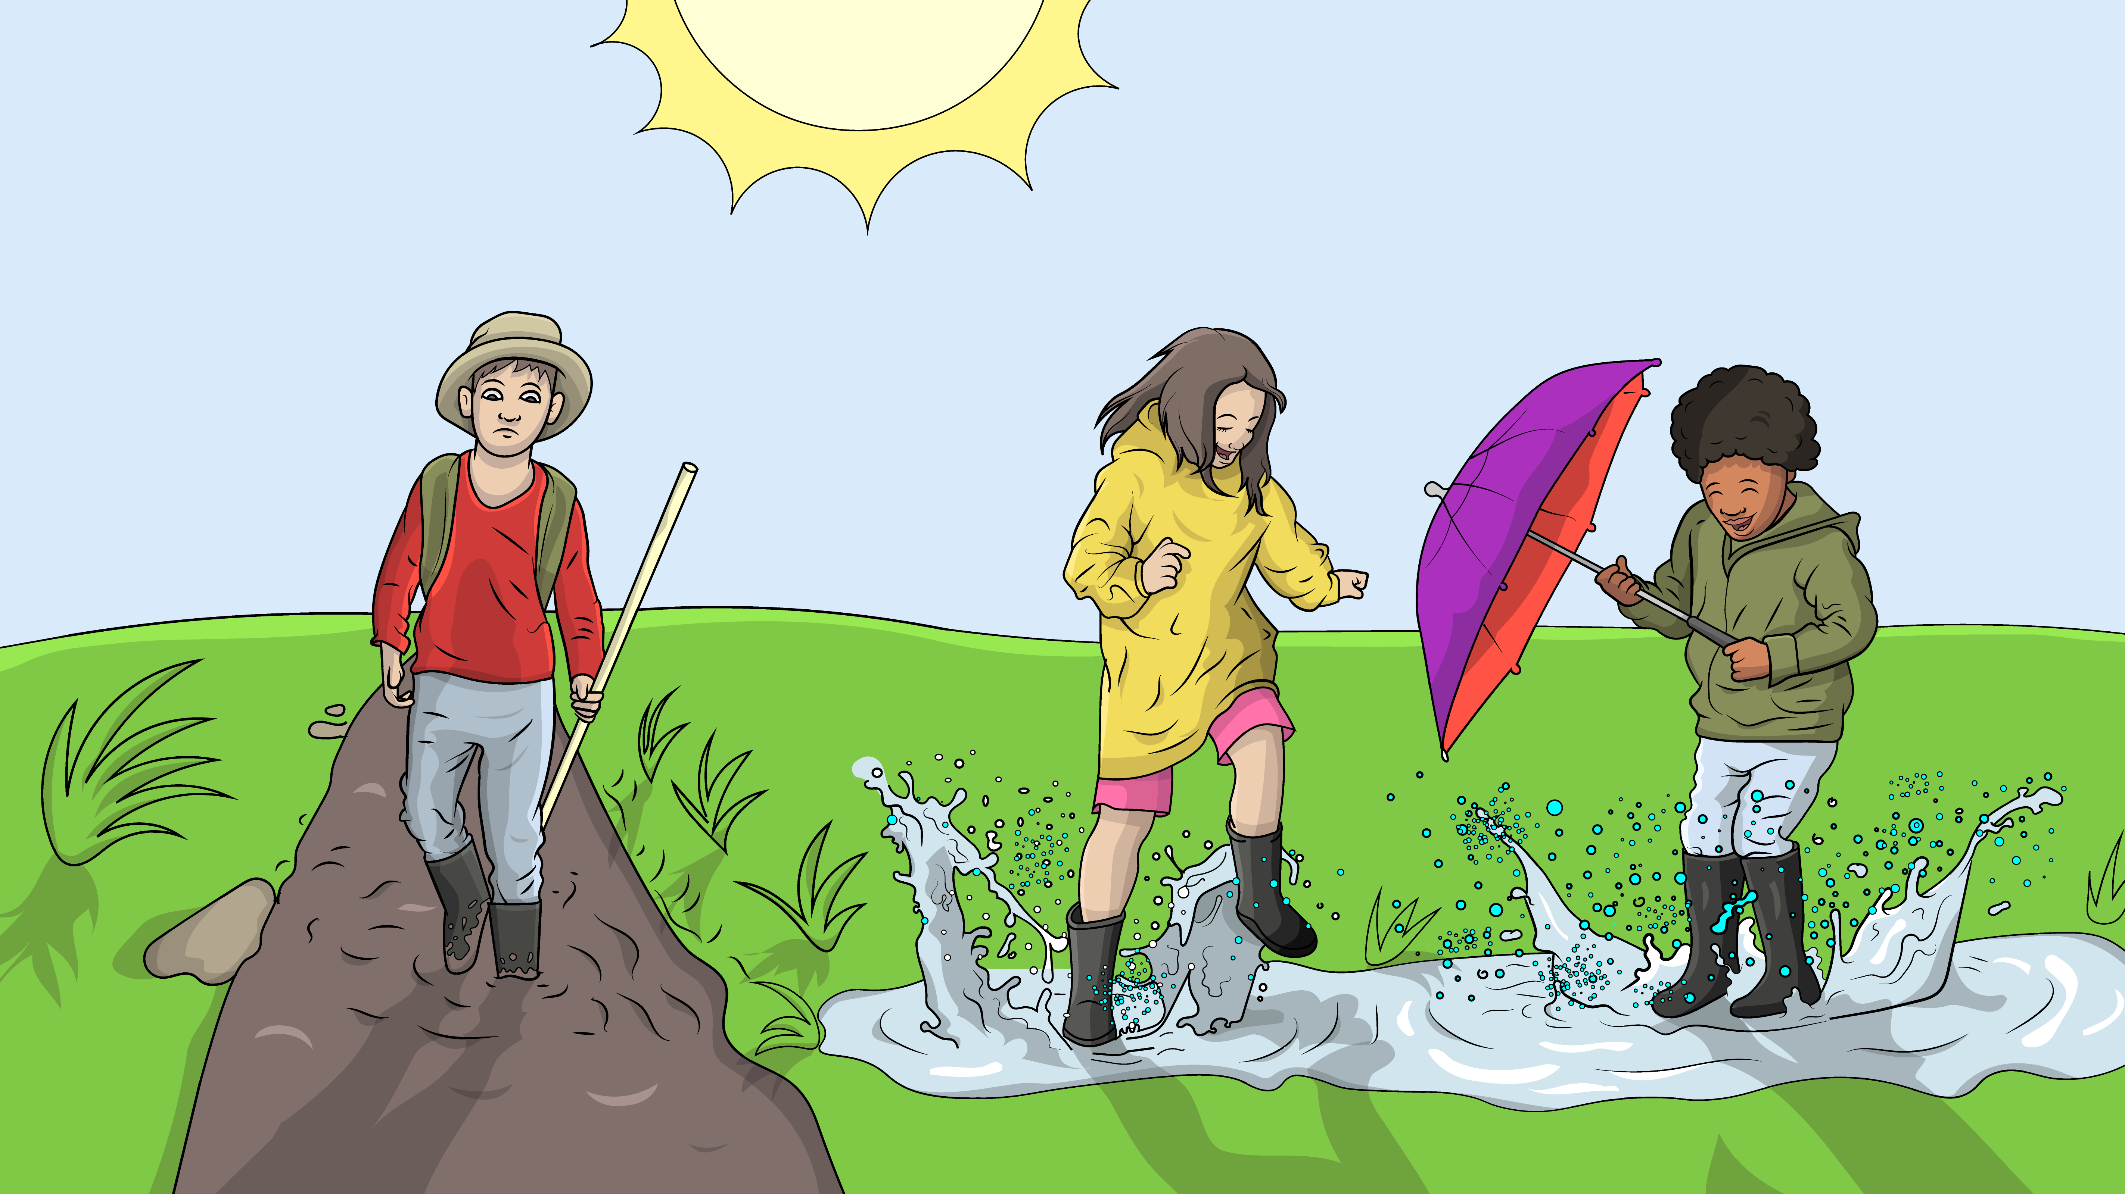
God is with us in all things, thick and thin.

Slide 5
Thick and thin, thick and thin.

Slide 6
God is with us in all things, thick and thin.

Slide 7
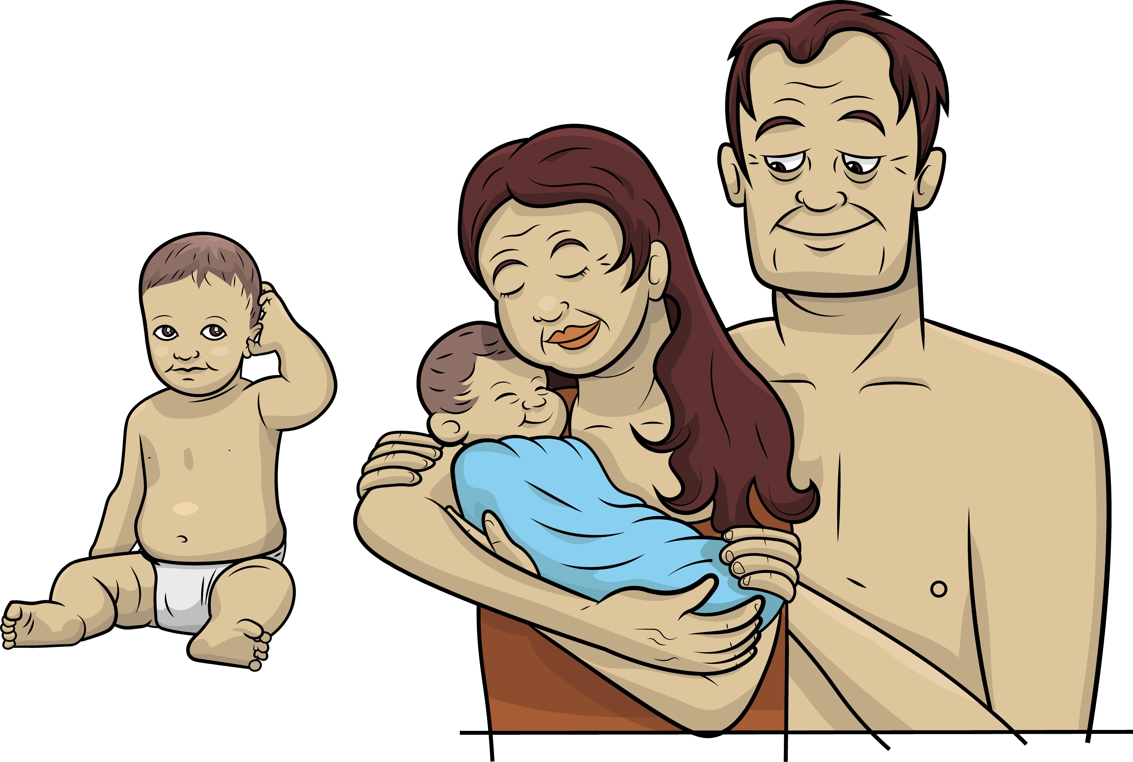
Eve had a son, had a son.

Slide 8
She had one son then another one.

Slide 9
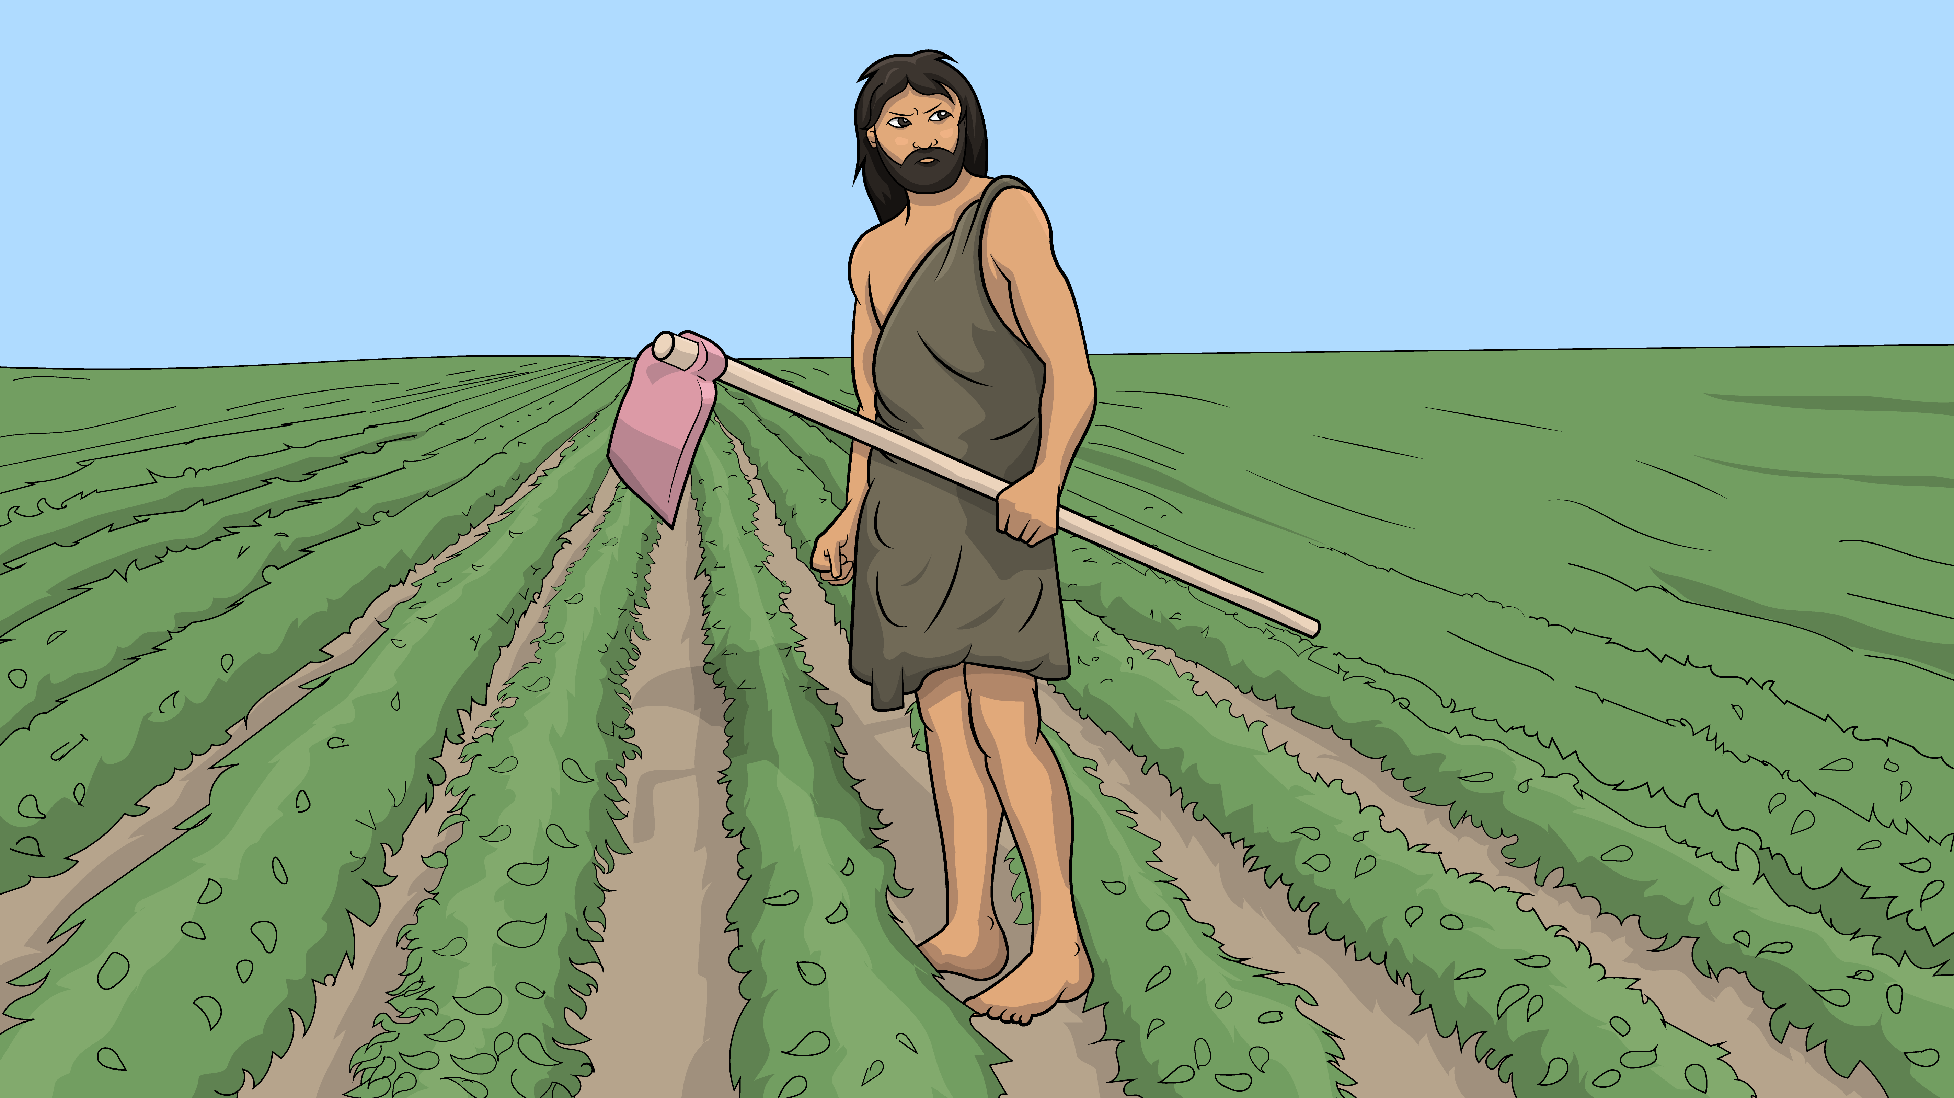
Eve had a son, had a son.

Slide 10
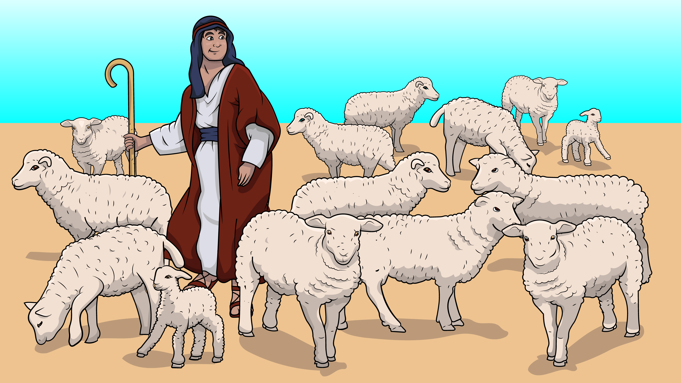
She had one son, then another one.

Slide 11
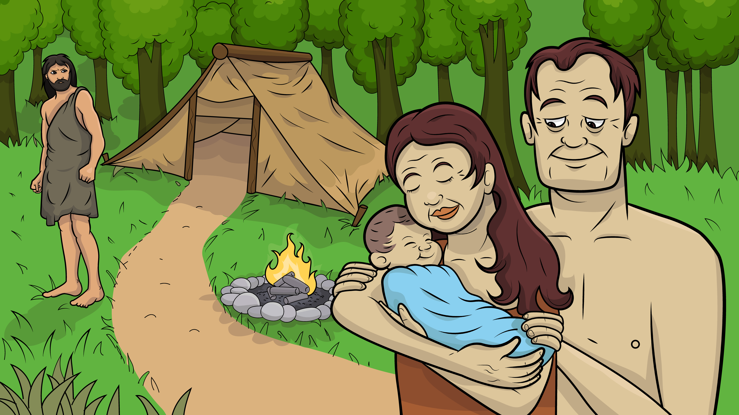
Then came Seth, then came Seth.

Slide 12
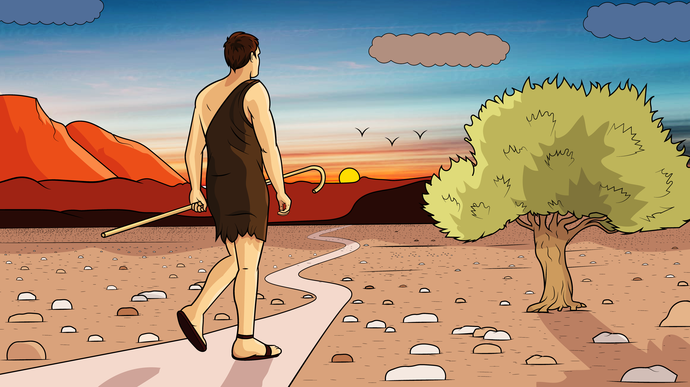
With God’s help, Seth went on the best path.

Slide 13
Then came Seth, then came Seth.

Slide 14
With God’s help, Seth went on the best path.

Slide 15
Thick and thin, thick and thin, God
is with us in all things, thick and thin.

Slide 16
Thick and thin, thick and thin God is with us in all things, thick and thin.

Slide 17
The End

Slide 18
Song lyrics and melody: Carol Hale
Song arrangements and singer: Steffi VornBerger
Illustrations: Ivan Mader
Power Point arrangements: Steve March
www.EasyReadEnglish.com

