Slide 1
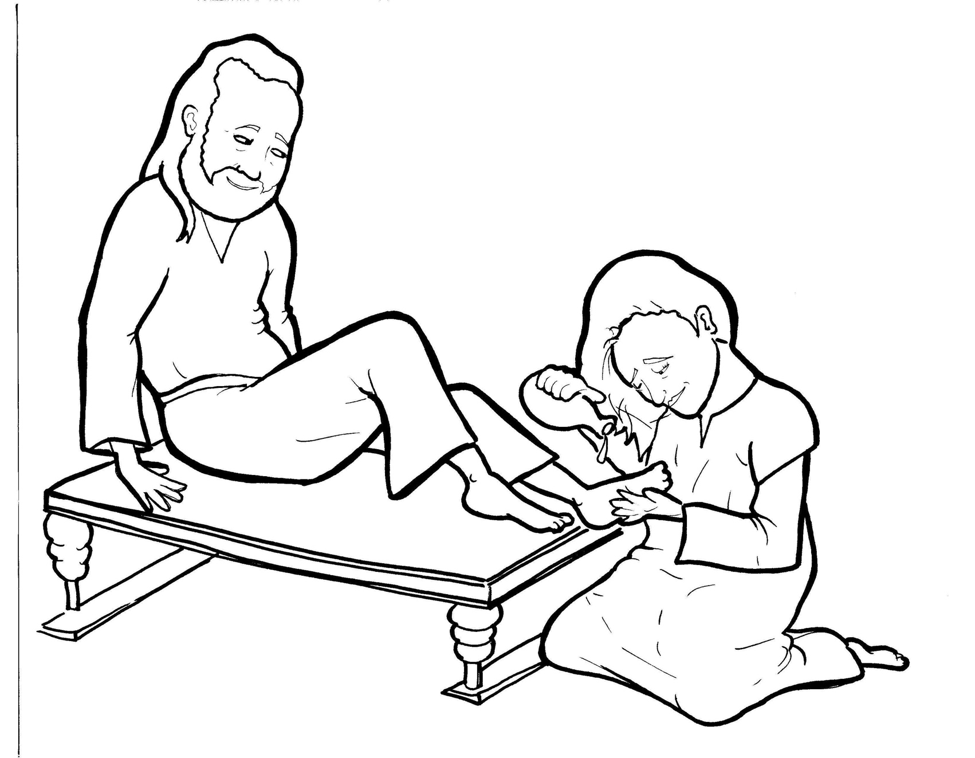
14. A Woman Washes Jesus’ Feet
Part 2
New Words
Rule Breakers

Slide 2
Other Sounds – Soft C
ce, ci, cy make the soft sound
cent
city
fancy

Slide 3
dis ci ple

Slide 4
Silent Letters
whole

Slide 5
Possessives
Jesus’ feet

Slide 6
Y to i and add a suffix
beautiful
buried

Slide 7
New Words
sorry
beautiful
buried

Slide 8
Rule Breakers
These words do not follow phonetic patterns.
have
was

Slide 9
of
what
his
the
has
done

Slide 10
you
poured
to
should
poor
could

Slide 11
friends
woman
sorry
bury
money
buried

Slide 12
beautiful

