Slide 1
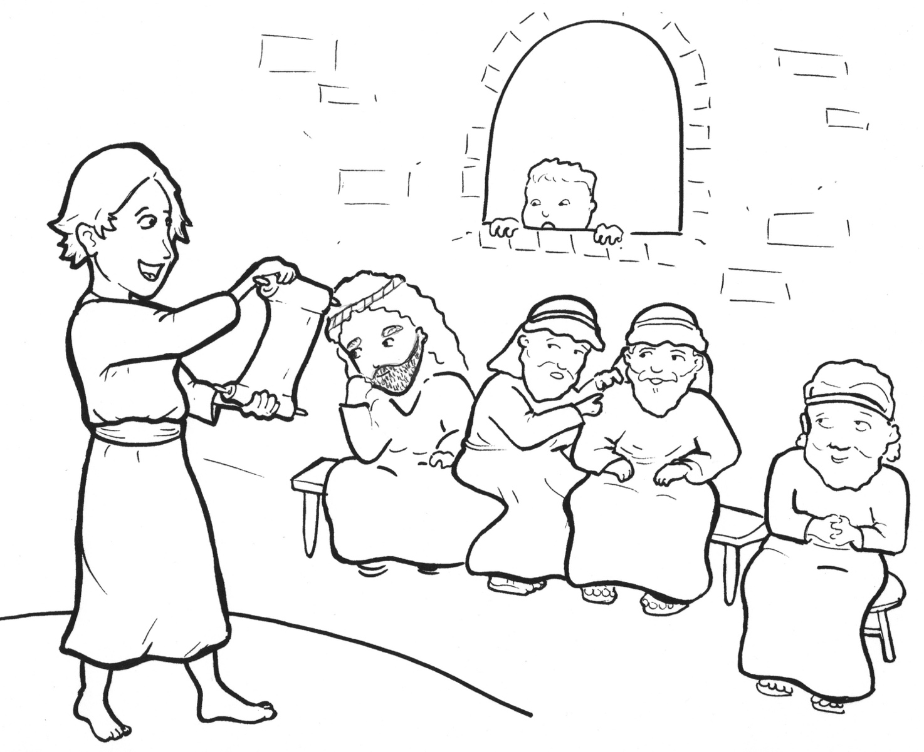
7. Jesus Gets Lost!
Part 1
Syllable Charts

Slide 2
Words in Syllable Types

Slide 3
Closed – Short Vowel
A closed syllable has one vowel
followed by one or more consonants,
and the vowel is short.
st
o
p
˘

Slide 4
wag-
cam-
lands
trav-

Slide 5
ev-
when
tem-
-seph

Slide 6
Scrip-
this
cit-
-ship

Slide 7
not
lost

Slide 8
un-
-sus

Slide 9
Open – Long Vowel
An open syllable has one vowel
with no consonant after it,
and the vowel is long.
−
go

Slide 10
la ter

Slide 11
we
Je sus
re turn

Slide 12
fi nal ly

Slide 13
so
o ver
Jo seph

Slide 14
Jer u salem

Slide 15
my
why

Slide 16
Mar y
cit y
fam i ly
fi nal ly

Slide 17
Silent e – Long Vowel
A silent e syllable has one vowel,
followed by one consonant
and a silent e at the end.
The vowel is long.
−
ca
e
v

Slide 18
a mazed

Slide 19
these

Slide 20
wise

Slide 21
home

Slide 22
Vowel Teams – Long Vowel
Many vowel teams follow this rule:
When two vowels get together,
the first one names its letter.
So the first vowel will make its long sound,
and the second vowel is silent.
−
e
a
t

Slide 23
days

Slide 24
each
teach
year

Slide 25
three

Slide 26
know

Slide 27
few

Slide 28
Vowel Teams – Other Sounds
Sometimes vowel teams make other sounds.
oil

Slide 29
found
house
a bout

Slide 30
how
crowd ed

Slide 31
boy

Slide 32
looked

Slide 33
all
small

Slide 34
R - Controlled
R-controlled syllables have one or more vowels
followed by an “r.”
The “r” changes the sound of the vowel.
o
r
ange

Slide 35
for

Slide 36
la ter
Jer u salem
teach ers
o ver
under stand
ev er y

Slide 37
re turned

Slide 38
Scrip tures

Slide 39
Mar y

Slide 40
wor ship

Slide 41
Consonant – l-e
When you see consonant l-e at the end of a word,
count back three.
The “l-e” makes the /–le/ sound.
pur
p
l
e

Slide 42
peo ple
tem ple

Slide 43
fi nal ly

Slide 44
cam el
trav el

Slide 45
Other Sounds – Long Vowel
These syllables or words are closed,
so the vowel should be short,
but the vowel is long.
−
cold

Slide 46
old

Slide 47
Other Sounds – -nk/-ng
The “-nk” and “-ng”
change the sound of the vowel.
bank
thing

Slide 48
miss ing

Slide 49
a long

Slide 50
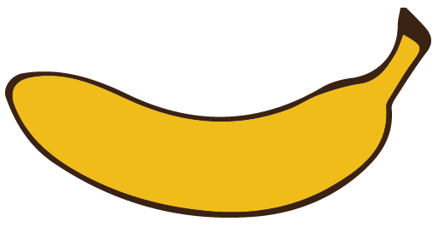
Other Sounds – schwa
The schwa syllable has an “a” that sounds
like the /u/ in banana.
The banana is even shaped like a short u.
ba nan a

Slide 51
a bout
a mazed
a long

Slide 52
Jer u sa lem
Naz a reth

Slide 53
wag ons

