Slide 1
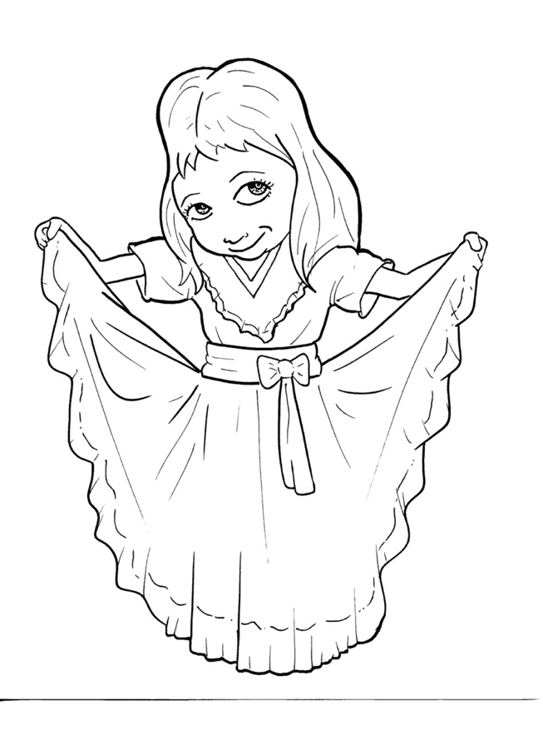
Part 2
47. Now, the Good
News – Jesus Saves
New Words
Rule Breakers

Slide 2
Other Sounds – Soft G
ge, gi, gy often make the soft sound
gentle
giant
gym

Slide 3
angels

Slide 4
Silent Letters
wrong

Slide 5
Possessives
God’s love
God’s eyes
God’s child

Slide 6
Contractions
The word “contraction” means “the thing pulled together.”
The first word stays the same,
and the apostrophe takes the place of the
missing letters in the second word.
’m
=
am
I
I

Slide 7
that’s
=
that is
I’m
=
I am

Slide 8
New Words
punishment

Slide 9
Rule Breakers
These words do not follow phonetic patterns.

Slide 10
to
his
do
has
are
great

Slide 11
who
what
you
only
your
love

Slide 12
eyes
giving
from
said
coming
would

Slide 13
friend
heart
sorry
somewhere
blood
someone

