Slide 1

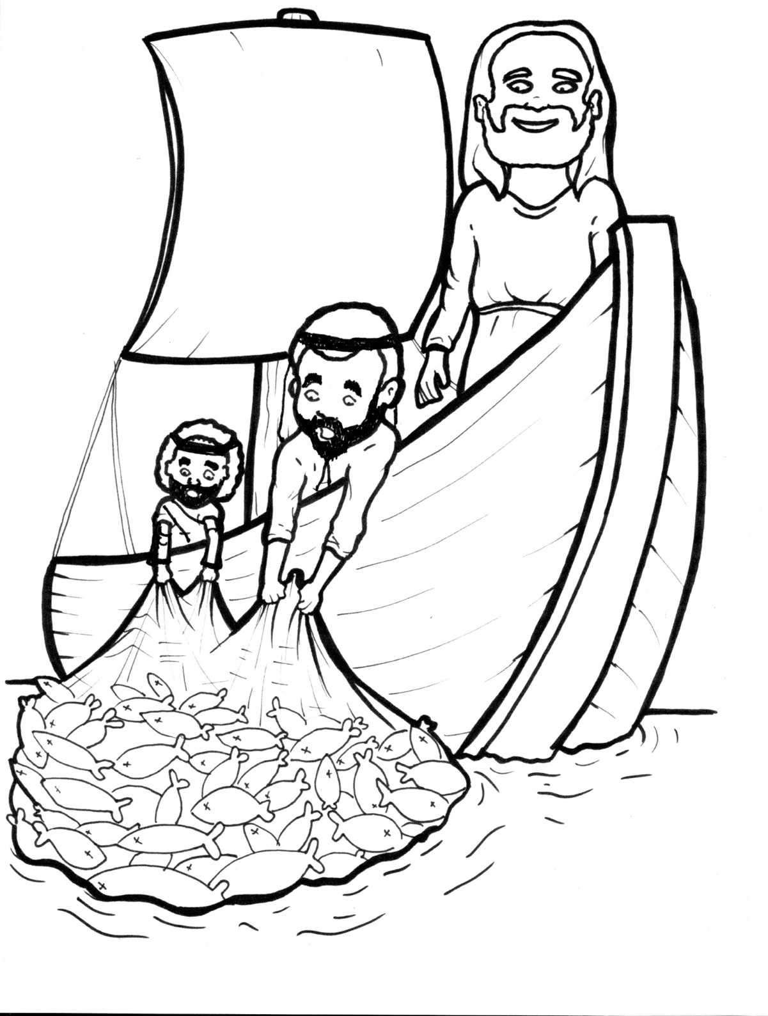
16. Jesus Commands Fish
Part 3
Syllable Divisions

Slide 2
Dividing Words
Into Syllables

Slide 3
Rabbit Words
When you see two consonants
between two vowels,
divide between the consonants.
ra it
bb
rab bit

Slide 4
Mas ter
Master

Slide 5
un der
under

Slide 6
sar dine
sardine

Slide 7
bar bel
barbel

Slide 8
sil ver
silver

Slide 9
fol low
follow

Slide 10
ear ly
early

Slide 11

Tiger Words
When you see one consonant
between two vowels,
divide after the first vowel.
Try this pattern first.
ti er
g
ti ger

Slide 12
Je sus
Jesus

Slide 13
Si mon
Simon

Slide 14
fi nally
finally

Slide 15
o bey
obey

Slide 16
be gan
began

Slide 17
Pe ter
Peter

Slide 18
Turtle Words
When you see consonant-l-e,
count back three and divide.
tur
t
l
e
tur tle

Slide 19
wig gle
wiggle

Slide 20
peo ple
people

Slide 21
spar kle
sparkle

Slide 22
bub ble
bubble

Slide 23
Hamster Words
When you see three consonants between two vowels,
divide after the first consonant.
ha
mst
er
ham ster

Slide 24
hun dred
hundred

Slide 25

Foxes Suffixes
Focus on your base word.
fox es
fox es

Slide 26
sparkled
sparkled

Slide 27
bubbled
bubbled

Slide 28
washed
washed

Slide 29
raced
raced

Slide 30
flashed
flashed

Slide 31
followed
followed

Slide 32
break ing
breaking

Slide 33
final ly
finally

Slide 34
sin ful
sinful

Slide 35

Anteater Words
These compound words are made up of two smaller words.
ant
eater
1
2
ant eater

Slide 36
in to
into

Slide 37
Other Syllable Divisions
Some words don’t fit so neatly
into standard syllable division patterns.
a way
away

Slide 38
a fraid
afraid

Slide 39
emp ty
empty

