Slide 1
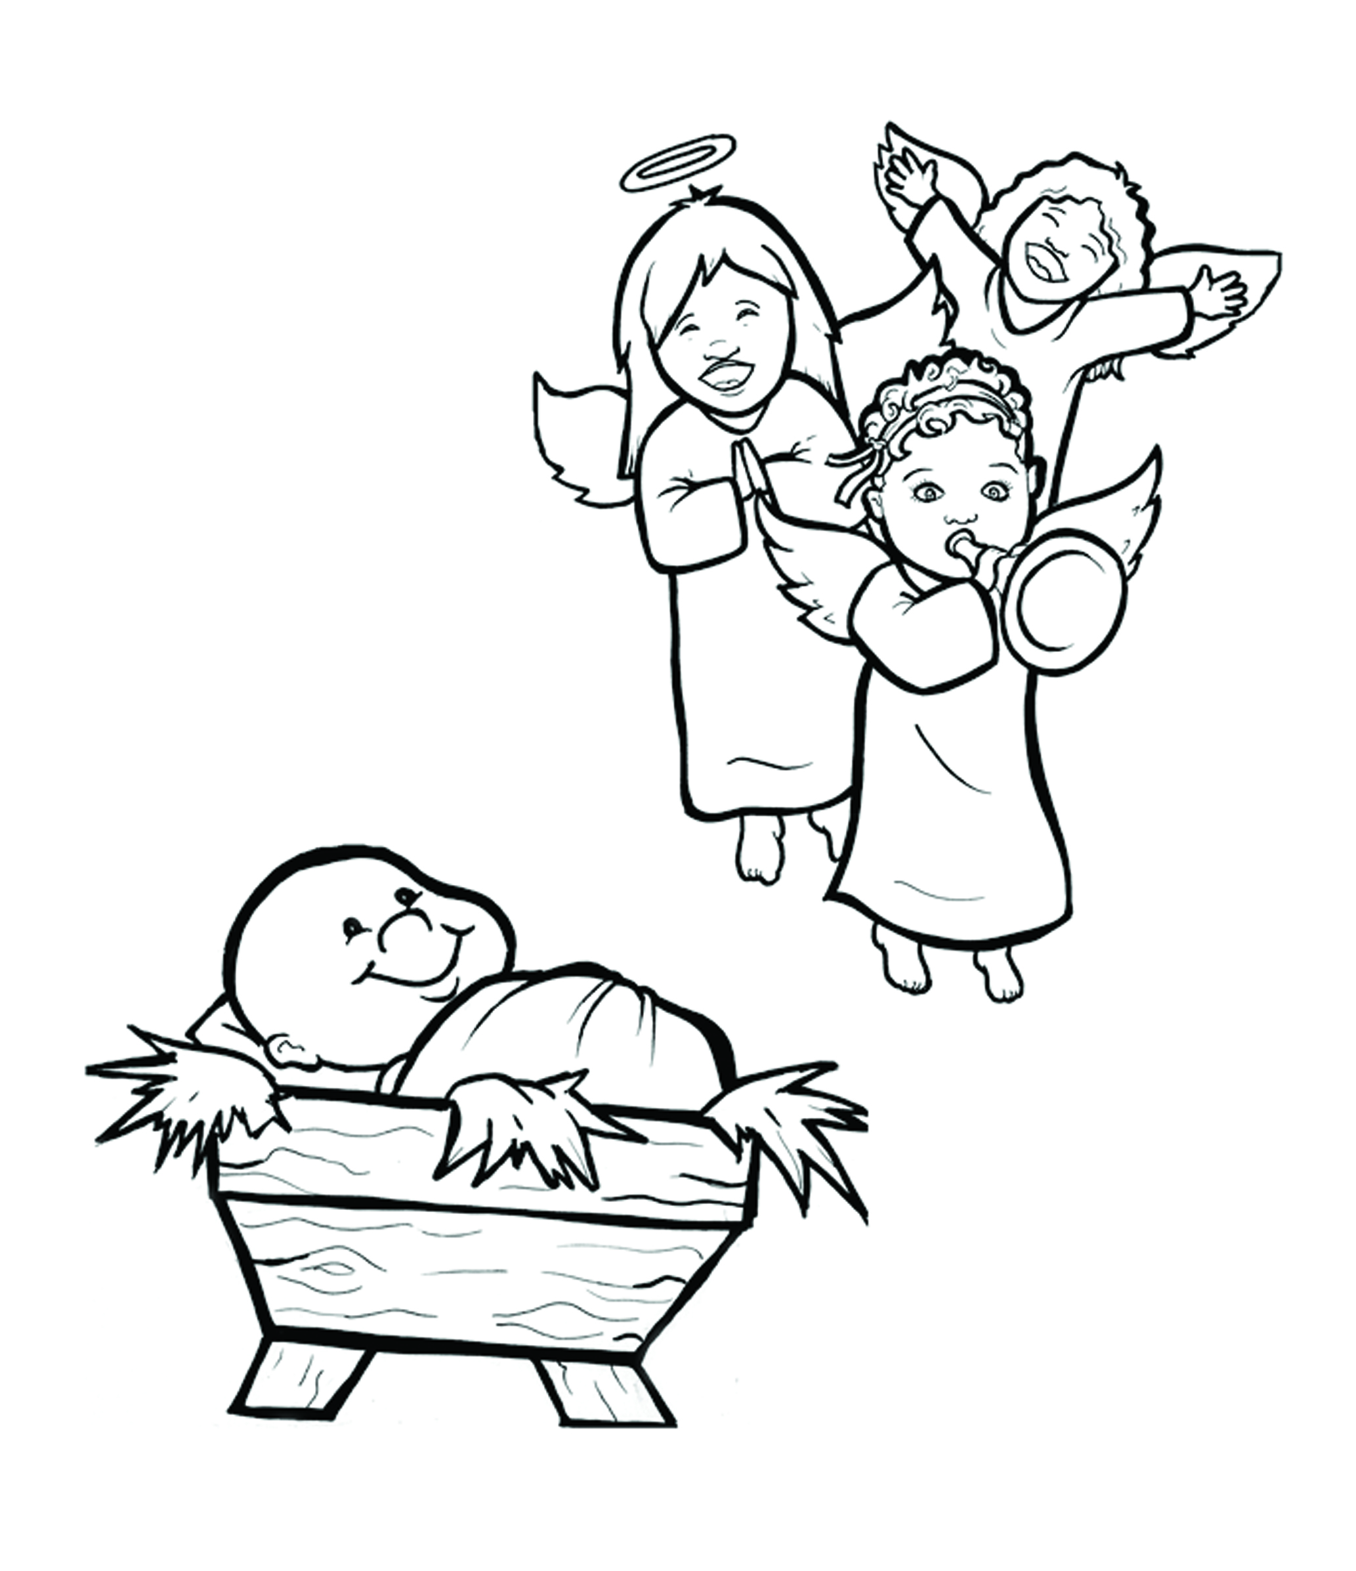
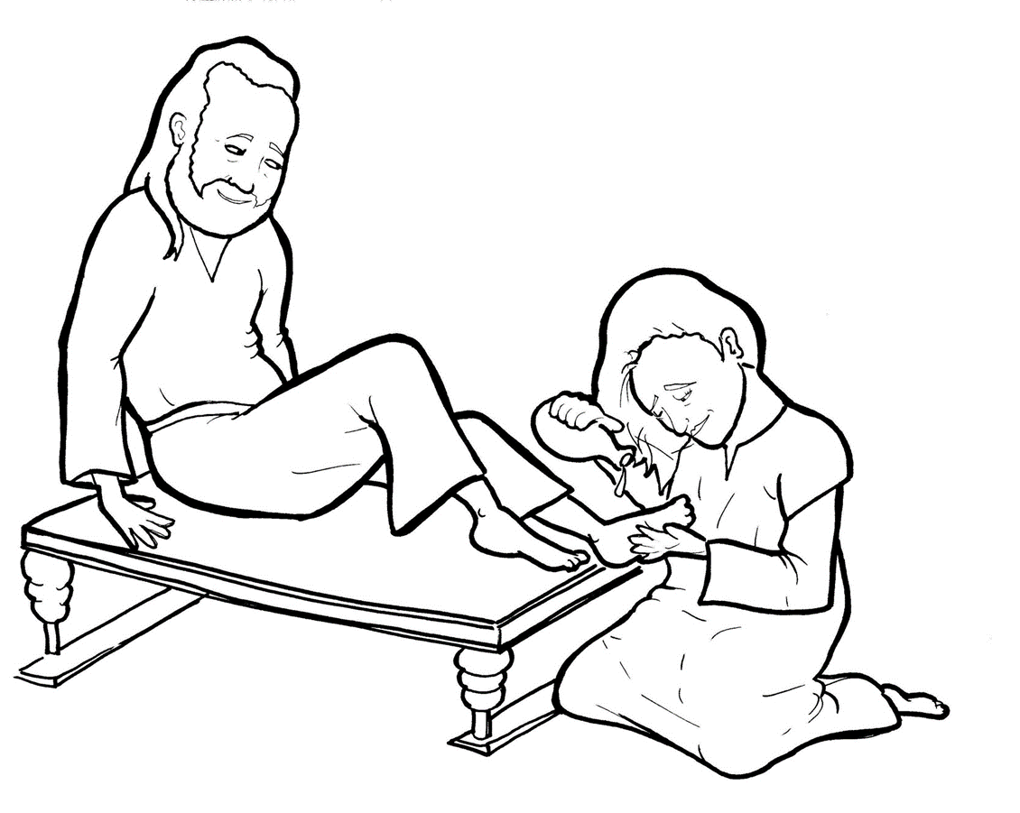
14. A Woman Washes Jesus’ Feet
Part 4
Story in Easy Read English
Questions
Story in Phrases

Slide 2
Jesus ate dinner with his friends.

Slide 3
A woman came to the house.

Slide 4
She came with her own perfume.

Slide 5
It cost a lot of money.

Slide 6
In tears, she poured the perfume over Jesus’ feet.

Slide 7
The whole house smelled sweet.

Slide 8
She wiped Jesus’ feet with her long hair.

Slide 9
She cried and kissed his feet.

Slide 10
She felt sorry for her sins.

Slide 11
Judas was a disciple.

Slide 12
He yelled, “That perfume cost a lot of money!

Slide 13
She should have sold it.

Slide 14
Then, she should have given the money to the poor.”

Slide 15
“Leave her alone,” Jesus said.

Slide 16
“She did a beautiful thing to me.

Slide 17
She did what she could.

Slide 18
“You will always have poor people with you.

Slide 19
But, you will not always have me with you.”

Slide 20
The woman did this for a reason.

Slide 21
An important reason.

Slide 22
Jesus was about to die.

Slide 23
The woman was getting him ready to be buried.

Slide 24
“Truly, I tell you,” Jesus said,

Slide 25
“what she has done will be told around the world.”

Slide 26
And it has.

Slide 27
Question 1
Why did Jesus say, “She did a beautiful thing to me”?

Slide 28
Question 2
What are some ways that people can show love for Jesus?

Slide 29
Question 3
What beautiful thing can you do for Jesus?

Slide 30
Prayer
Dear Jesus,
Help me to love you deeply. Help me to pour out my love for you. I also want to do beautiful things for you.
Amen

Slide 31
A Woman Washes Jesus’ Feet
Phrased for Fluency

Slide 32
Jesus
ate dinner
with his friends.

Slide 33
A woman
came
to the house.

Slide 34
She came with
her own perfume.

Slide 35
It cost
a lot of money.

Slide 36
In tears,
she poured the perfume
over Jesus’ feet.

Slide 37
The whole house
smelled sweet.

Slide 38
She wiped
Jesus’ feet
with her long hair.

Slide 39
She cried
and kissed
his feet.

Slide 40
She felt sorry
for her sins.

Slide 41
Judas
was a disciple.

Slide 42
He yelled,
“That perfume
cost
a lot of money!

Slide 43
She should have
sold it.

Slide 44
Then,
she should have
given the money
to the poor.”

Slide 45
“Leave her alone,”
Jesus said.

Slide 46
“She did
a beautiful thing
to me.

Slide 47
She did
what she could.

Slide 48
You
will always have
poor people
with you.

Slide 49
But,
you will not
always have me
with you.”

Slide 50
The woman
did this
for a reason.

Slide 51
An important reason.

Slide 52
Jesus
was about
to die.

Slide 53
The woman
was getting him ready
to be buried.

Slide 54
“Truly,
I tell you,”
Jesus said,

Slide 55
“what
she has done
will be told
around the world.”

Slide 56
And it has.

