Slide 1

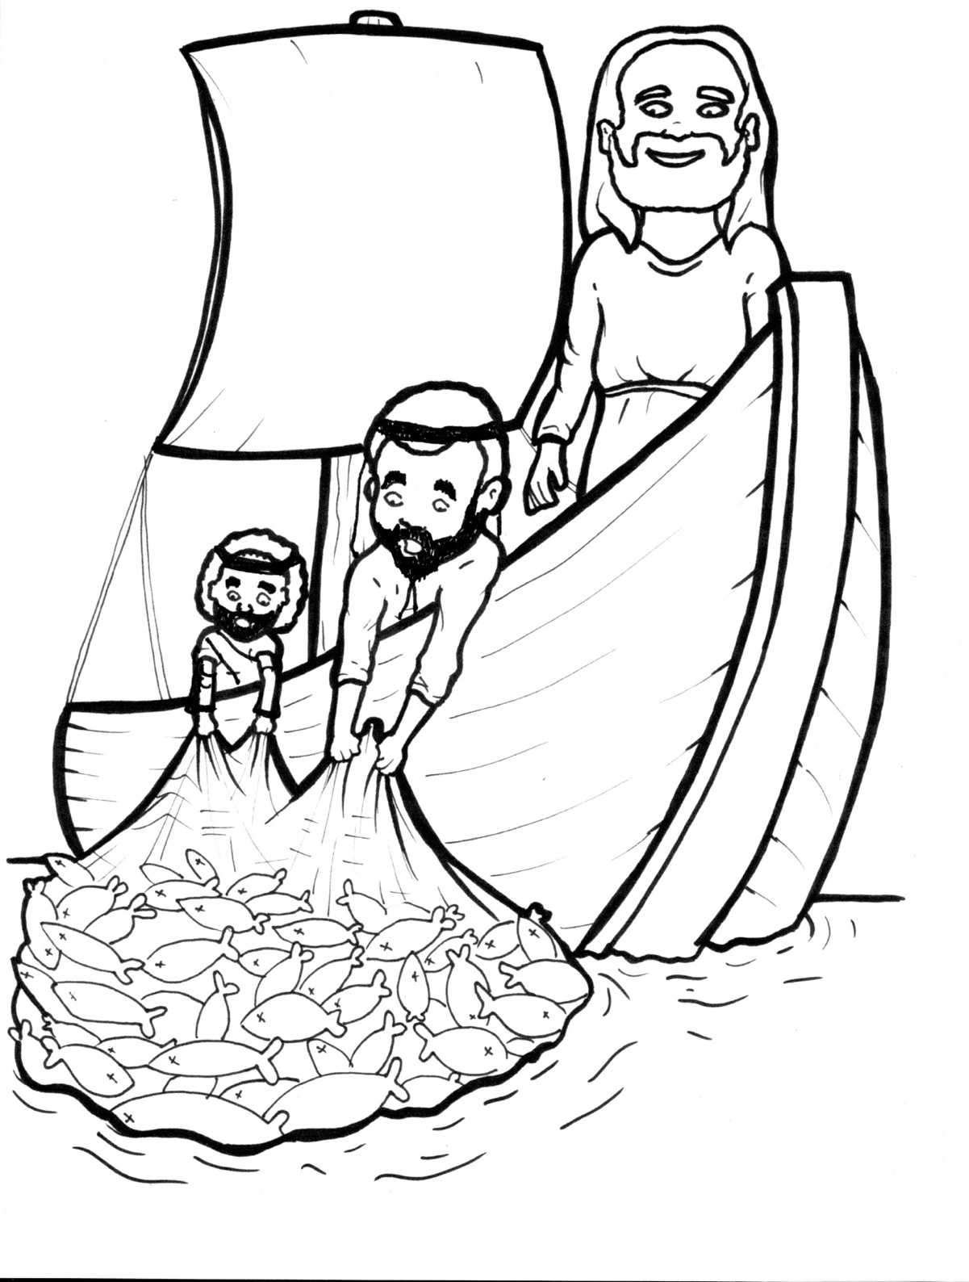
16. Jesus Commands Fish
Part 5
Vocabulary
Original Bible Story

Slide 2
Vocabulary

Slide 3
multitude
(MUL -
ti -
tude):
a crowd

Slide 4
press
(press):
to push forward

Slide 5
Word of God
(Word -
of -
God):
God's words as given in the Bible

Slide 6
beckon
on):
(BECK -
to call

Slide 7
put out
(PUT-
out):
to move the boat
farther from the shore

Slide 8
depart
PART):
(de -
to go away

Slide 9
Jesus Commands Fish
Luke 5:1-11
World English Bible (WEB)

Slide 10
Now while the multitude pressed on him and heard the Word of God, he was standing by the Lake of Gennesaret.

Slide 11
He saw two boats standing by the lake, but the fishermen had gone out of them, and were washing their nets.

Slide 12
He entered into one of the boats, which was Simon’s, and asked him to put out a little from the land.

Slide 13
He sat down and taught the multitudes from the boat.

Slide 14
When he had finished speaking, he said to Simon, “Put out into the deep, and let down your nets for a catch.”

Slide 15
Simon answered him, “Master, we worked all night, and took nothing; but at your word I will let down the net.”

Slide 16
When they had done this, they caught a great multitude of fish, and their net was breaking.

Slide 17
They beckoned to their partners in the other boat, that they should come and help them.

Slide 18
They came, and filled both boats, so that they began to sink.

Slide 19
But Simon Peter, when he saw it, fell down at Jesus’ knees, saying, “Depart from me, for I am a sinful man.”

Slide 20
For he was amazed, and all who were with him, at the catch of fish which they had caught; and so also were James and John, sons of Zebedee, who were partners with Simon.

Slide 21
Jesus said to Simon, “Don’t be afraid. From now on you will be catching people alive.”

Slide 22
When they had brought their boats to land, they left everything, and followed him.

