Slide 1
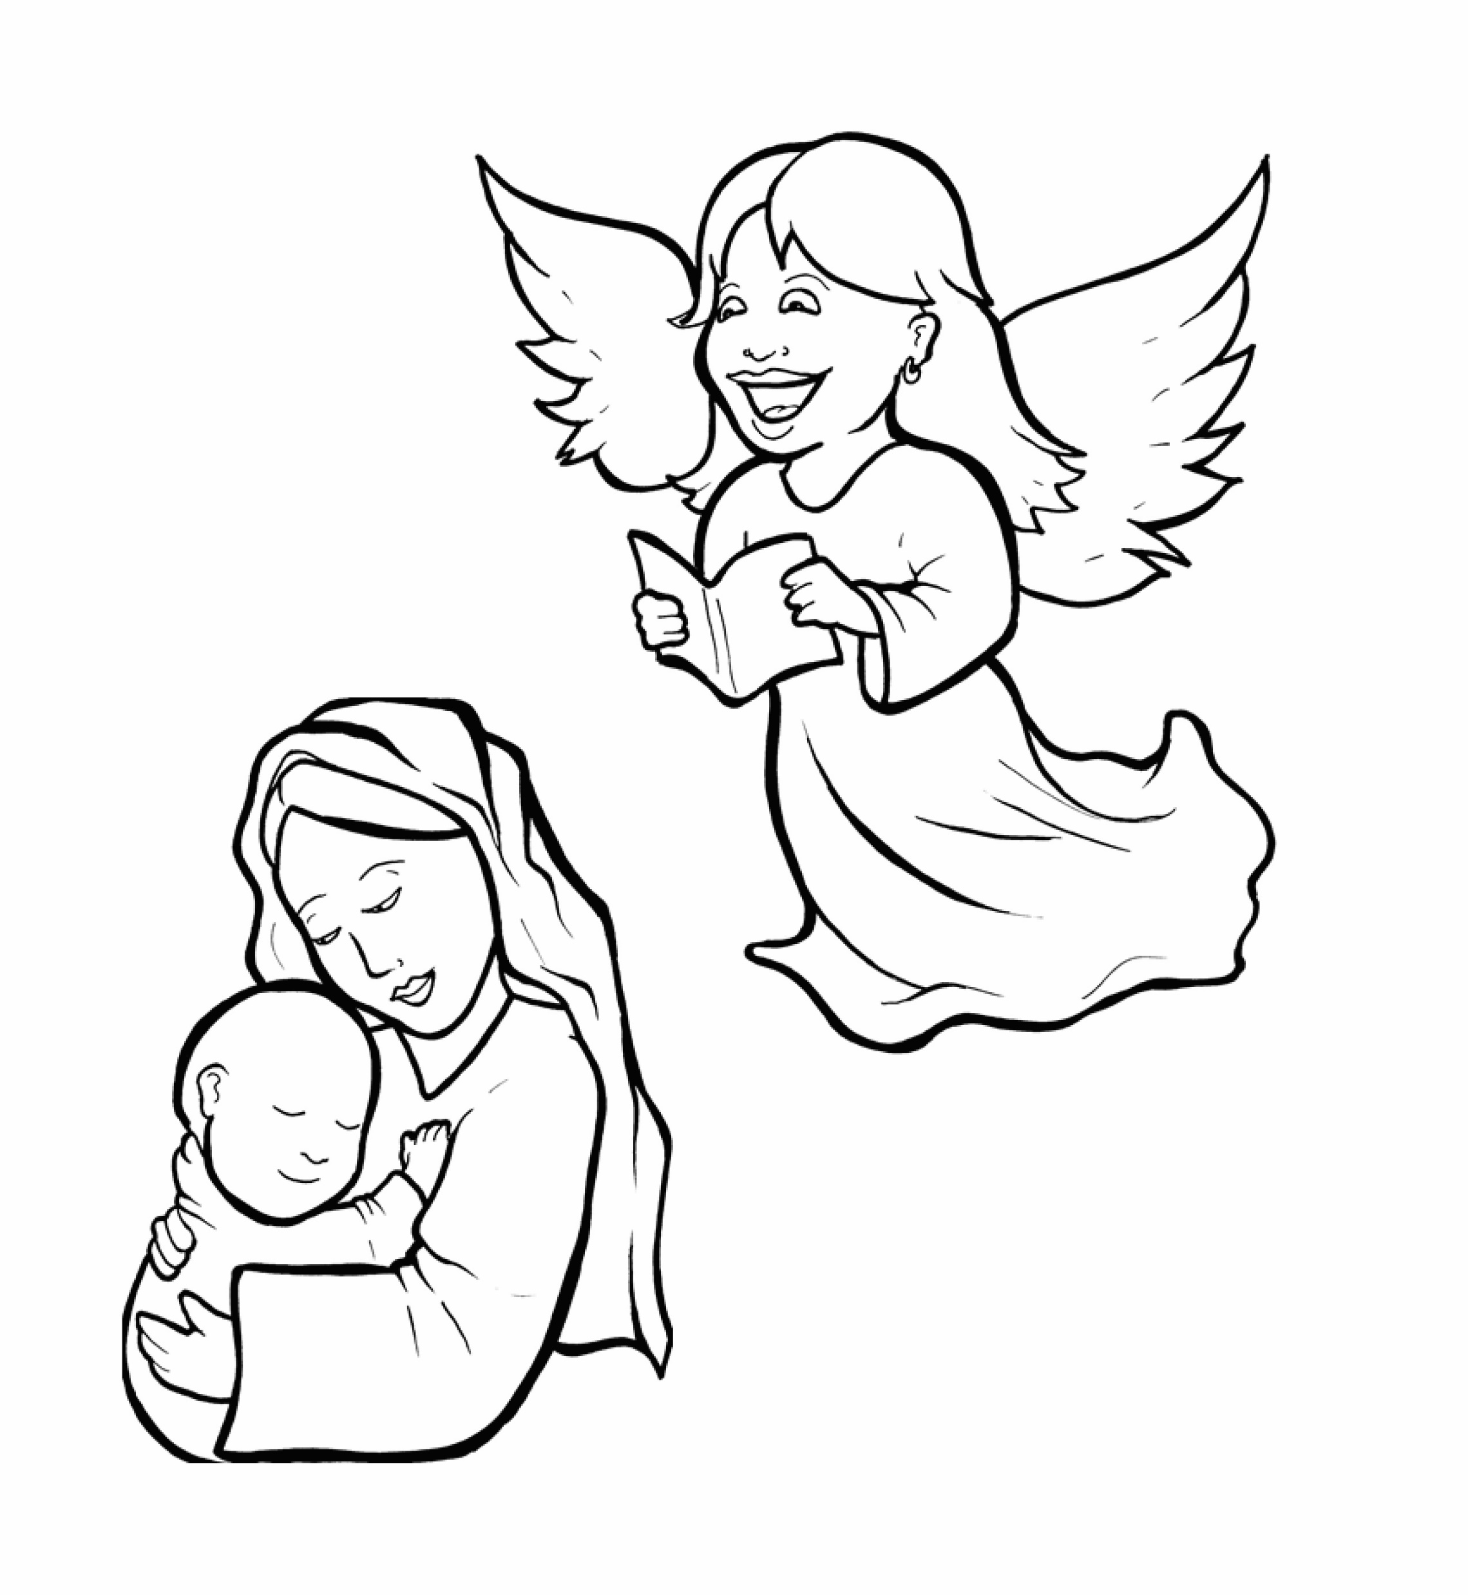
1.Will Mary Say Yes to God?
Part 4
Story in Easy Read English
Questions
Story in Phrases

Slide 2
Mary and Joseph were soon to be married.

Slide 3
They both loved God and obeyed him.

Slide 4
God told the angel Gabriel,

Slide 5
"Go to Nazareth and tell Mary about a wonderful job I have for her."

Slide 6
The angel Gabriel came to Mary.

Slide 7
He said, "Rejoice!
The Lord is with you.

Slide 8
Mary, you are blessed."

Slide 9
Mary was afraid and upset.

Slide 10
But the angel said, "Don't be afraid, Mary.

Slide 11
God is happy with you.

Slide 12
You are going to have a baby!

Slide 13
You must call him Jesus.

Slide 14
Your son will be a mighty king.

Slide 15
His kingdom will never end."

Slide 16
Mary asked, "How will this be?"

Slide 17
The angel said, "Nothing is impossible with God.

Slide 18
The Holy Spirit will come over you.

Slide 19
This child will be called Son of the Most High God."

Slide 20
Mary said, "Yes. I am a servant of the Lord.

Slide 21
Let it be done to me as God says."

Slide 22
The angel left.

Slide 23
Baby Jesus grew inside Mary.

Slide 24
She was happy that she said yes to God.

Slide 25
Question 1
God put Mary into a special place and time to do a very special job. What job did God give Mary?

Slide 26
Question 2
Mary could have said, "No. That job is too big, too hard, too scary.” What did she say?

Slide 27
Question 3
What should we say when God gives us a job to do?

Slide 28
Question 4
What job is God giving you that might be big, hard, long, or scary?

Slide 29
Pray this Prayer
Dear King Jesus,
Thank you for coming into our world.
Thank you that Mary said yes.
Lord, I also say yes.
Amen

Slide 30
Story in Phrases
Will Mary Say Yes to God?
Phrased for Fluency

Slide 31
Mary and Joseph
were soon
to be married.

Slide 32
They both
loved God
and obeyed him.

Slide 33
God
told the angel
Gabriel,

Slide 34
"Go
to Nazareth
and tell Mary
about
a wonderful job
I have
for her."

Slide 35
The angel Gabriel
came
to Mary.

Slide 36
He said,
"Rejoice!
The Lord
is with you.

Slide 37
Mary,
you
are blessed."

Slide 38
Mary
was afraid
and upset.

Slide 39
But the angel said,
"Don't
be afraid,
Mary.

Slide 40
God
is happy
with you.

Slide 41
You
are going
to have a baby!

Slide 42
You
must call him
Jesus.

Slide 43
Your son will be
a mighty king.

Slide 44
His kingdom
will never end."

Slide 45
Mary asked,
"How
will this be?"

Slide 46
The angel said,
"Nothing
is impossible
with God.

Slide 47
The Holy Spirit
will come
over you.

Slide 48
The child
will be called
“Son
of the Most High
God."

Slide 49
Mary said,
"Yes.
I am
a servant
of the Lord.

Slide 50
Let it be
done to me
as God says."

Slide 51
The angel left.

Slide 52
Baby Jesus
grew inside
Mary.

Slide 53
She was happy
that she said
yes
to God.

