Slide 1

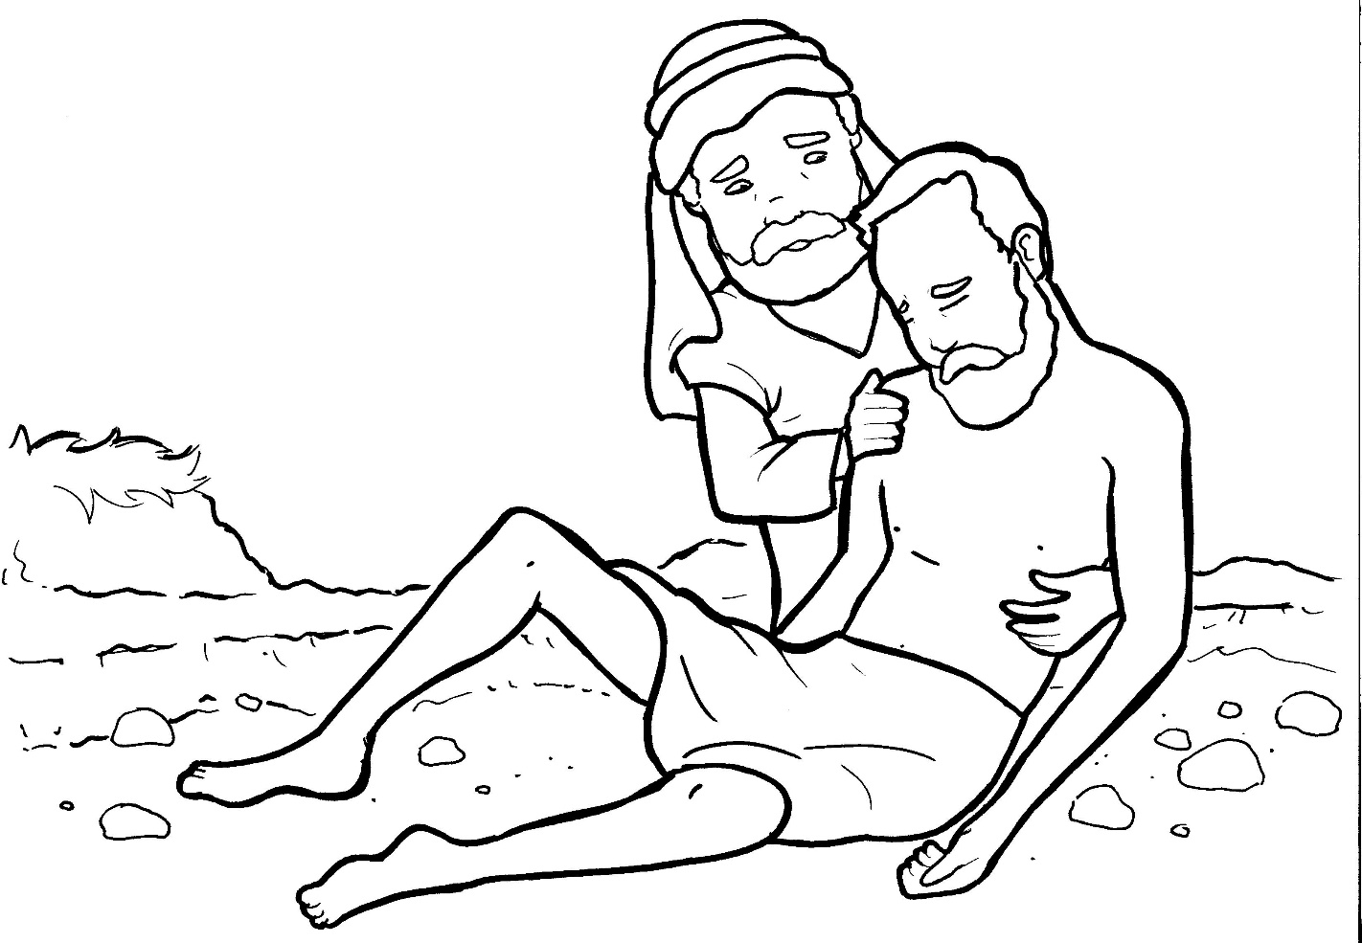
Part 5
25. The Good Samaritan
Vocabulary
Original Bible Story

Slide 2

Vocabulary

Slide 3
justify
(JUST - i - fy)
to explain why you did something

Slide 4
compassion
(com – PAS – sion)
feeling sorry for someone and wanting to help

Slide 5
bound
(bound)
tied or wrapped up

Slide 6
wounds
(wounds)
sores or injuries

Slide 7
denarii
(den – AR – ii)
Roman money used in Israel

Slide 8
mercy
(MER – cy)
kindness given to a person who did not earn it

Slide 9
The Good
Samaritan
Luke 10: 29-37
World English Bible (WEB)

Slide 10
But he,
desiring to justify himself,
asked Jesus,
“Who is my neighbor?”

Slide 11
Jesus answered,
“A certain man was going down
from Jerusalem to Jericho,

Slide 12
and he fell among robbers,
who both stripped him
and beat him,

Slide 13
and departed,
leaving him half dead.

Slide 14
By chance a certain priest
was going down that way.

Slide 15
When he saw him,
he passed by on the other side.

Slide 16
In the same way, a Levite also,
when he came to the place,

Slide 17
and saw him,
passed by on the other side.

Slide 18
But a certain Samaritan,
as he traveled,
came where he was.

Slide 19
When he saw him,
he was moved with compassion,

Slide 20
came to him,
and bound up his wounds,
pouring on oil and wine.

Slide 21
He set him on his own animal,
brought him to an inn,
and took care of him.

Slide 22
On the next day,
when he departed,
he took out two denarii,

Slide 23
gave them to the host,
and said to him,
‘Take care of him.

Slide 24
Whatever you spend
beyond that,
I will repay you
when I return.’

Slide 25
Now which of these three
do you think
seemed to be a neighbor

Slide 26
to him who fell
among the robbers?”

Slide 27
He said,
“He who showed mercy on him.”

Slide 28
Then Jesus said to him,
“Go and do likewise.”

