Slide 1
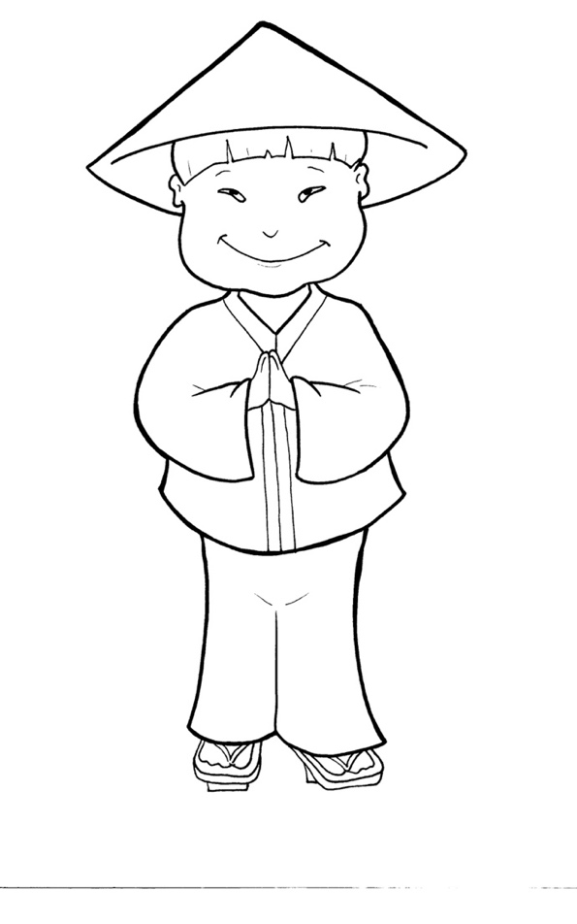
53. I am Alive:
Tell the World
Part 5
Vocabulary
Original Bible Story

Slide 2
Vocabulary

Slide 3
baptize
(BAP - tize):
to show the world you follow
Jesus using a water custom

Slide 4
sign
(sign):
a miracle that points us
to God to bring belief

Slide 5
lawless
(LAW - less):
not obeying rules or laws

Slide 6
crucify
(CRU - ci - fy):
to put someone to death nailing him on a cross

Slide 7
agony
(AG - on - y ):
extreme pain

Slide 8
apostles
(a - POS - tles):
The 12 men first chosen as His followers

Slide 9
I am Alive: Tell the World
Matthew 28:18-20*; Acts 2*
World English Bible (WEB)

Slide 10
Jesus came to them and spoke to them, saying,
“Go and make disciples of all nations,

Slide 11
baptizing them in the name of the Father and of the Son
and of the Holy Spirit…

Slide 12
Behold, I am with you always, even to the end
of the age.” Amen.

Slide 13
Peter, standing up with the eleven, lifted up his voice
and spoke out to them, …

Slide 14
“Jesus of Nazareth, a man approved by God to you by
mighty works and wonders and signs which God did by
him among you,

Slide 15
even as you yourselves know…
by the hand of lawless men,
you have taken Him
crucified and killed;

Slide 16
whom God raised up,
of death,
held by it.
having freed him from the agony
because it was not possible that he should be

Slide 17
“Let all the house of Israel
that God has made him both Lord and Christ,
this Jesus whom you crucified.”
therefore know certainly

Slide 18
Now when they heard this, they were cut to the heart,
and said to Peter and the rest of the apostles,
“Brothers, what shall we do?”

Slide 19
Peter said to them, “Repent, and be baptized,
every one of you, in the name of Jesus Christ
for the forgiveness of sins, and you will receive
the gift of the Holy Spirit.

Slide 20
For this promise is to you, and to your children,
and to all who are far off, even as many as the
Lord our God will call to himself.”

Slide 21
Then those who gladly received his word were baptized.
There were added that day about three thousand souls.
* Matthew 28:18-20; Acts 2:14; 22 – 23; 32-33; 38-41 (modified)

