Slide 1
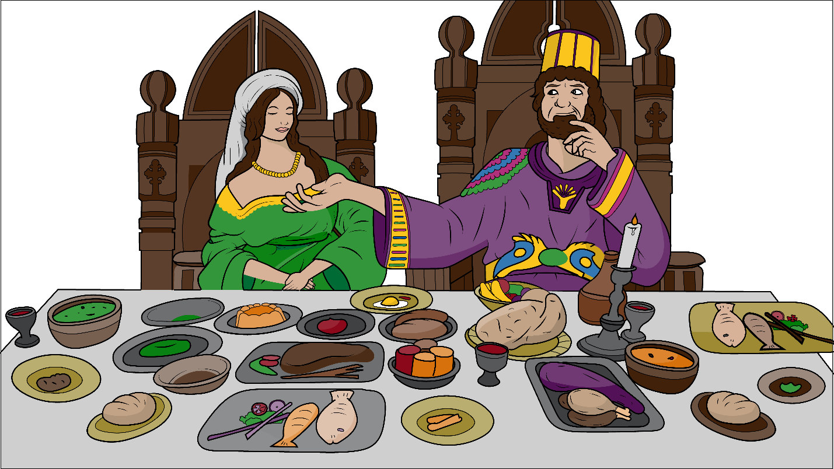
Song 1.9 Why Did The Queen Quit?
Story of
King Xerxes,
Queen Vashti, and Queen Esther
Esther 1-10
(qu), (wh)

Slide 2
Why did the queen
quit?
Why did the queen
quit?

Slide 3
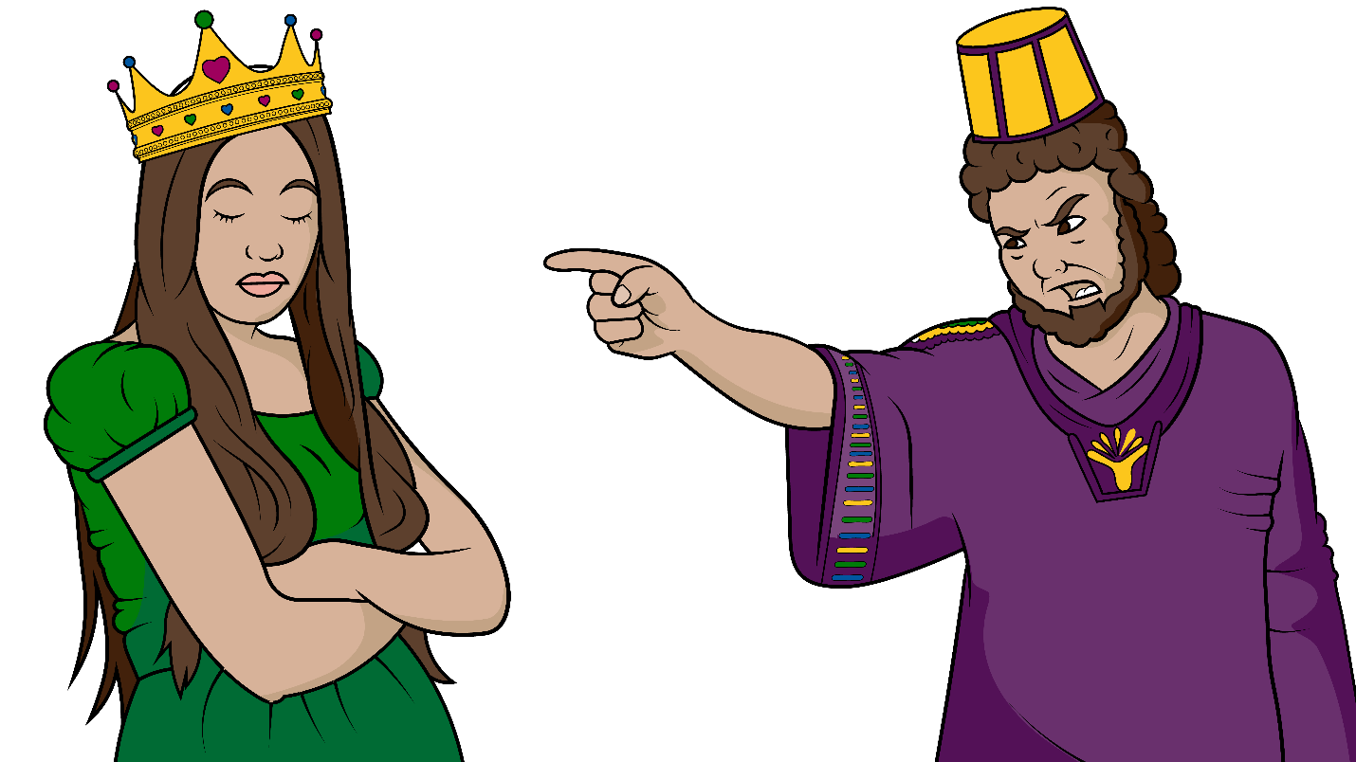
The king said, “She must quit!”
That’s why the queen quit.
That’s why the queen quit.

Slide 4
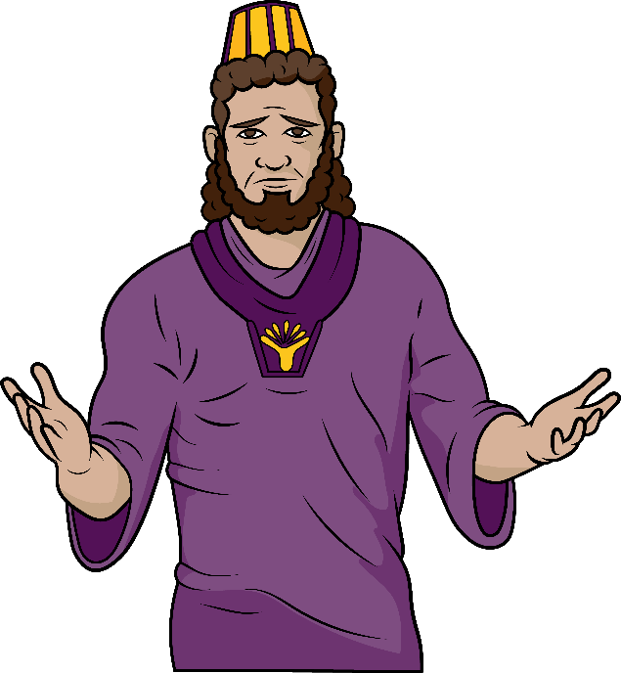
Who will be the next queen?
Who will be the next queen?

Slide 5
Which one? That’s the question.
Who will be the next queen?

Slide 6
Who will be the next queen?
Who will be the next queen?

Slide 7
Which one? That’s the question.
Who will be the next queen?

Slide 8
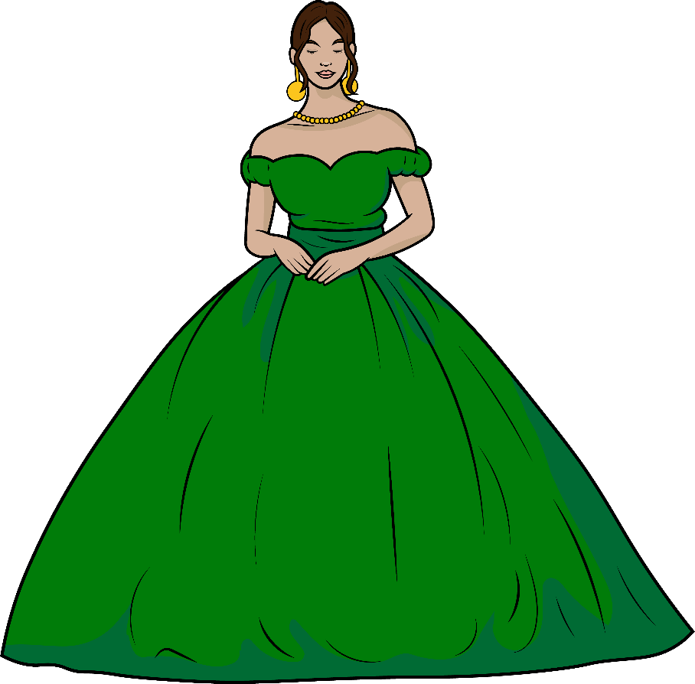
The quiet queen came.
The quiet queen came.

Slide 9
The king had a banquet when the quiet
queen
came.
When the quiet queen came.

Slide 10
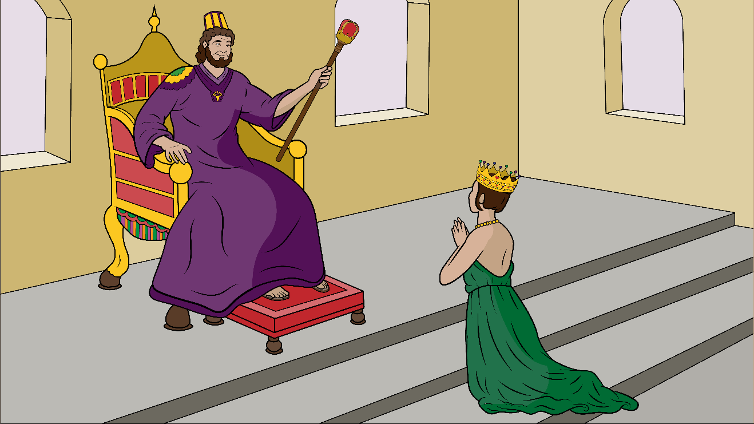
The queen had a request.
The queen had a request.

Slide 11
“What do you want, Esther?
What is your request?”

Slide 12
The queen had a request.
The queen had a request.
“What do you want Esther?
What is your request?”

Slide 13
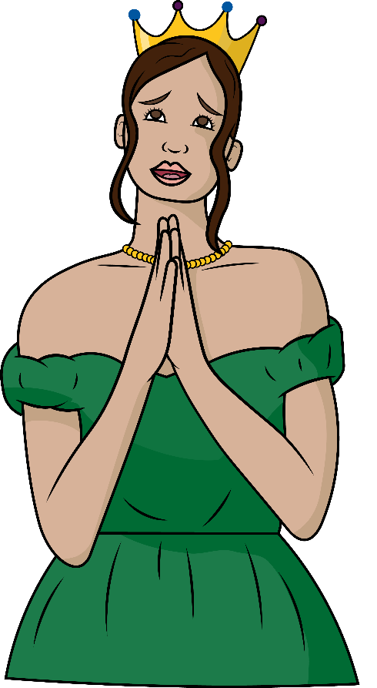
“Quick, stop that bad plan.
Quick, stop that bad plan.”

Slide 14
“Oh, King, save my people!” “Quick, stop that bad plan.”
Quick, stop that bad plan.

Slide 15
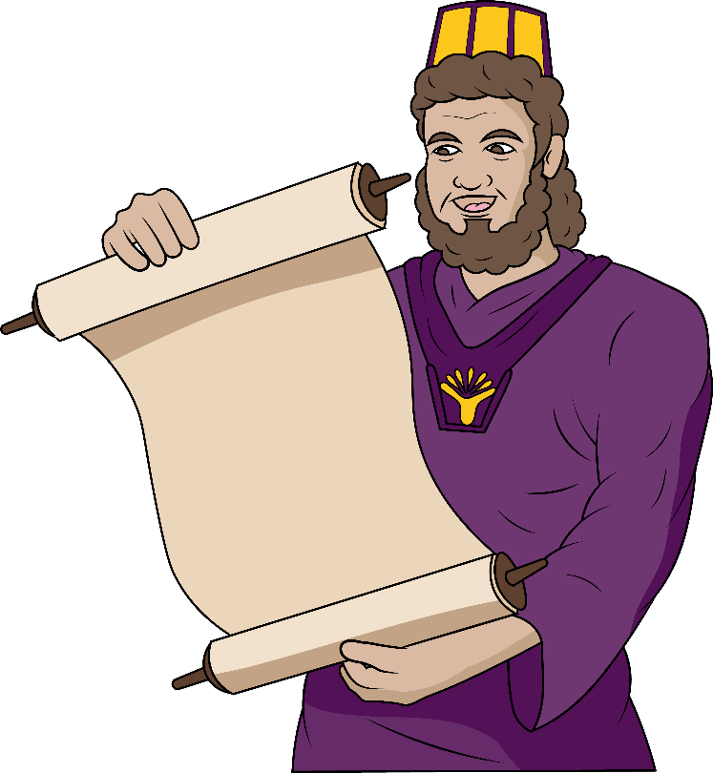
The king stopped that plan.
The king stopped that plan.

Slide 16
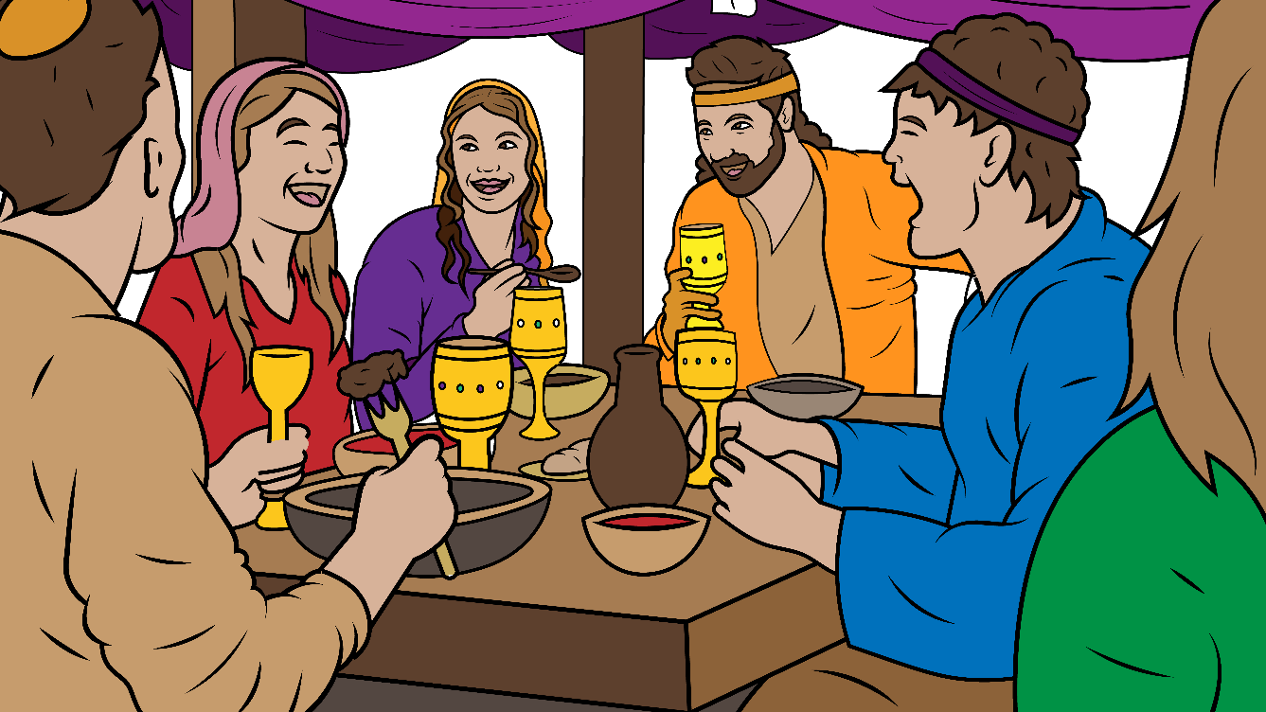
Now, the Jews had a banquet when the king stopped that plan.
When the king stopped that plan.

Slide 17
Why was the queen there?
Why was the queen there?

Slide 18
To save all her people. That’s why God put her there.

Slide 19
Why was the queen there?
Why was the queen there?

Slide 20
To save all her people. That’s why God put her there.

Slide 21
Why are you where you are?
Why are you where you are?

Slide 22
God does have a good plan when he put you there.

Slide 23
Why are you where you are?
Why are you where you are?

Slide 24
God does have a good plan when he put you there.
God does have a good plan when he put you there.

Slide 25
The End

Slide 26
Song lyrics and melody: Carol Hale
Song arrangements and singer: Steffi VornBerger
Illustrations: Ivan Mader, Christine McCurdy
Power Point arrangements: Steve March
www.EasyReadEnglish.com
www.EZReadEnglish.org/Lower-Levels

Slide 27
Another important teaching tool…
Easy Breezy Reading (https://www.easybreezyreading.com)
Designed to help new, struggling, and especially dyslexic learners, Easy Breezy Reading is broken up into Laughing Letters and Funny Phonograms. Both tools use illustrated patterns that mimic the shapes of the letters to give your students one more sense to link the phonetic sound of the letters.
ey
monk
Our scope and sequence matches Easy Read English Lower Levels. Progressing through the Easy Breezy Reading curriculum is sure to accelerate your students’ comprehension of the written English language.
You can procure Laughing Letters or Funny Phonograms through our website.
https://www.easybreezyreading.com/curriculum

