Slide 1
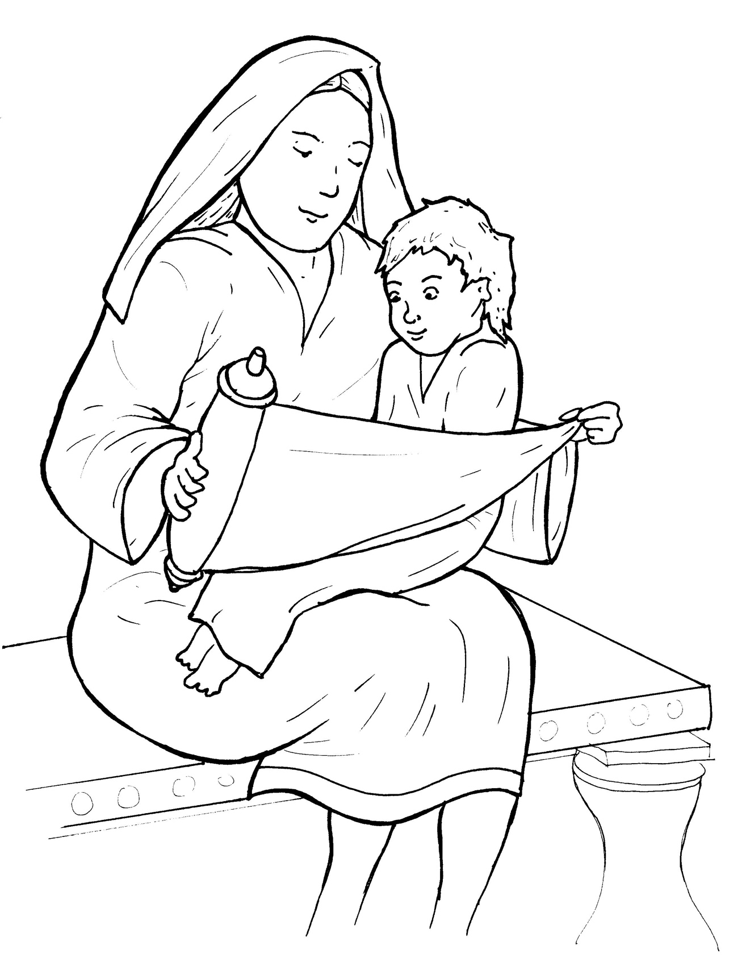
6. Jesus Grows Up
Part 5
Vocabulary
Original Bible Story

Slide 2
Vocabulary

Slide 3
require
(re -
QUIRE):
must do

Slide 4
obedient
BE -
di -
ent):
(o -
to do what you are told

Slide 5
stature
(STAT-
ure):
how tall a person is

Slide 6
wisdom
(WIS -
dom):
knowing right from wrong

Slide 7
treasure
ure):
(TREAS -
to keep and love

Slide 8
favor
(FA -
vor ):
on the side of
(from favorite)

Slide 9
Jesus Grows Up
Luke 2:39-40; 51-52
World English Bible (WEB)

Slide 10
When Joseph and Mary had done everything required by the Law of the Lord, they returned to Galilee to their own town of Nazareth.

Slide 11
And the child grew and became strong;
he was filled with wisdom, and the grace
of God was on him.

Slide 12
Then he went down to Nazareth with them and was obedient to them.
But his mother treasured all these things in her heart .

Slide 13
And Jesus grew in wisdom and stature,
and in favor with God and man.

