Slide 1

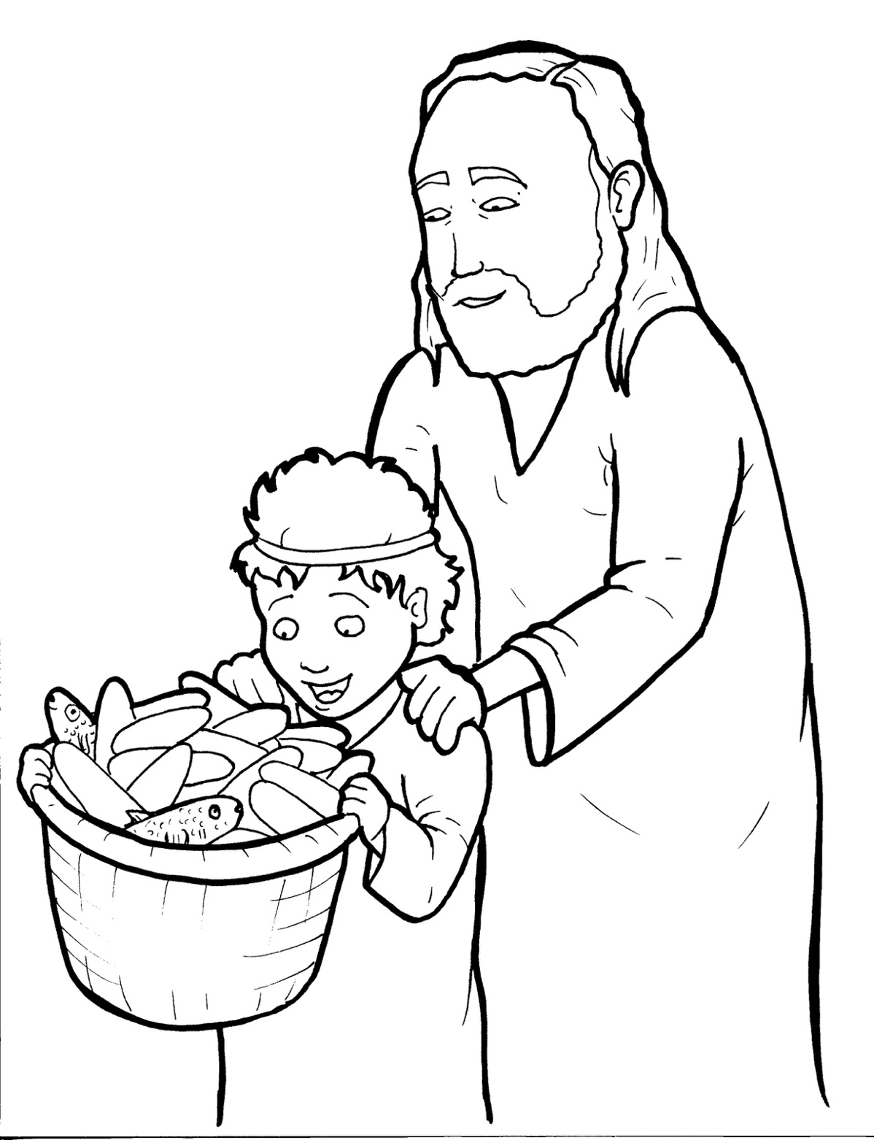
18. Jesus Feeds Five Thousand
Part 3
Syllable Divisions

Slide 2
Dividing Words
Into Syllables

Slide 3
Rabbit Words
When you see two consonants
between two vowels,
divide between the consonants.
ra it
bb
rab bit

Slide 4
un til
until

Slide 5
dis ci ple
disciple

Slide 6
bas kets
baskets

Slide 7
af ter
after

Slide 8
lis ten
listen

Slide 9
per son
person

Slide 10

Tiger Words
When you see one consonant
between two vowels,
divide after the first vowel.
Try this pattern first.
ti er
g
ti ger

Slide 11
Je sus
Jesus

Slide 12
ti ny
tiny

Slide 13
Camel Words
When you see one consonant
between two vowels,
divide after the first consonant.
Try this pattern second.
ca el
m
cam el

Slide 14
cit y
city

Slide 15
Phil ip
Philip

Slide 16
Turtle Words
When you see consonant-l-e,
count back three and divide.
tur
t
l
e
tur tle

Slide 17
peo ple
people

Slide 18
dis ci ple
disciple

Slide 19
lit tle
little

Slide 20
Hamster Words
When you see three consonants between two vowels,
divide after the first consonant.
ha
mst
er
ham ster

Slide 21
An drew
Andrew

Slide 22
ex tra
extra

Slide 23
Lion Words
If a word has two vowels together
that make two different sounds,
divide between the two vowels.
lion
li on

Slide 24
qui et
quiet

Slide 25

Anteater Words
These compound words are made up of two smaller words.
ant
eater
1
2
ant eater

Slide 26
an other
another

Slide 27

Foxes Suffixes
Focus on your base word.
fox es
fox es

Slide 28
asked
asked

Slide 29
healed
healed

Slide 30
listened
listened

Slide 31
giv ing
giving

Slide 32
Other Syllable Divisions
Some words don’t fit so neatly
into standard syllable division patterns.
a way
away

Slide 33
hung ry
hungry

Slide 34
thou sand
thousand

