Slide 1
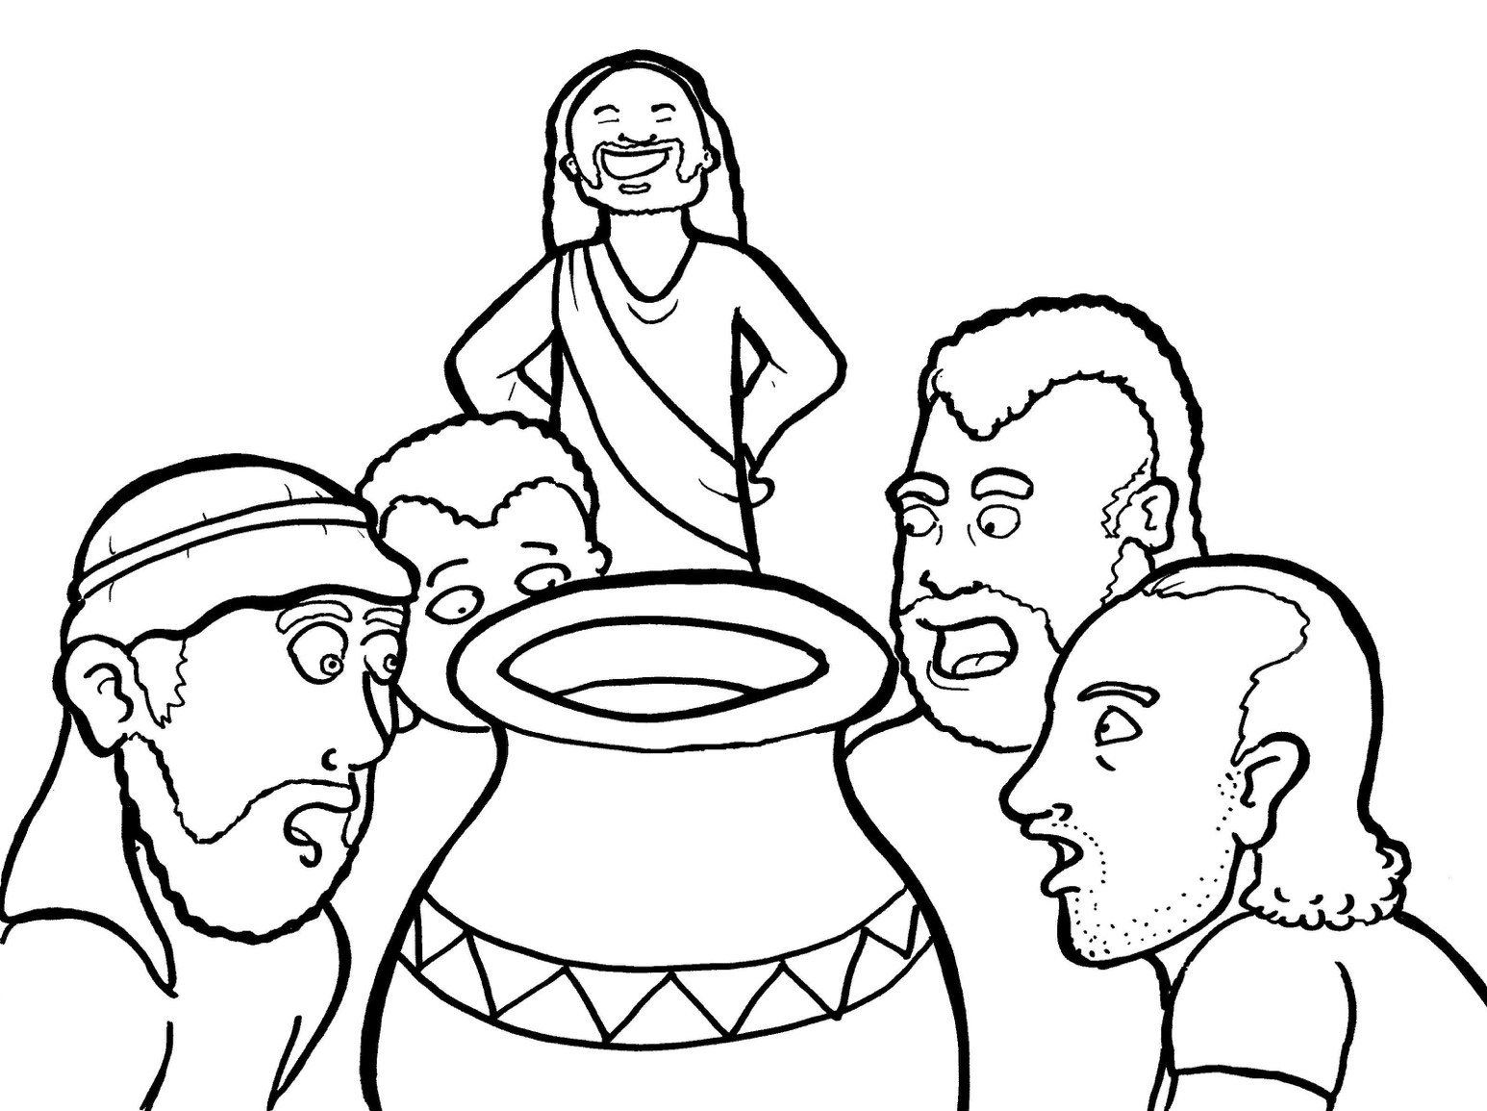
15. Jesus Saves a Wedding
Part 1
Syllable Charts

Slide 2
Words in Syllable Types

Slide 3
Closed – Short Vowel
A closed syllable has one vowel
followed by one or more consonants,
and the vowel is short.
st
o
p
˘

Slide 4
ran
-vant
hap-
dance

Slide 5
wed-
-pen
emp-
-dren
ev-
best

Slide 6
sip
giv-
chil-
six
dis-
-sic

Slide 7
not
lots
soft

Slide 8
-sus

Slide 9
Open – Long Vowel
An open syllable has one vowel
with no consonant after it,
and the vowel is long.
−
go

Slide 10
Ca na

Slide 11
he
be lieve
Je sus

Slide 12
go
no
o bey

Slide 13
mu sic

Slide 14
by

Slide 15
Mar y
hap py
par ty
emp ty
glor y
soft ly

Slide 16
Silent e – Long Vowel
A silent e syllable has one vowel,
followed by one consonant
and a silent e at the end.
The vowel is long.
−
ca
e
v

Slide 17
came
ate
take

Slide 18
fire
bride
wine
time

Slide 19
home
stone

Slide 20
Vowel Teams – Long Vowel
Many vowel teams follow this rule:
When two vowels get together,
the first one names its letter.
So the first vowel will make its long sound,
and the second vowel is silent.
−
e
a
t

Slide 21
play

Slide 22
air

Slide 23
o bey

Slide 24
be lieve

Slide 25
night

Slide 26
glow
show

Slide 27
groom

Slide 28
Vowel Teams – Other Sounds
Sometimes vowel teams make other sounds.
oil

Slide 29
out
a round

Slide 30
now

Slide 31
took

Slide 32
joy

Slide 33
R - Controlled
R-controlled syllables have one or more vowels
followed by an “r.”
The “r” changes the sound of the vowel.
o
r
ange

Slide 34
jar
par ty
charge

Slide 35
torch
glor y

Slide 36
more

Slide 37
her
ev er
wat er
ser vant
per son

Slide 38
first

Slide 39
turn

Slide 40
Consonant – l-e
When you see consonant l-e at the end of a word,
count back three.
The “l-e” makes the /–le/ sound.
pur
p
l
e

Slide 41
disci ple
peo ple

Slide 42
mira cle

Slide 43
Other Sounds – Long Vowel
These syllables or words are closed,
so the vowel should be short,
but the vowel is long.
−
cold

Slide 44
told
sold

Slide 45
Other Sounds – -nk/-ng
The “-nk” and “-ng”
change the sound of the vowel.
bank
thing

Slide 46
drank

Slide 47
wed ding

Slide 48
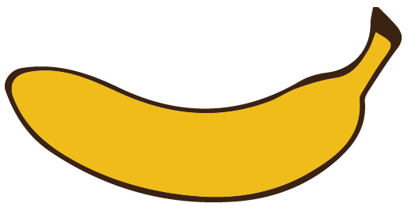
Other Sounds – schwa
The schwa syllable has an “a” that sounds
like the /u/ in banana.
The banana is even shaped like a short u.
ba nan a

Slide 49
a round
Ca na

