Slide 1
Help Me See!
Jesus heals a
blind man.
Mark 10:46-52

Slide 2
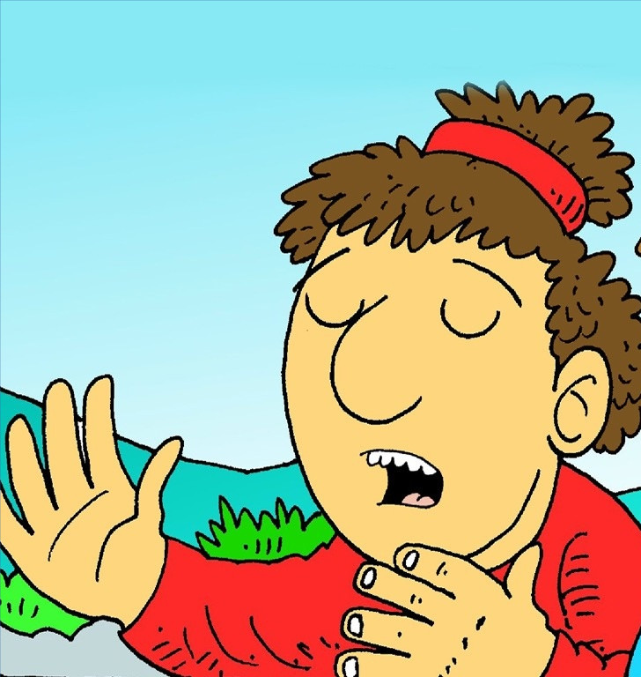
I cannot see.
I cannot see you.
No, I cannot see me.

Slide 3
I cannot see the cat.

Slide 4
I cannot see the sun.

Slide 5
I cannot see the tree.

Slide 6
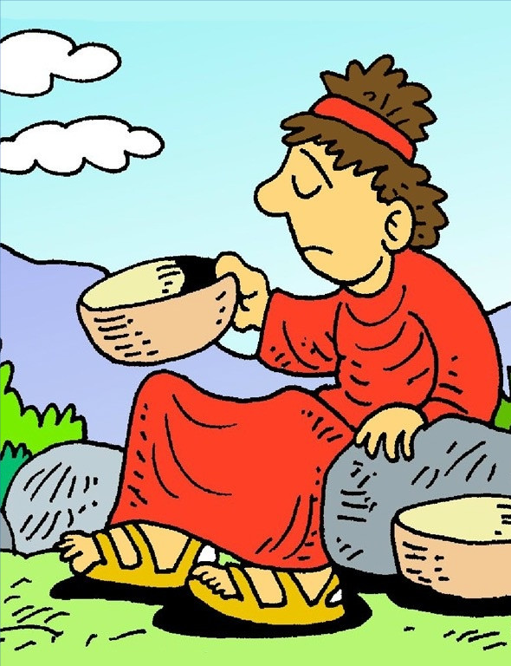
I am sad, so sad.
But, God can see.

Slide 7
I will tell Jesus.
Yes, I will yell!

Slide 8
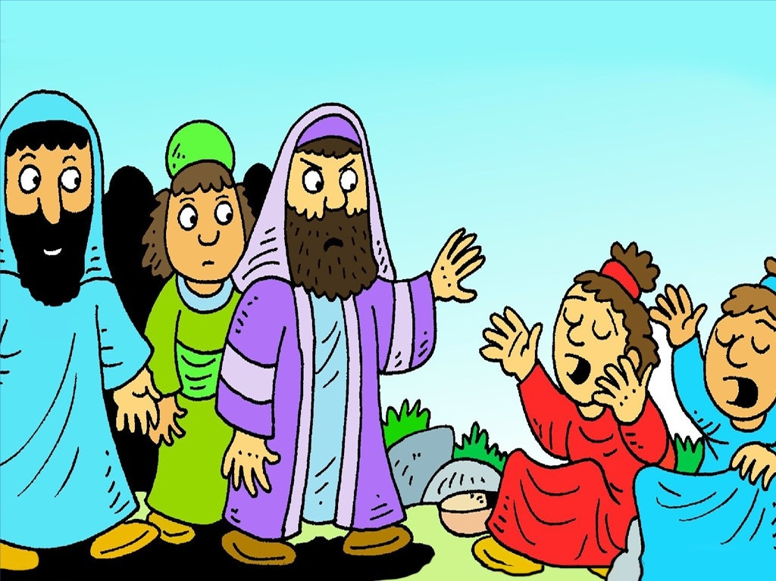
No, do not yell.

Slide 9
Yes, I will yell.

Slide 10
Jesus, help!
I cannot
see.
Can you
help me?

Slide 11
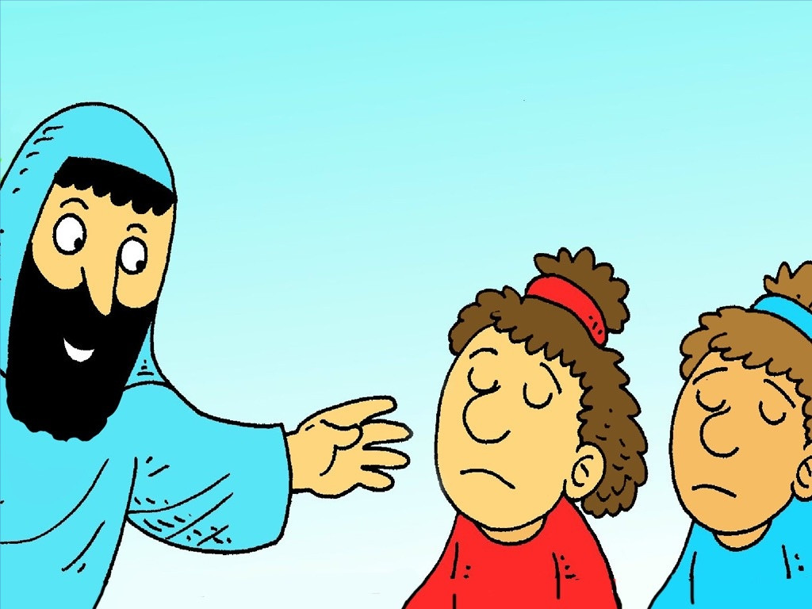
Yes, I can help you.

Slide 12
I ...
can...

Slide 13
see!

Slide 14
I can see. I am not sad.
I can see. I am glad, glad, glad!

Slide 15
I can see you. I can see me.
Yes, I can see the cat.

Slide 16
I can see the sun.

Slide 17
I can see the tree.

Slide 18
And I can see...
Jesus!

Slide 19
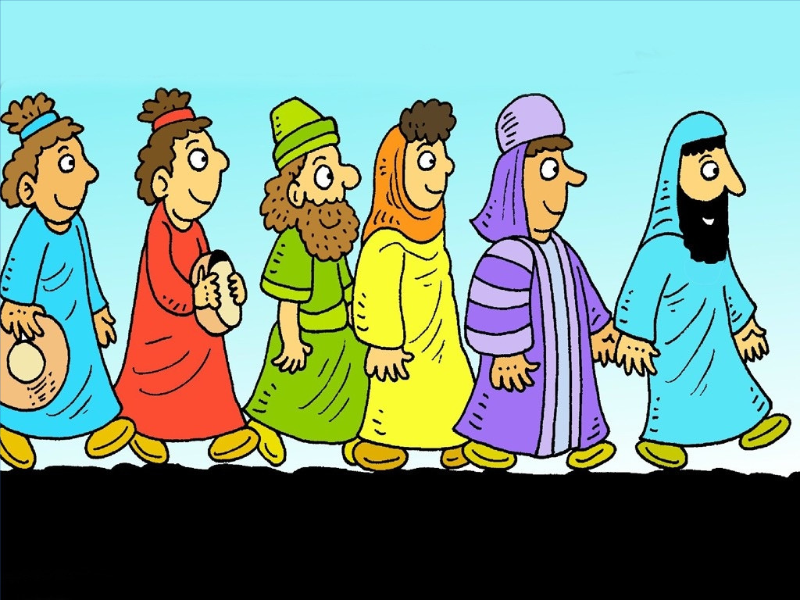
I will go with Jesus.

Slide 20
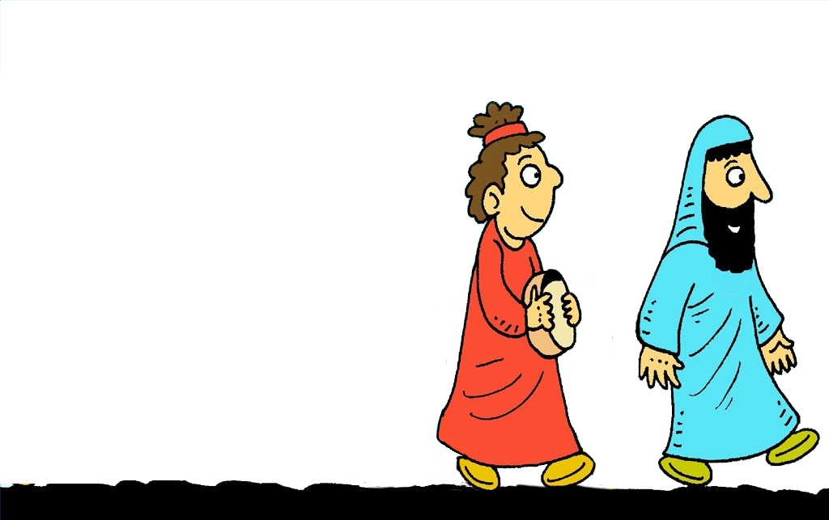
The
End

Slide 21
Fluency Builder

Slide 22
6_FB_LS_Two_BlindMen_1024.jpg
Help Me See!
Jesus heals a
blind man.
Mark 10:46-52

Slide 23
I cannot see.
I cannot see you. No.
I cannot see me.

Slide 24
I cannot see the cat.

Slide 25
I cannot see the sun.

Slide 26
And I cannot see the tree.

Slide 27
I am sad, so sad.
But, God can see.

Slide 28
I will tell Jesus.
Yes, I will yell:
Jesus, help! I cannot see.

Slide 29
Can you help me?

Slide 30
"Yes, I can help you."

Slide 31
I can see! I am not sad.

Slide 32
I can see!
I am glad, glad, glad!

Slide 33
I can see you.
I can see me.

Slide 34
Yes, I can see the cat.

Slide 35
I can see the sun.

Slide 36
And I can see the tree.

Slide 37
And I can see Jesus!
I will go with Jesus.

Slide 38
The End

Slide 39
Help Me See!
With many thanks to
www.FreeBibleImages.org
and
Richard Gunther for his
amazing illustrations.
www.RichardGunther.org
Story by Carol Hale
www.EasyReadEnglish.com

