Slide 1

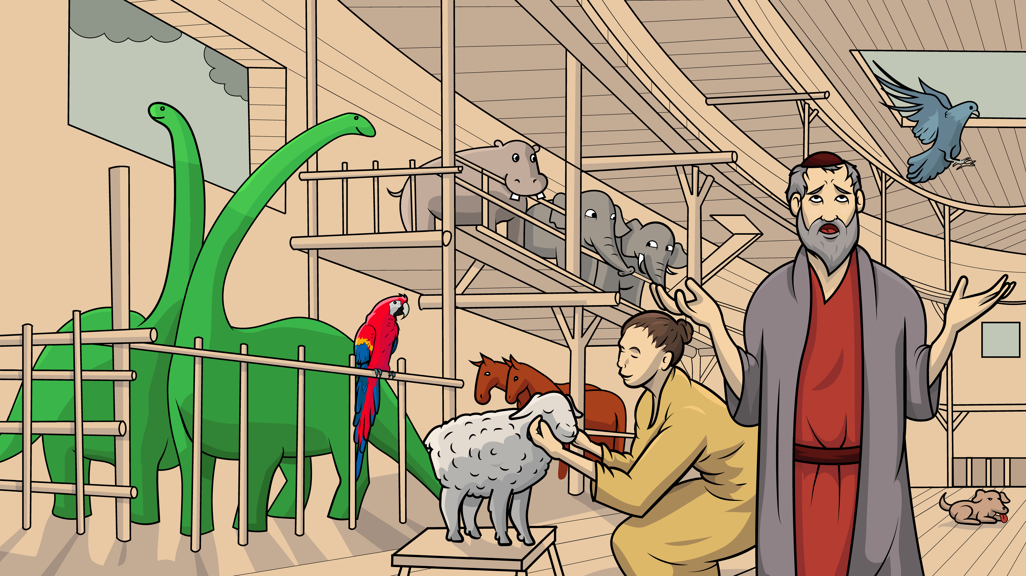
Song 1.10 Oh, No, Off We Go !
Noah’s Ark, Part 2
Genesis 7
( Open Vowels )

Slide 2
Oh me, oh my, oh yes, oh no…

Slide 3
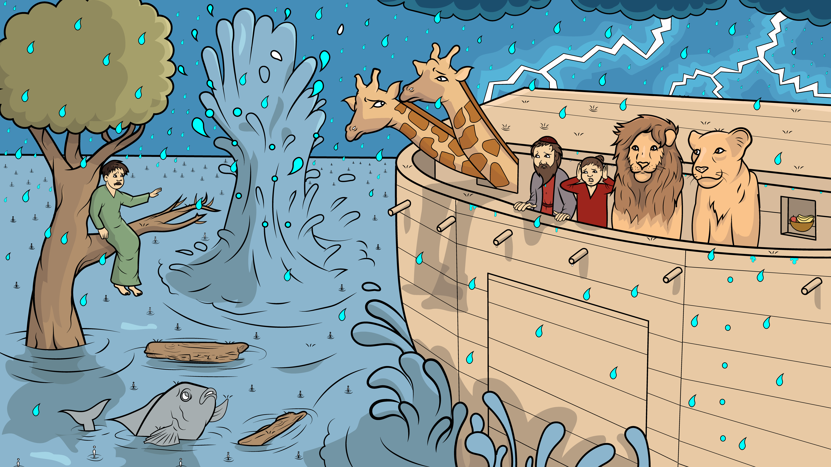
Off we go!

Slide 4
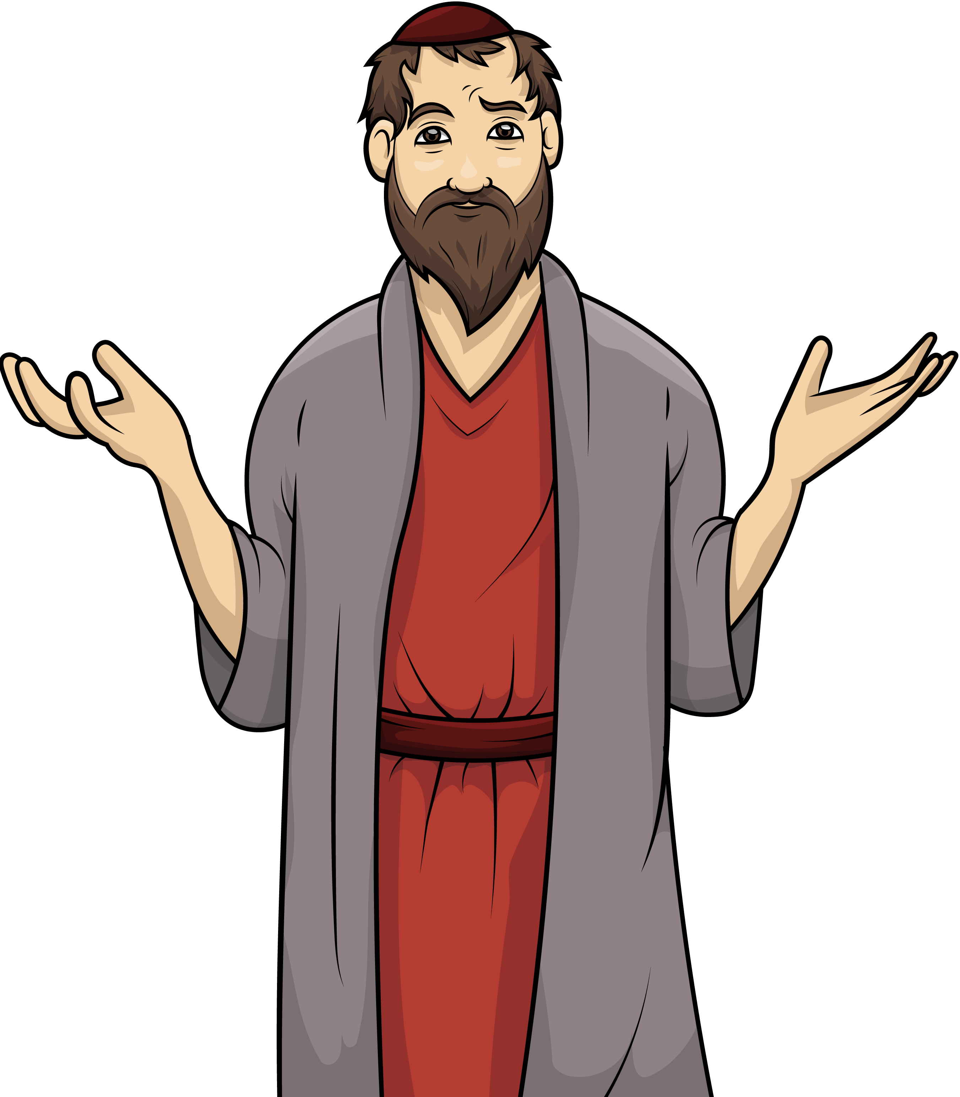
Oh me, oh my,
oh why, why,
why?

Slide 5
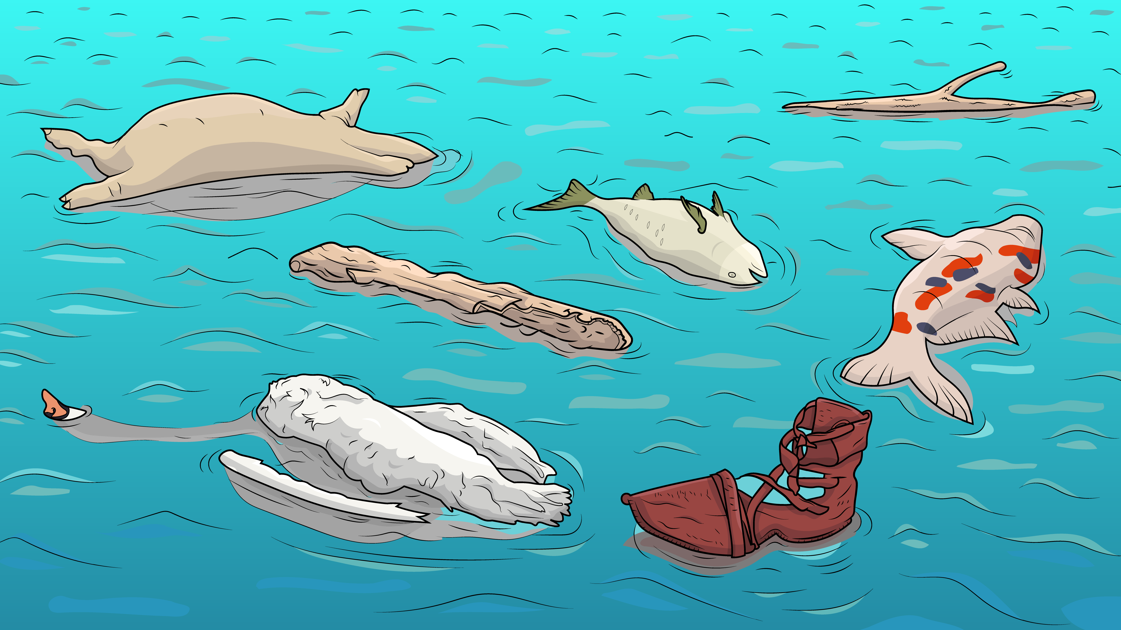
Did the men and the pets all die, die, die?

Slide 6
Oh me, oh my, oh why,
why,
why?

Slide 7
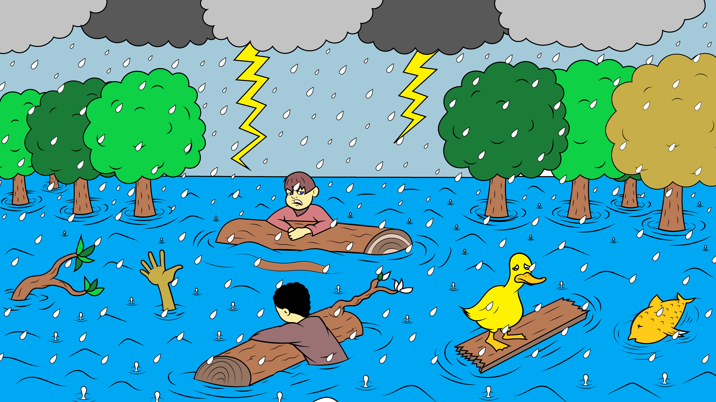
Did the sky open? None is dry, dry, dry.

Slide 8
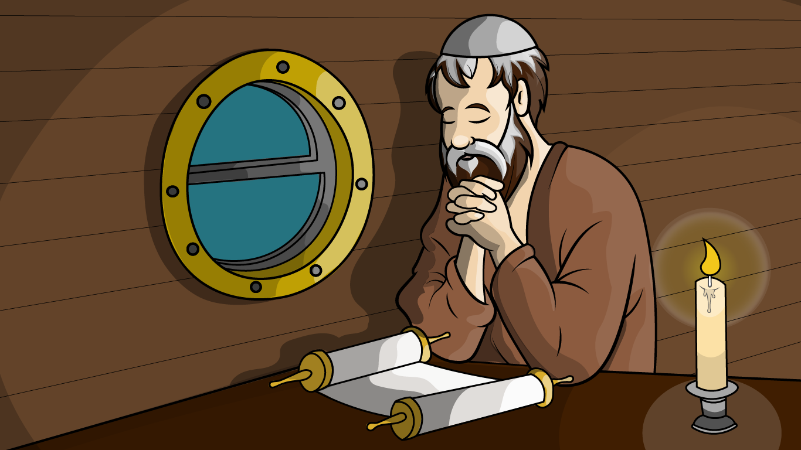
Oh me, oh my, I will try, try, try…

Slide 9
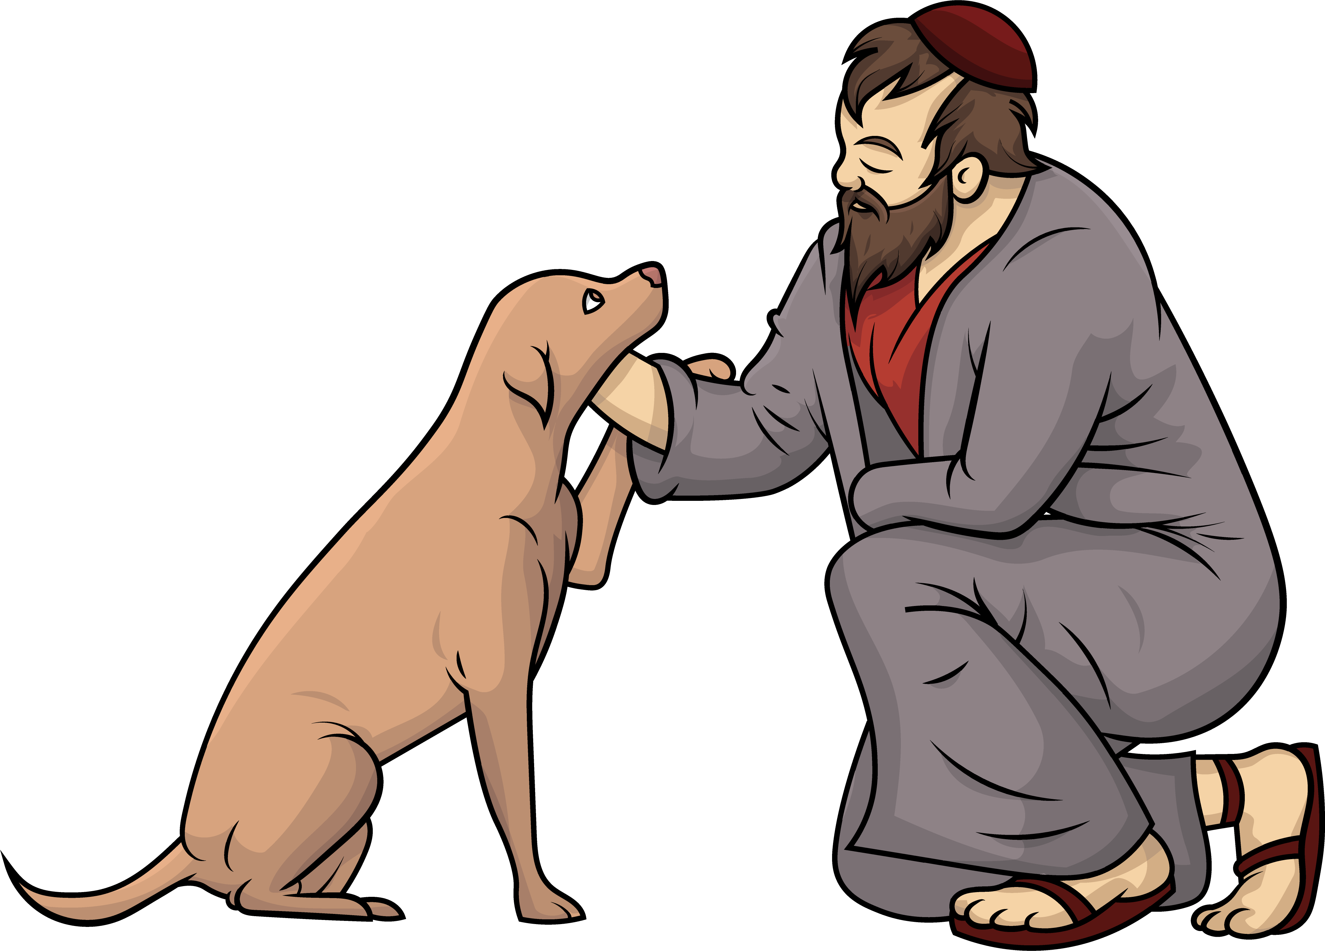
to trust and not to
cry, cry, cry.

Slide 10

Oh, me, oh my, what went by, by, by?

Slide 11
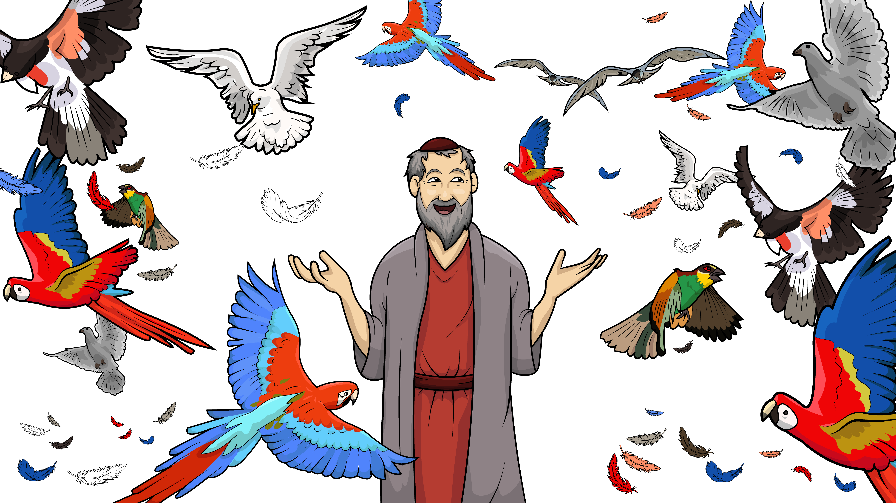
So, the birds on this ship can fly, fly, fly?

Slide 12
Oh me, oh my, oh yes, oh no…

Slide 13
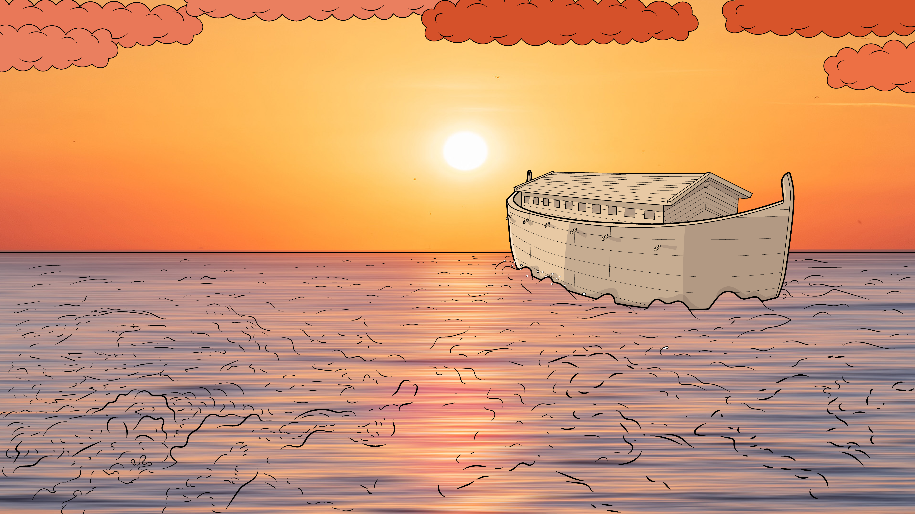
Off we go!

Slide 14
Oh me, oh my,
oh why, why,
why?

Slide 15
Did the men and the pets all die, die, die?

Slide 16
Oh me, oh my, oh why,
why,
why?

Slide 17
Did the sky open? None is dry, dry, dry.

Slide 18
Oh me, oh my, I will try, try, try…

Slide 19
to trust and not to
cry, cry, cry.

Slide 20
Oh, me, oh my, what went by, by, by?

Slide 21
So, the birds on this ship can fly, fly, fly?

Slide 22
Oh me, oh my, oh yes, oh no…

Slide 23
Off we go!

Slide 24
Oh me, oh my,
oh why, why,
why?

Slide 25
Did the men and the pets all die, die, die?

Slide 26
Oh me, oh my, oh why, why,
why?

Slide 27
Did the sky open? None is dry, dry, dry.

Slide 28
Oh me, oh my, I will try, try, try…

Slide 29
to trust and not to
cry, cry, cry.

Slide 30
Oh, me, oh my, what went by, by, by?

Slide 31
So, the birds on this ship can fly, fly, fly?

Slide 32
Oh me, oh my, oh yes, oh no…

Slide 33
Off we go!

Slide 34
The End

Slide 35
Song lyrics and melody: Carol Hale
Song arrangements and singer: Steffi VornBerger
Illustrations: Ivan Mader
Power Point arrangements: Steve March
www.EasyReadEnglish.com
www.EZReadEnglish.org/Lower-Levels

Slide 36
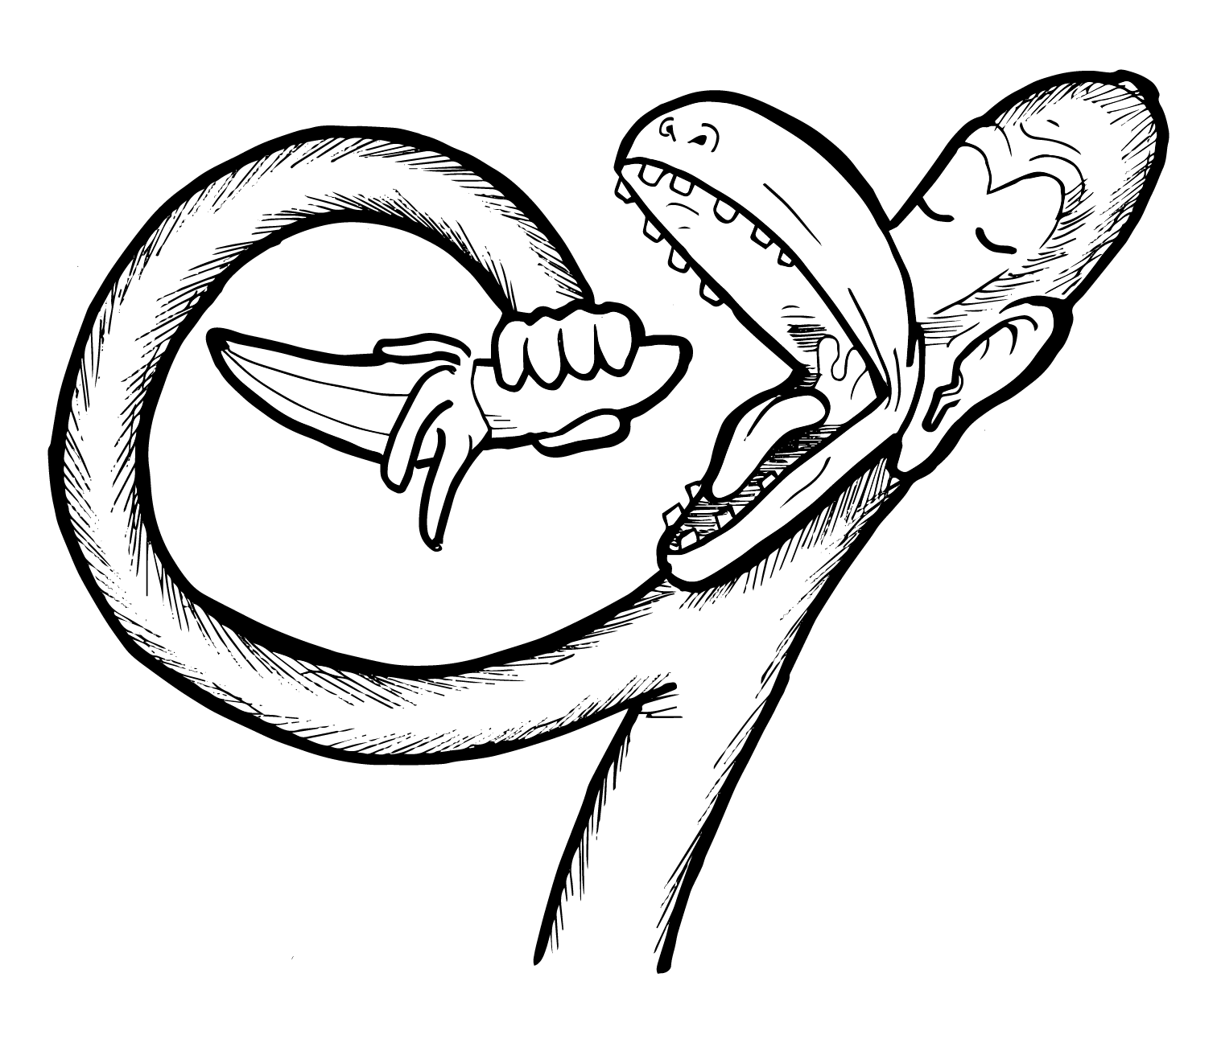
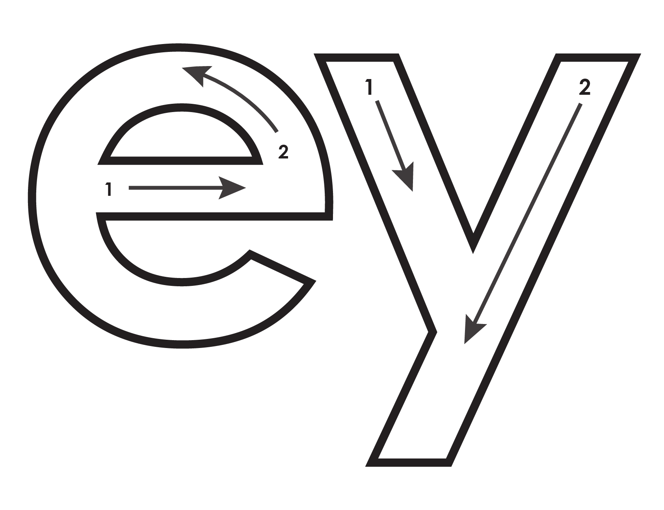
Another important teaching tool…
Easy Breezy Reading (https://www.easybreezyreading.com)
Designed to help new, struggling, and especially dyslexic learners, Easy Breezy Reading is broken up into Laughing Letters and Funny Phonograms. Both tools use illustrated patterns that mimic the shapes of the letters to give your students one more sense to link the phonetic sound of the letters.
ey
monk
Our scope and sequence matches Easy Read English Lower Levels. Progressing through the Easy Breezy Reading curriculum is sure to accelerate your students’ comprehension of the written English language.
You can procure Laughing Letters or Funny Phonograms through our website.
https://www.easybreezyreading.com/curriculum

